Slide 1
Amiodarone induced lung disease
Bora Yoon
Division of Pulmonology
Department Of internal medicine
Yonsei University College of Medicine

Slide 2
Amiodarone ..in Drug of the Heart, 8th ed.
Unique “wide-spectrum” antiarrhythmic agent, class III
Blocks sodium, calcium and repolarizing potassium channels
Very slow elimination with long half-life up to 6months.
Amiodarone is lipid soluble, extensively distributed in the body and highly concentrated in many tissues, especially in the liver and lungs.
The most serious pneumonitis occurs in 10% to 17% at dose of 400mg/day, which may be fatal in 10% of those effected.
Pulmonary toxicity may be dose related, and very rarely occurs with the low doses of about 200mg/day.
Drugs for the heart, 8th ed.

Slide 3
Drug induced lung disease
DI (Drug induced) infiltrative lung disease
Interstitial lung disease : NSIP, eosinophilic pneumonia
Alveolar changes : pulmonary edema, hemorrhage,
diffuse alveolar damage,
exogenous lipoid pneumonia
Vasculitis
Drug-induced and iatrogenic infiltrative lung disease
Clin Chest Med 25 (2004) 479– 519

Slide 4
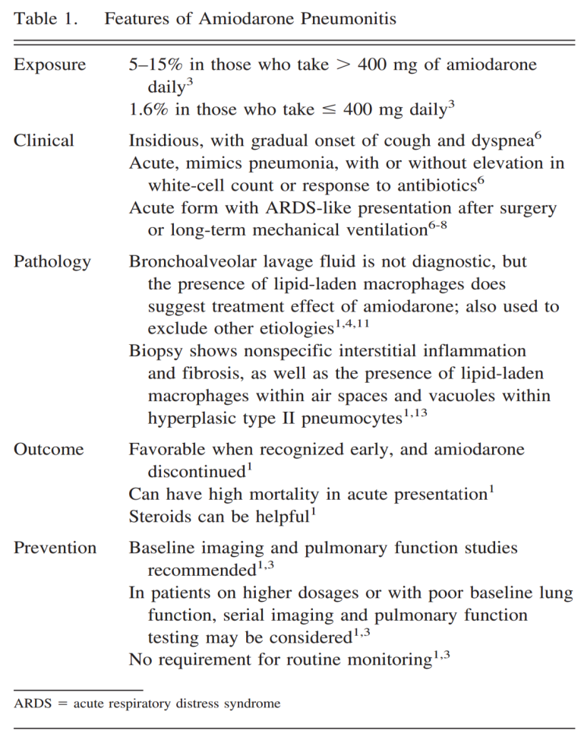
[RESPIRATORY CARE MARCH 2008 VOL 53 NO 3]
Amiodarone Pneumonitis
Jeffrey I Stewart MD, Rashmi Chawla MD, Joshua M Lloyd MD, and Gregory C Kane MD
Initially reported in 1980, amiodarone associated pulmonary toxicity has been reported to occur in 1-17% of treated cases and to have a potentially fatal course.
RESPIRATORY CARE MARCH 2008 VOL 53 NO 3

Slide 5
[Circulation Vol 82, No 1, July 1990]
Clinical Features of Amiodarone-Induced Pulmonary Toxicity
Raymond E. Dusman, MD, Marshall S. Stanton, MD, William M. Miles, MD, Lawrence S. Klein, MD, Douglas P. Zipes, MD, Naomi S. Fineberg, PhD, and James J. Heger, MD
Methods
Indiana University Medical Center
573 patients initiated amiodarone therapy
between April 1977 and March 1986
receiving amiodarone for more than 3 days
the loading phase was 800 mg/day administered for up to 6-8 weeks
during maintenance therapy, daily doses ranged from 50 to 800 mg/day
Plasma concentrations of amiodarone and its metabolite, desethylamiodarone, were measured every 6-12 months during follow-up.
Circulation Vol 82, No 1, July 1990

Slide 6
[Circulation Vol 82, No 1, July 1990]
Clinical Features of Amiodarone-Induced Pulmonary Toxicity
Raymond E. Dusman, MD, Marshall S. Stanton, MD, William M. Miles, MD, Lawrence S. Klein, MD, Douglas P. Zipes, MD, Naomi S. Fineberg, PhD, and James J. Heger, MD
Diagnosis
new onset of symptoms such as dyspnea, cough, or pleuritic chest pain
new chest radiographic abnormality such as an interstitial or alveolar infiltrate
a decrease in the DLCO of 20% from the pretreatment value, or if none was available, a value less than 80% of predicted
abnormal lung uptake with gallium-67 radioisotope
characteristic histologic changes of lung tissue obtained by bronchoscopic or open lung biopsy
Circulation Vol 82, No 1, July 1990

Slide 7
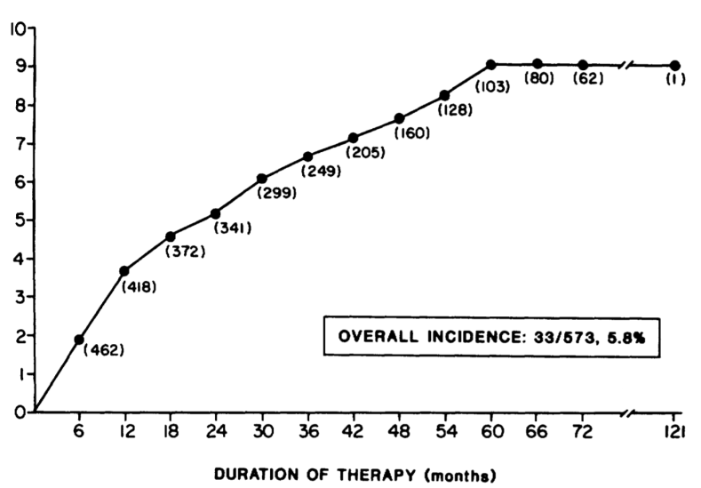
[Circulation Vol 82, No 1, July 1990]
Clinical Features of Amiodarone-Induced Pulmonary Toxicity
Raymond E. Dusman, MD, Marshall S. Stanton, MD, William M. Miles, MD, Lawrence S. Klein, MD, Douglas P. Zipes, MD, Naomi S. Fineberg, PhD, and James J. Heger, MD
Result
Of the 573 patients, 33 developed pulmonary toxicity (5.8%).
No cases developed after 60 months
The highest incidence during the first 12 months
Circulation Vol 82, No 1, July 1990

Slide 8
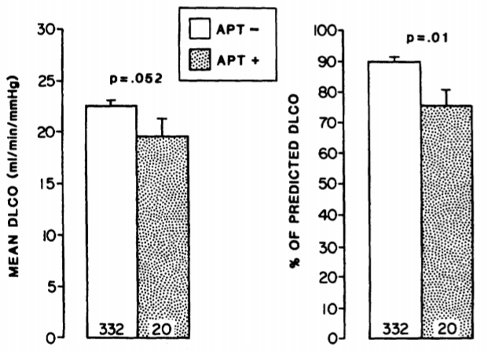
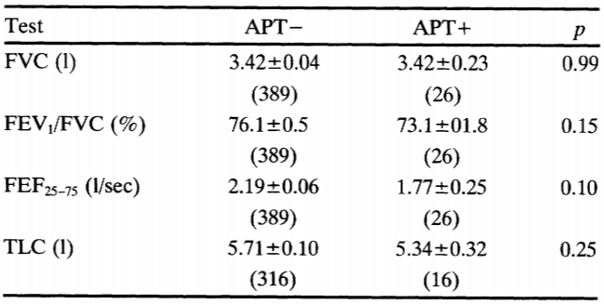
[Circulation Vol 82, No 1, July 1990]
Clinical Features of Amiodarone-Induced Pulmonary Toxicity
Raymond E. Dusman, MD, Marshall S. Stanton, MD, William M. Miles, MD, Lawrence S. Klein, MD, Douglas P. Zipes, MD, Naomi S. Fineberg, PhD, and James J. Heger, MD
Result
pretreatment chest radiographic, spirometric, and lung volume abnormalities were not predictive for development of amiodarone pulmonary toxicity.
Circulation Vol 82, No 1, July 1990
Notes:
New chest radiographic abnormalities occurred in 32 of the 33 patients and were most often diffuse interstitial pulmonary infiltrates, occasionally alveolar in distribution, and often involved the upper lobes. Two patients had pleural effusions.
Restrictive lung function (decreased FVC and TLC and increased FEV1/FVC) occurred in all 15 patients who had these parameters measured.

Slide 9
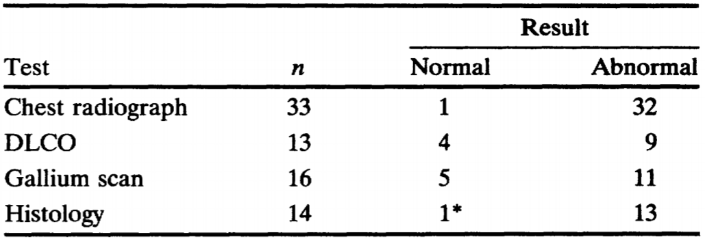
[Circulation Vol 82, No 1, July 1990]
Clinical Features of Amiodarone-Induced Pulmonary Toxicity
Raymond E. Dusman, MD, Marshall S. Stanton, MD, William M. Miles, MD, Lawrence S. Klein, MD, Douglas P. Zipes, MD, Naomi S. Fineberg, PhD, and James J. Heger, MD
Result
The presenting symptoms of amiodarone-induced pulmonary toxicity were known in 28 patients.
The majority (71%) had dyspnea as the initial symptom.
Other symptoms were cough (25%), fever (21%), nausea (7%), weakness or fatigue (7%), weight loss (4%), and pleuritic chest pain (4%).
Other findings
Circulation Vol 82, No 1, July 1990
Notes:
New chest radiographic abnormalities occurred in 32 of the 33 patients and were most often diffuse interstitial pulmonary infiltrates, occasionally alveolar in distribution, and often involved the upper lobes. Two patients had pleural effusions.
Restrictive lung function (decreased FVC and TLC and increased FEV1/FVC) occurred in all 15 patients who had these parameters measured.

Slide 10
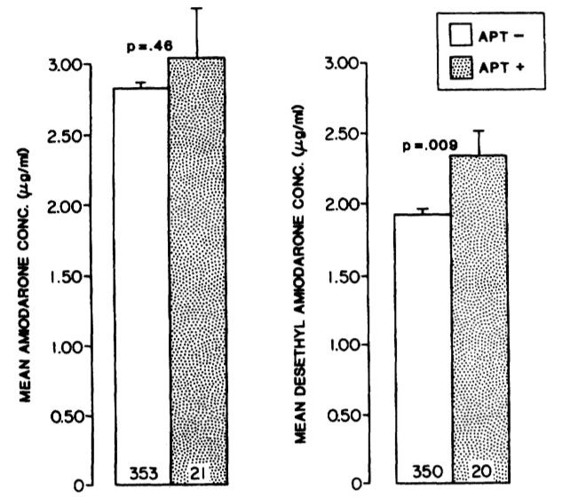
[Circulation Vol 82, No 1, July 1990]
Clinical Features of Amiodarone-Induced Pulmonary Toxicity
Raymond E. Dusman, MD, Marshall S. Stanton, MD, William M. Miles, MD, Lawrence S. Klein, MD, Douglas P. Zipes, MD, Naomi S. Fineberg, PhD, and James J. Heger, MD
Result
Plasma concentrations of amiodarone was no difference in mean plasma concentration between the groups with and without toxicity.
However, the mean plasma desethylamiodarone
concentrations were significantly higher in
the group with pulmonary toxicity.
(2.34±+0.18 versus 1.92±0.04 4g/ml, p=0.009)
Circulation Vol 82, No 1, July 1990

Slide 11
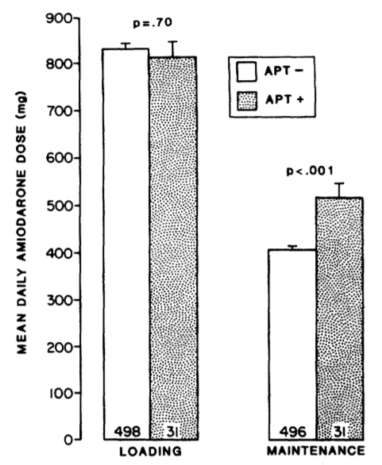
[Circulation Vol 82, No 1, July 1990]
Clinical Features of Amiodarone-Induced Pulmonary Toxicity
Raymond E. Dusman, MD, Marshall S. Stanton, MD, William M. Miles, MD, Lawrence S. Klein, MD, Douglas P. Zipes, MD, Naomi S. Fineberg, PhD, and James J. Heger, MD
Result
There was no significant difference between the
group with and without amiodarone pulmonary
toxicity with respect to the actual length of the
loading period and the mean daily loading Dose.
During the maintenance period, however, the patients
who developed toxicity received a significantly
higher mean daily dose.
(517+25 versus 409±6 mg, p<0.001)
Circulation Vol 82, No 1, July 1990
Notes:
No patient receiving a mean daily maintenance dose less than 305 mg developed pulmonary toxicity

Slide 12
[Circulation Vol 82, No 1, July 1990]
Clinical Features of Amiodarone-Induced Pulmonary Toxicity
Raymond E. Dusman, MD, Marshall S. Stanton, MD, William M. Miles, MD, Lawrence S. Klein, MD, Douglas P. Zipes, MD, Naomi S. Fineberg, PhD, and James J. Heger, MD
Concolusions
amiodarone pulmonary toxicity (APT) occurred in 5.8% of patients.
APT was more common with
a higher amiodarone maintenance dose,
advanced age,
lower pretreatment DLCO,
and higher plasma desethylamiodarone concentrations.
pretreatment chest radiographic, spirometric, and lung volume abnormalities were not predictive for development of amiodarone pulmonary toxicity.
Circulation Vol 82, No 1, July 1990
Notes:
No patient receiving a mean daily maintenance dose less than 305 mg developed pulmonary toxicity

Slide 13
[Annals of Diagnostic Pathology, Vol 1, No 1 (October), 1997: pp 47-56]
Amiodarone Pulmonary Toxicity: Cytopathology, Ultrastructure, and Immunocytochemistry
Carlos W.M. Bedrossian, MD, CindyJ. Warren, MD, Jill Ohar, MD, and Raj Bhan, MD.
190 cardiac patients were prospectively enrolled in an amiodarone protocol. Over a 10-year period, 16 patients developed new or progressive respiratory symptoms while taking amiodarone.
Large foamy macrophages with characteristic lamellated cytoplasmic inclusions were noted in all specimens, regardless of other evidence of pulmonary toxicity, suggesting that foamy macrophages represent a routine drug effect.
Foamy macrophages were not present in BAL specimens from 53 normal controls.
Fibrosis was noted in 11 of 16 histological specimens, whereas type II-cell-hyperplasia was observed in 7 of the 16 specimens.
Hyperplastic type II cells were not found in the absence of fibrosis.
Four of the 16 patients with respiratory symptoms died, and their autopsy revealed a combination of foamy macrophages with fibrosis and type II cell hyperplasia reflective of amiodarone pulmonary toxicity.
Annals of Diagnostic Pathology, Vol 1, No 1 (October), 1997: pp 47-56
Notes:
No patient receiving a mean daily maintenance dose less than 305 mg developed pulmonary toxicity

Slide 14
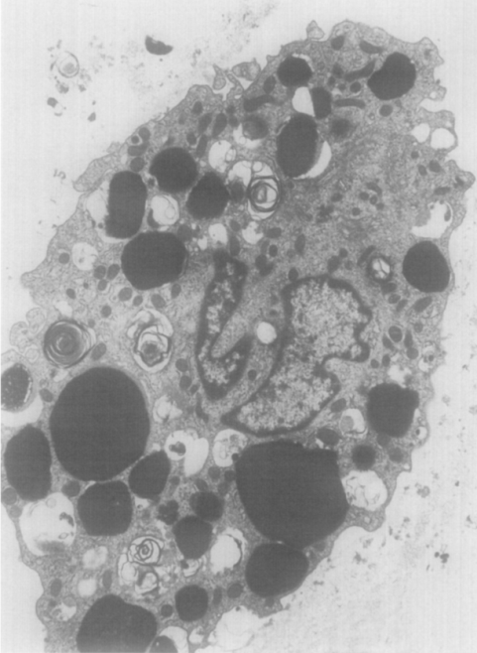
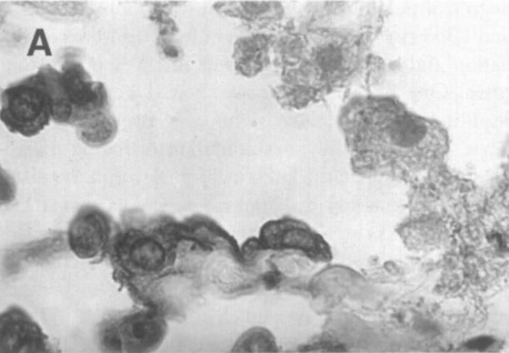
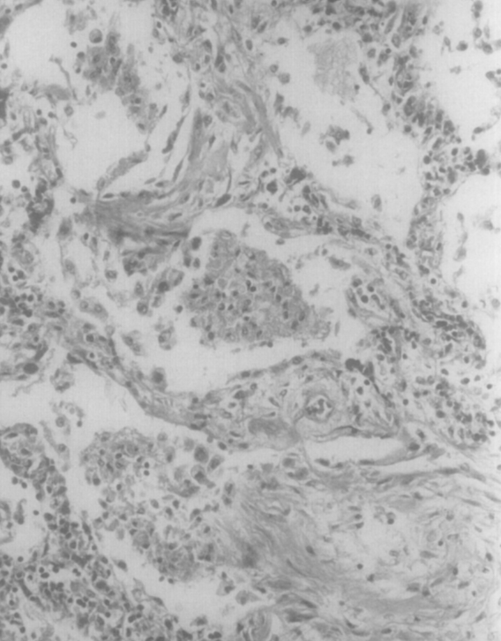
[Annals of Diagnostic Pathology, Vol 1, No 1 (October), 1997: pp 47-56]
Amiodarone Pulmonary Toxicity: Cytopathology, Ultrastructure, and Immunocytochemistry
Carlos W.M. Bedrossian, MD, CindyJ. Warren, MD, Jill Ohar, MD, and Raj Bhan, MD.
Macrophages
cytoplasm contains lipid and occasional lamellated inclusions.
Hyperplastic type II cells stain strongly for EMA.
Open lung biopsy with interstitial and intra-alveolar
fibrosis.
Annals of Diagnostic Pathology, Vol 1, No 1 (October), 1997: pp 47-56
Notes:
No patient receiving a mean daily maintenance dose less than 305 mg developed pulmonary toxicity

Slide 15
[Clin Res Cardiol (2010) 99:693–700]
Amiodarone-induced pulmonary toxicity: an under-recognized and severe adverse effect?
Martin Schwaiblmair, Thomas Berghaus, Thomas Haeckel, Theodor Wagner, Wolfgang von Scheidt.
There are no adequate predictors of pulmonary toxicity due to amiodarone.
Amiodarone-induced pulmonary toxicity is a diagnosis of exclusion.
Pulmonary evaluation with chest X-ray and pulmonary function testing,
including diffusion capacity for carbon monoxide is recommended
when amiodarone is started.
A documented decline in the diffusing capacity of greater than 20% is
useful in suggesting the need for closer monitoring or for further
diagnostic testing.
Pulmonary function tests and imaging may be performed every 3–6
months, depending on the presumed individual risk.
Clin Res Cardiol (2010) 99:693–700

Slide 16
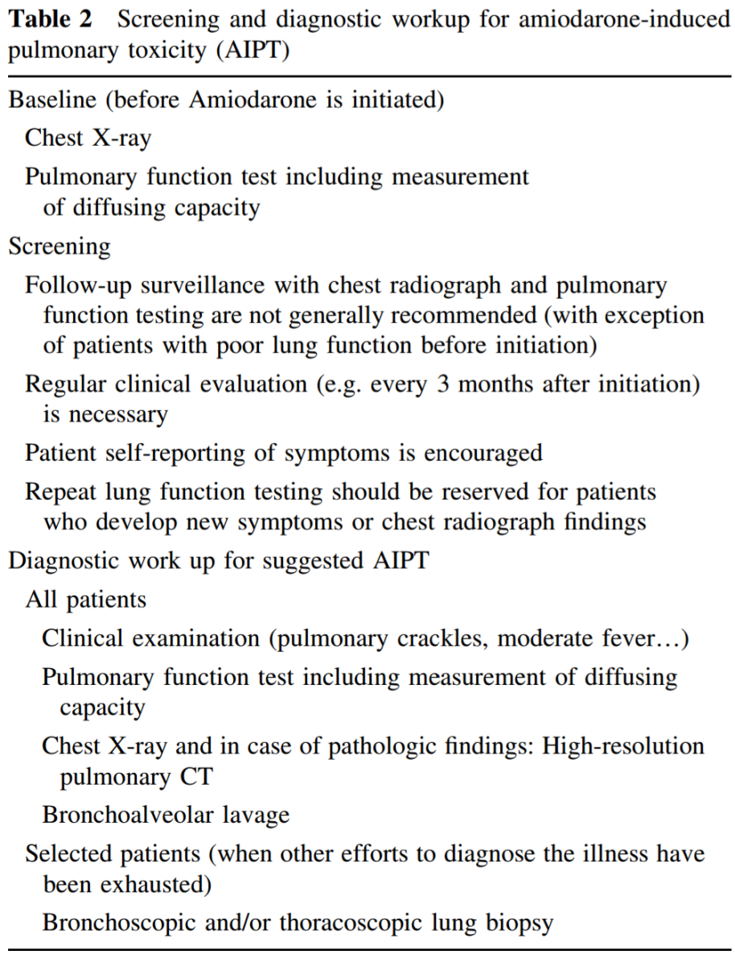
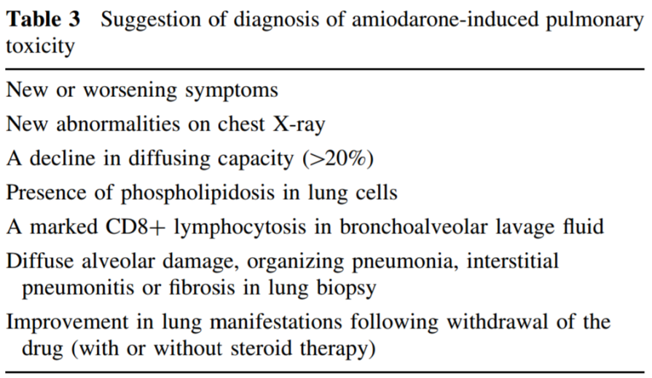
[Clin Res Cardiol (2010) 99:693–700]
Amiodarone-induced pulmonary toxicity: an under-recognized and severe adverse effect?
Martin Schwaiblmair, Thomas Berghaus, Thomas Haeckel, Theodor Wagner, Wolfgang von Scheidt.
There are no biologic findings that are specific for the diagnosis.
Measurement of serum concentrations
of KL-6, a mucin-like high-molecular-weight
glycoprotein secreted by proliferating type
II pneumocytes, has been proposed as a
marker of amiodarone pulmonary toxicity.
Clin Res Cardiol (2010) 99:693–700

Slide 17
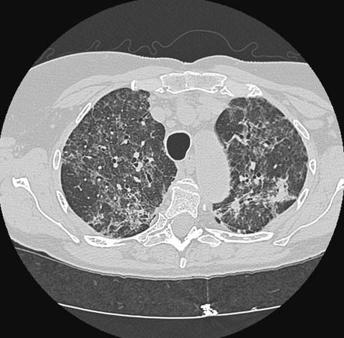
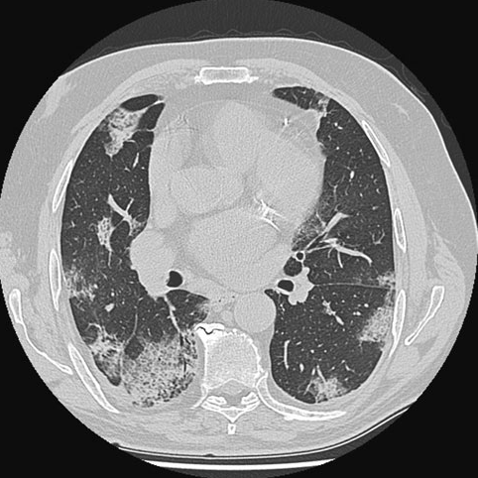
[Clin Res Cardiol (2010) 99:693–700]
Amiodarone-induced pulmonary toxicity: an under-recognized and severe adverse effect?
Martin Schwaiblmair, Thomas Berghaus, Thomas Haeckel, Theodor Wagner, Wolfgang von Scheidt.
Amiodarone pulmonary toxicity is a disease of the alveolar space or interstitial compartment.
The chest radiograph may reveal diffuse or localized interstitial, alveolar, or mixed opacities, and these changes may be migratory and can occur in the absence of symptoms.
The most common pattern is septal thickening, or diffuse, patchy, small-sized alveolar, shadowed with a random
distribution
CT scan of the chest with bilateral diffuse reticulo-nodular opacities.
Clin Res Cardiol (2010) 99:693–700

Slide 18
[Clin Res Cardiol (2010) 99:693–700]
Amiodarone-induced pulmonary toxicity: an under-recognized and severe adverse effect?
Martin Schwaiblmair, Thomas Berghaus, Thomas Haeckel, Theodor Wagner, Wolfgang von Scheidt.
A wide range of abnormalities can be found in the BAL.
Certain BAL findings, like foam cells, CD8 predominant lymphocytic or neutrophilic alveolitis, and increased phospholipid content, may also point to a diagnosis of amiodarone pulmonary toxicity.
amiodarone-induced pulmonary toxicity is considered unlikely if foam cells are not present in the broncho-alveolar lavage.
The histopathologic appearances of amiodarone pneumonitis and of
subpleural masses include septal thickening, interstitial edema,
non-specific inflammation and fibrosis, as well as the presence of lipids
within interstitial and endothelial cells and lying free in alveolar spaces.
Clin Res Cardiol (2010) 99:693–700

Slide 19
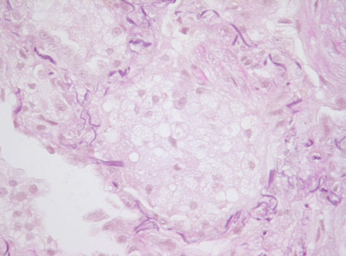
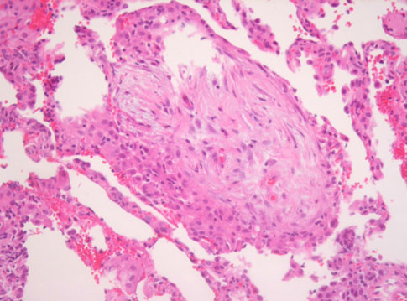
[Clin Res Cardiol (2010) 99:693–700]
Amiodarone-induced pulmonary toxicity: an under-recognized and severe adverse effect?
Martin Schwaiblmair, Thomas Berghaus, Thomas Haeckel, Theodor Wagner, Wolfgang von Scheidt.
Numerous foamy macrophages in a BAL fluid.
Alveolar lung tissue showed interstitial inflammation with septal thickening and foci of organizing
Clin Res Cardiol (2010) 99:693–700

Slide 20
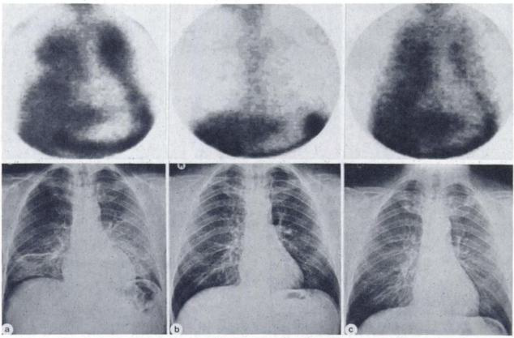
[J Nuci Med 25: 211-213, 1984]
Pulmonary Gallium-67 Uptake in Amiodarone Pneumonitis
W.J. vanRooij,S.C.vanderMeer,E.A. vanRoyen,N.vanZandwijk,andJ. I. Darmanata
A : On amiodarone treatment, 9wks
Intense diffuse Ga-67 lung activity & Radiographs shows GGO pattern
B : After prednisolone 40mg/day, 3wks
Ga-67 image & radiographs become normal
C : After reduction of prednisolone, lowered to 30mg/day
Ga-67 uptake is intense, but radiograph is unchanged
J Nuci Med 25: 211-213, 1984

Slide 21
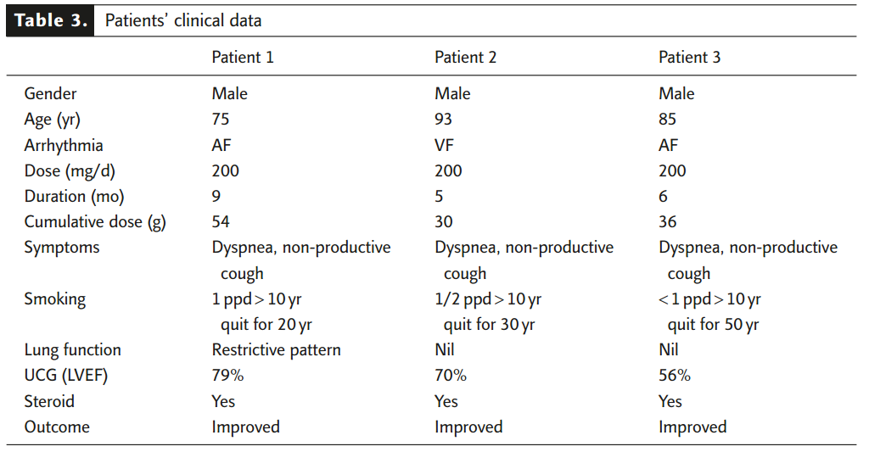
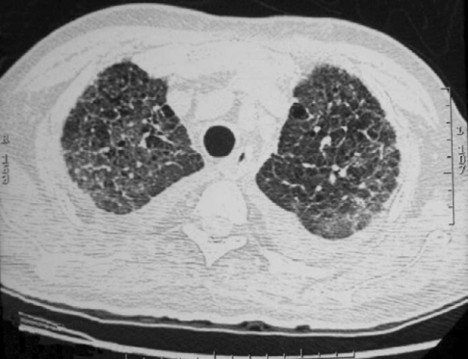
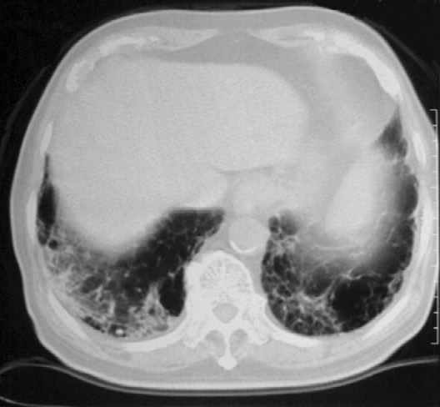
[J Formos Med Assoc. 2007 Vol 106 No 5]
Amiodarone-related Pneumonitis
Sheng-Nan Chang, Juey-Jen Hwang, Kuan-Lih Hsu, Chia-Ti Tsai, Ling-Ping Lai, Jiunn-Lee Lin,
Chuen-Den Tseng, Fu-Tien Chiang.
It is believed that amiodarone-related pneumonitis is unlikely to occur during low-dose and short courses of therapy.
This case report implies that old age and possible pre-existing pulmonary abnormalities caused by smoking could be associated with amiodarone-related pulmonary toxicity.
J Formos Med Assoc. 2007 Vol 106 No 5

Slide 22
Reference
Drug-induced and iatrogenic infiltrative lung disease, Philippe Camus, MD*, Philippe Bonniaud, MD, Annlyse Fanton, MD, Clio Camus, MD, Nicolas Baudaun, MD, Pascal Foucher, MD, Clin Chest Med 25 (2004) 479– 519.
Pulmonary Gallium-67 Uptake in Amiodarone Pneumonitis, W.J. vanRooij,S.C.vanderMeer,E.A. vanRoyen,N.vanZandwijk,andJ. I. Darmanata, J Nuci Med 25: 211-213, 1984.
Clinical Features of Amiodarone-Induced Pulmonary Toxicity, Raymond E. Dusman, MD, Marshall S. Stanton, MD, William M. Miles, MD, Lawrence S. Klein, MD, Douglas P. Zipes, MD, Naomi S. Fineberg, PhD, and James J. Heger, MD, Circulation Vol 82, No 1, July 1990.
Amiodarone Pulmonary Toxicity: Cytopathology, Ultrastructure, and Immunocytochemistry, Carlos W.M. Bedrossian, MD, CindyJ. Warren, MD, Jill Ohar, MD, and Raj Bhan, MD, Annals of Diagnostic Pathology, Vol 1, No 1 (October), 1997: pp 47-56.
Amiodarone-induced pulmonary toxicity: an under-recognized and severe adverse effect?, Martin Schwaiblmair, Thomas Berghaus, Thomas Haeckel, Theodor Wagner, Wolfgang von Scheidt, Clin Res Cardiol (2010) 99:693–700.

