Slide 1
VATS Conference
2017.10.19
Department of pathology

Slide 2
서O순 3711149 F/62

Slide 3
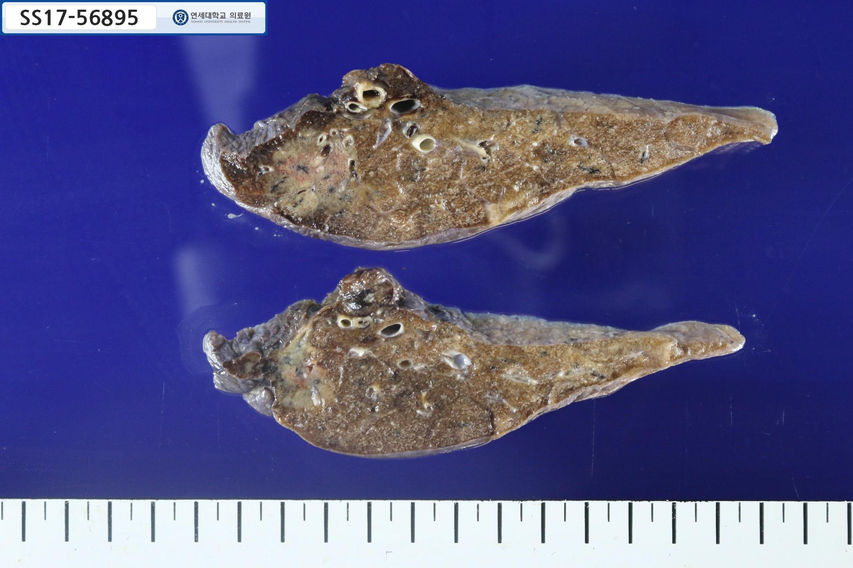
2.5cm

Slide 4
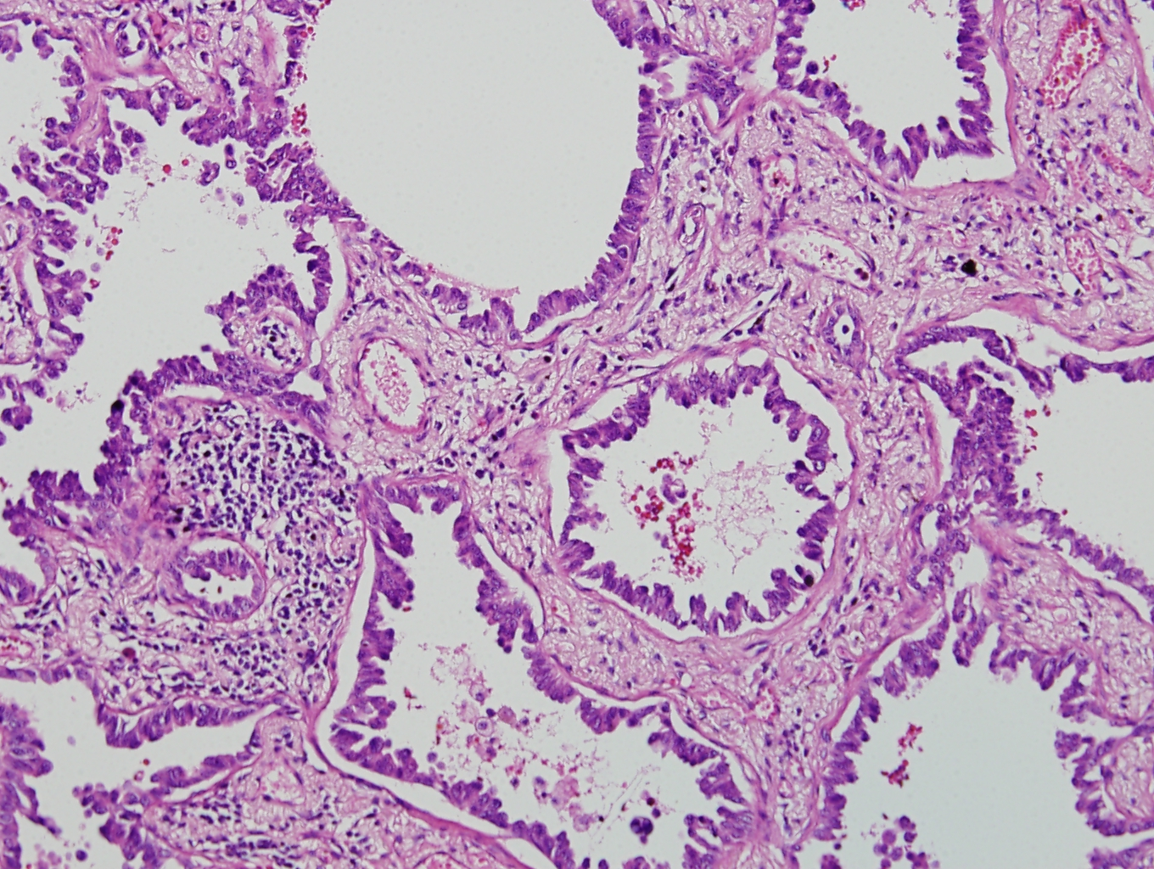

Slide 5
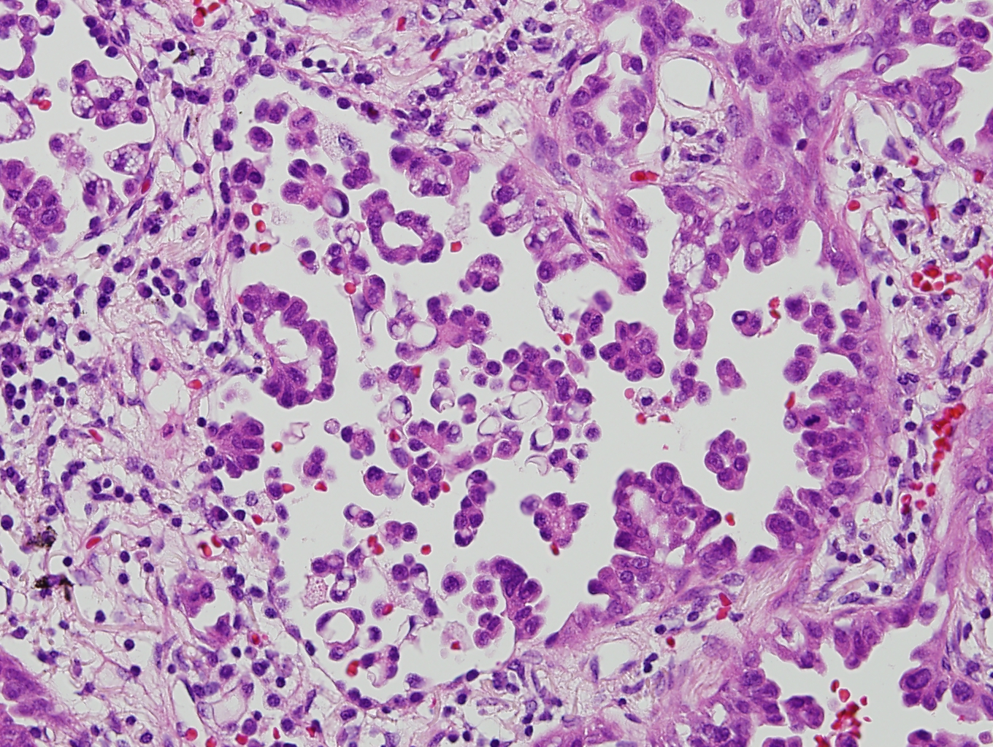

Slide 6
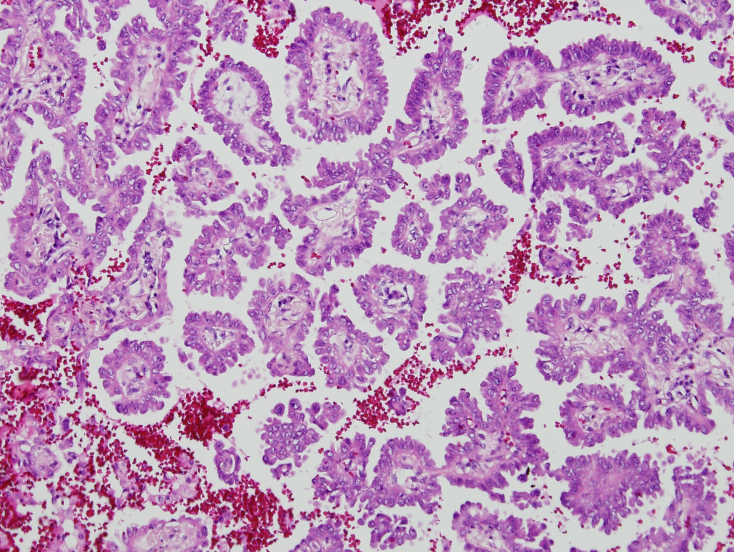

Slide 7
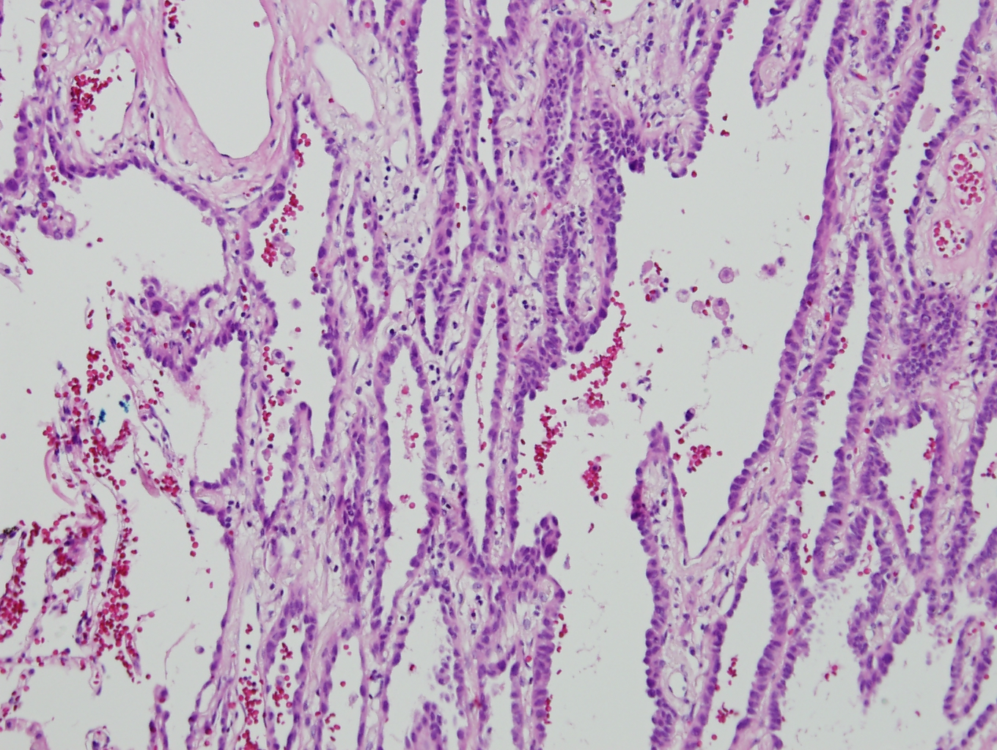

Slide 8
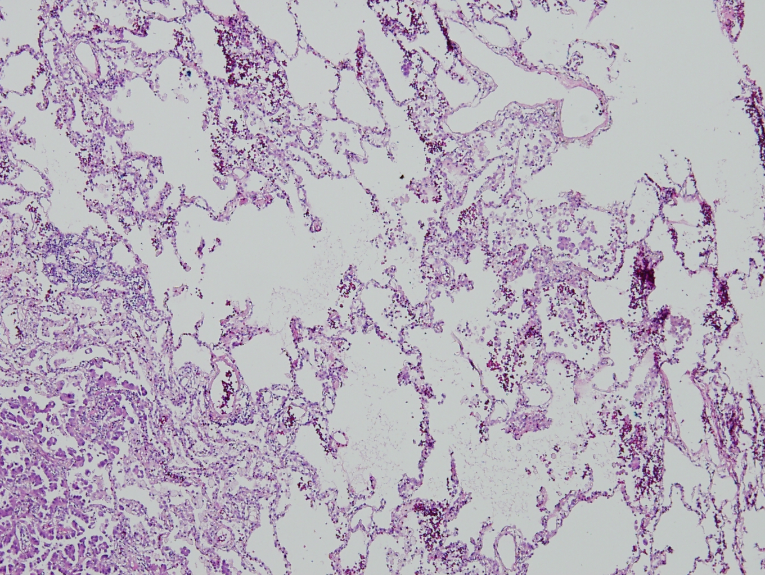

Slide 9
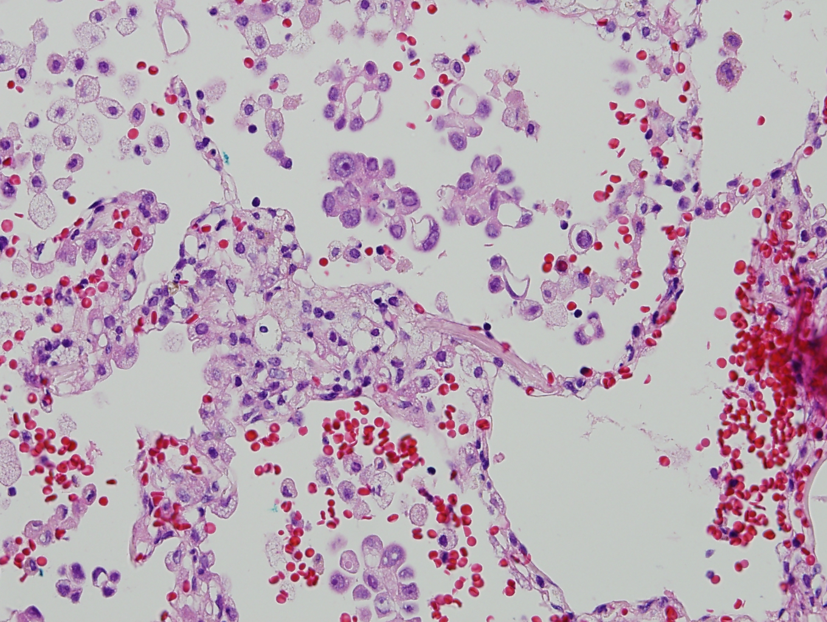

Slide 10
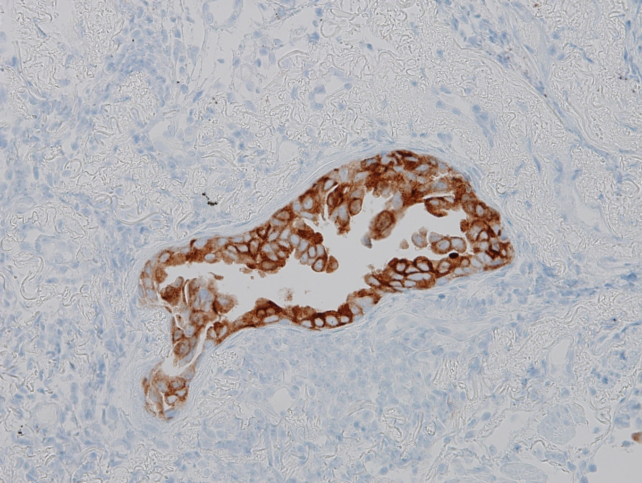

Slide 11
Bx. SS17-53049
EGFR: wild type
ALK IHC: negative
ROS1 IHC: positive (H score=300)

Slide 12
최 O순 2803071 M/76

Slide 13
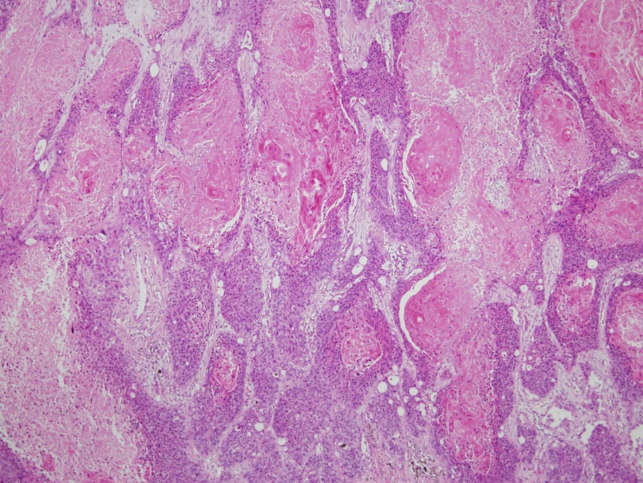
2.2cm

Slide 14
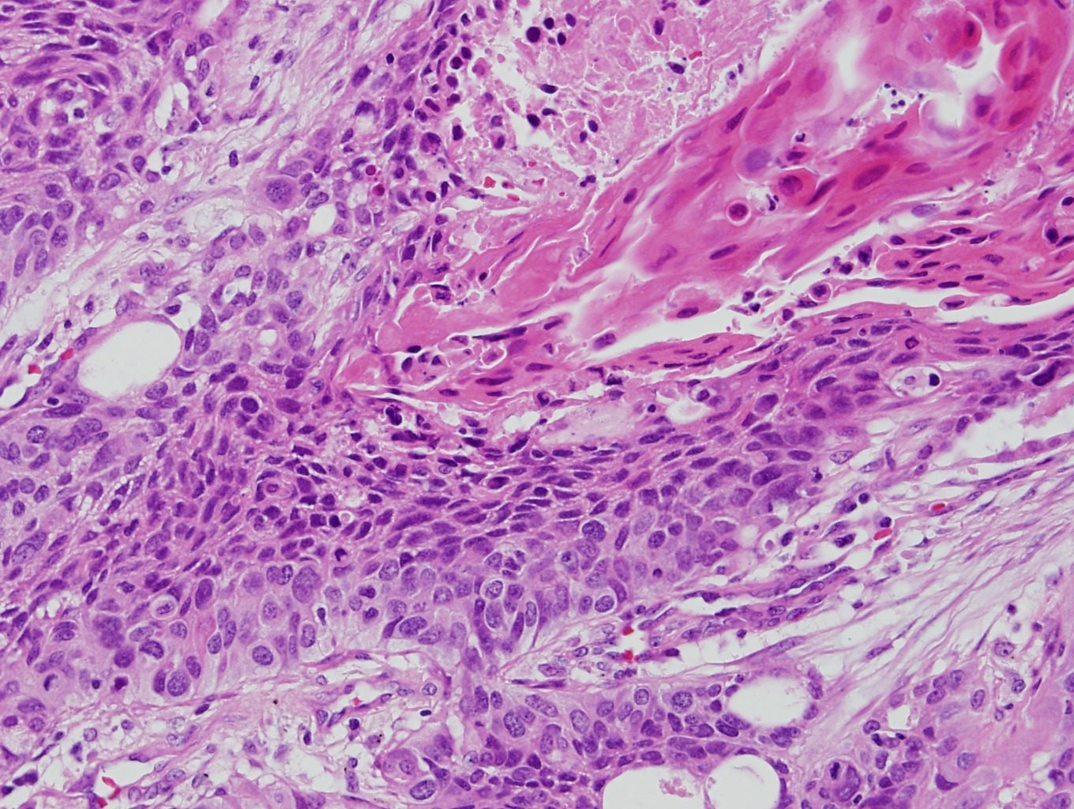

Slide 15
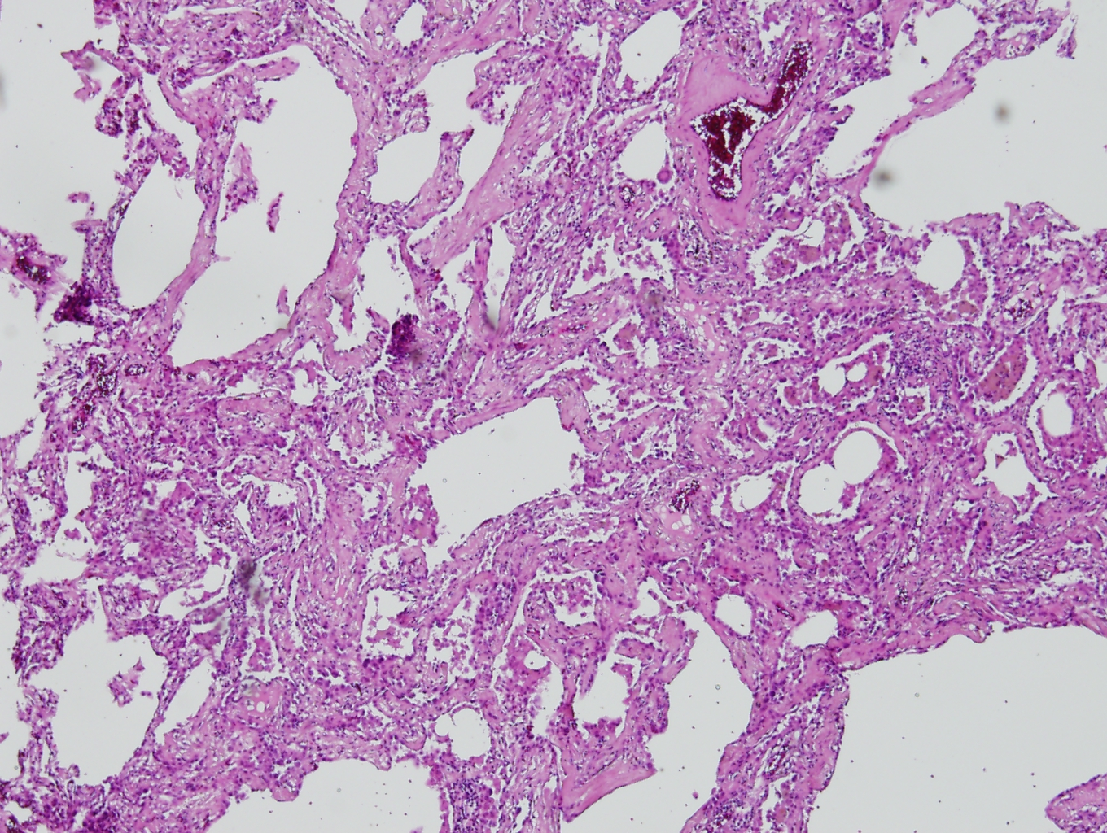
0.3cm

Slide 16
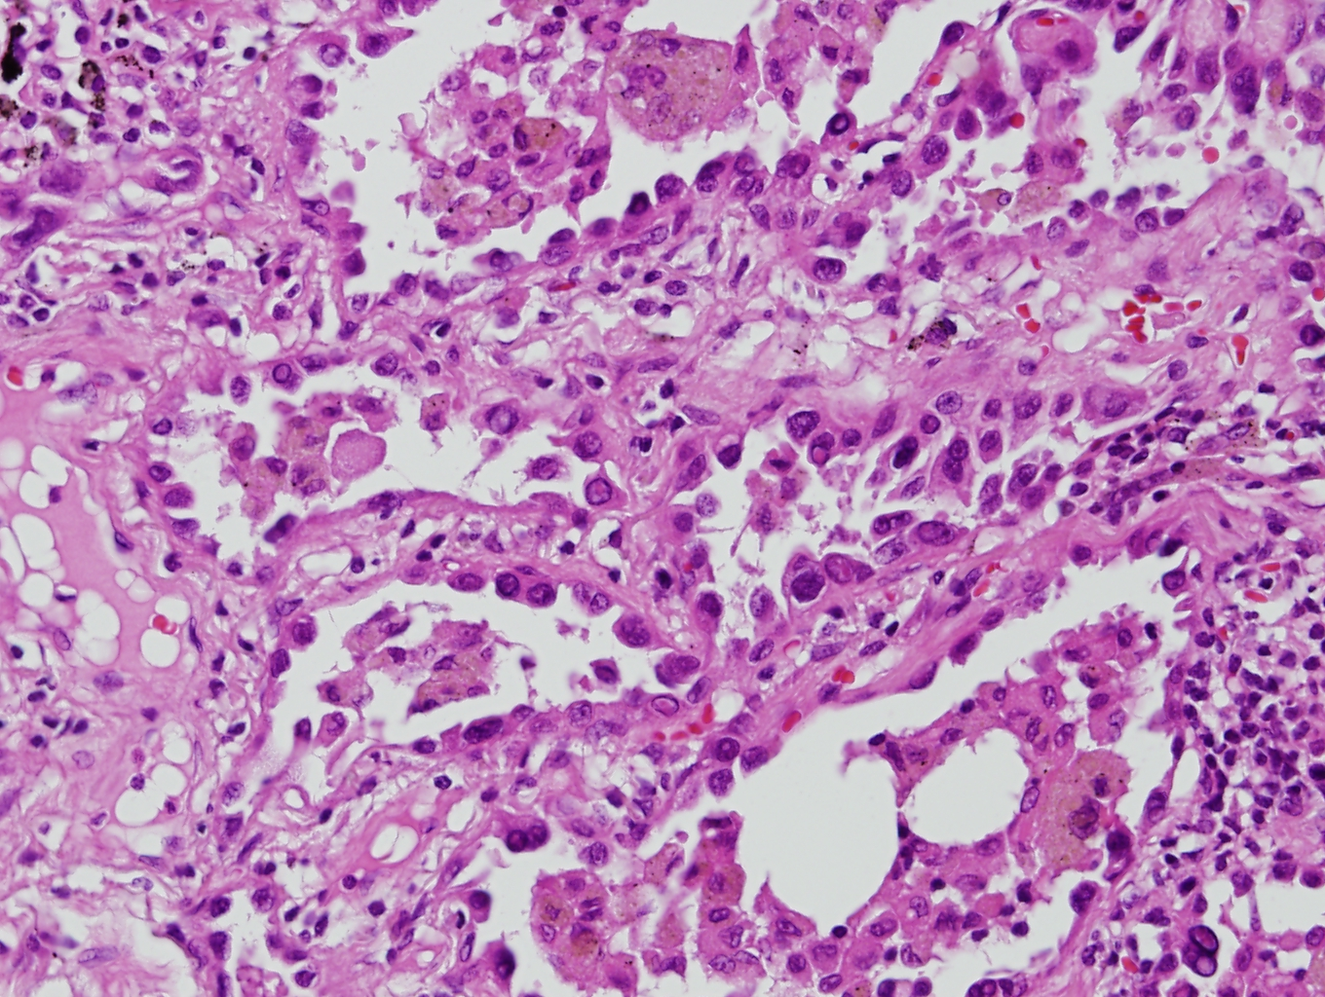

Slide 17
이O애 3172552 F/58

Slide 18
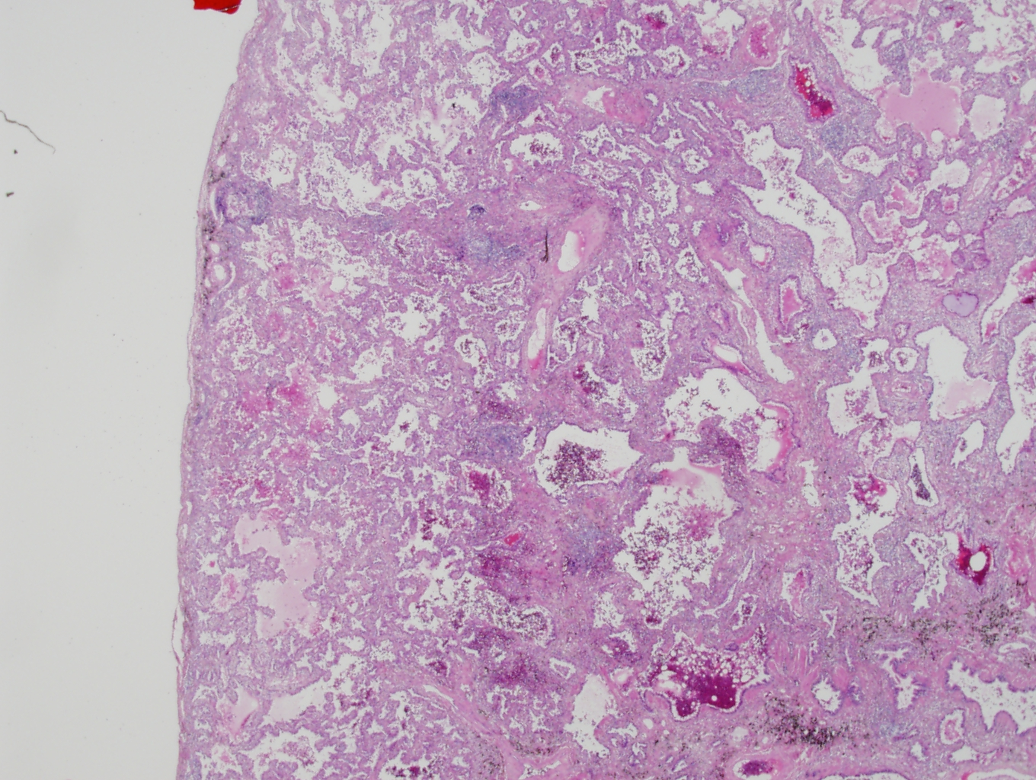
1.4cm

Slide 19
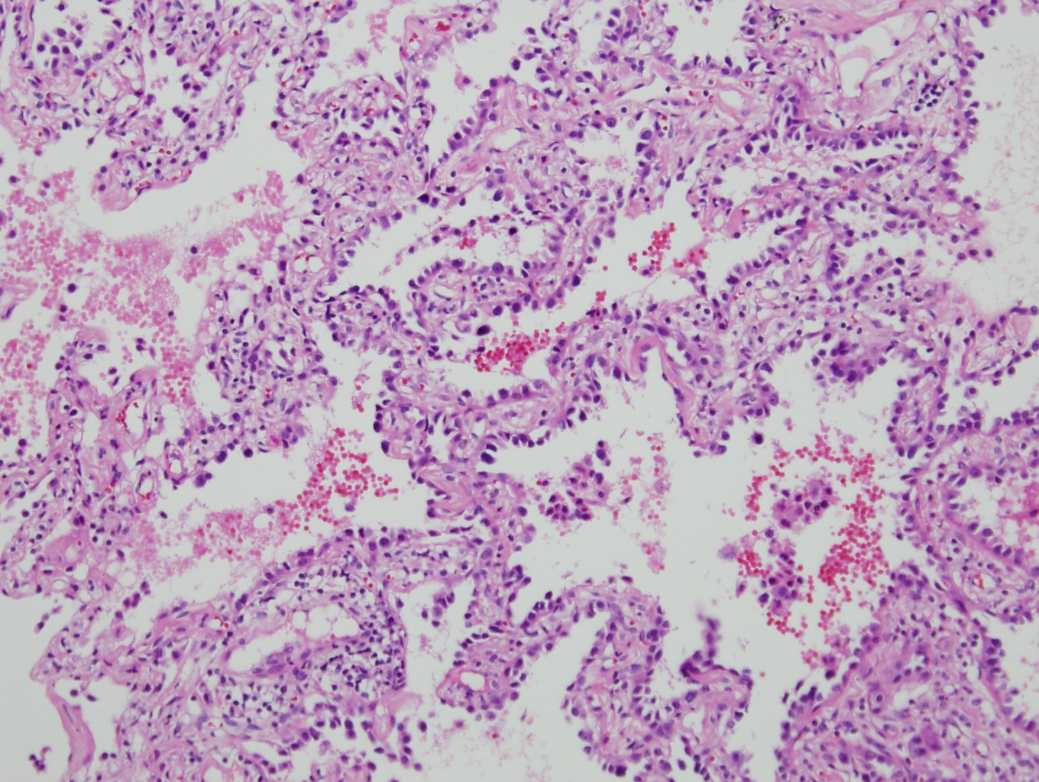

Slide 20
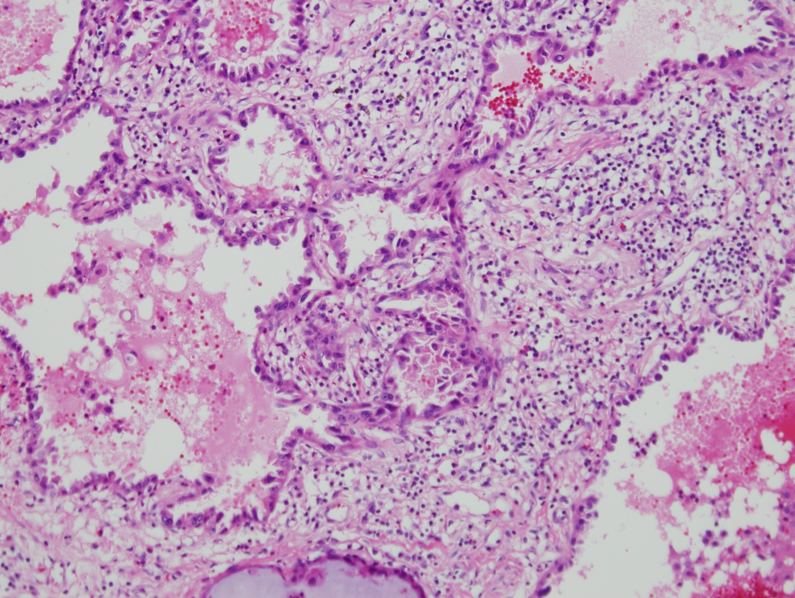

Slide 21
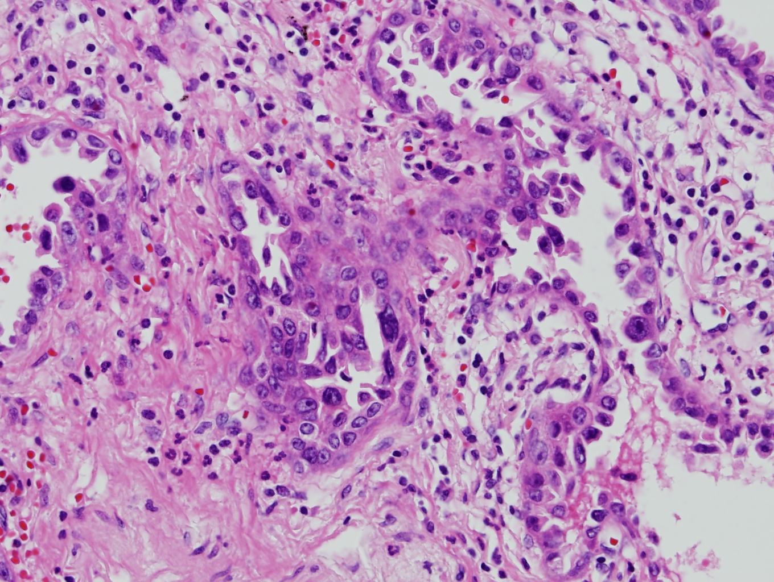

Slide 22
EGFR: L858R mutant
ALK IHC: negative
ROS1 IHC: H-score=70

Slide 23
