Slide 1
VATS Conference
2017.09.21.
Department of pathology

Slide 2
이O자 8387504
SS17-17820

Slide 3
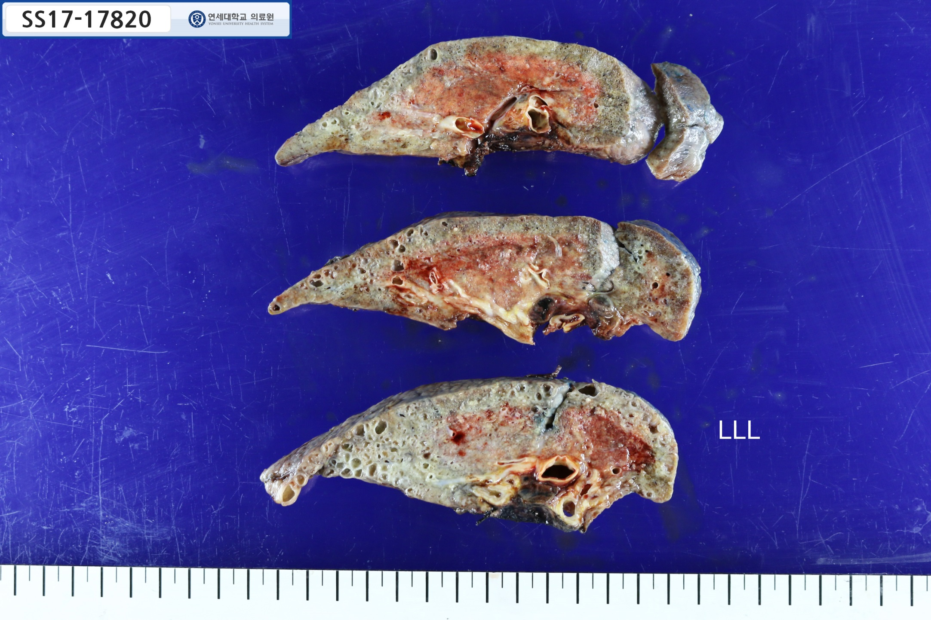

Slide 4
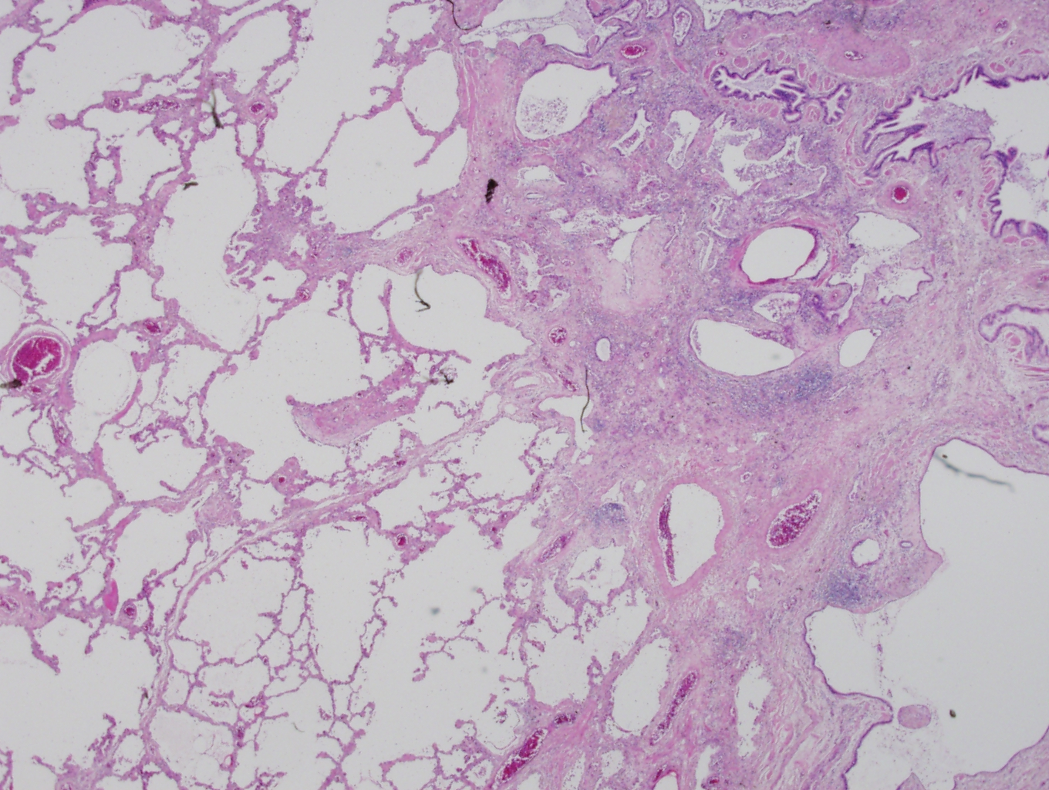

Slide 5
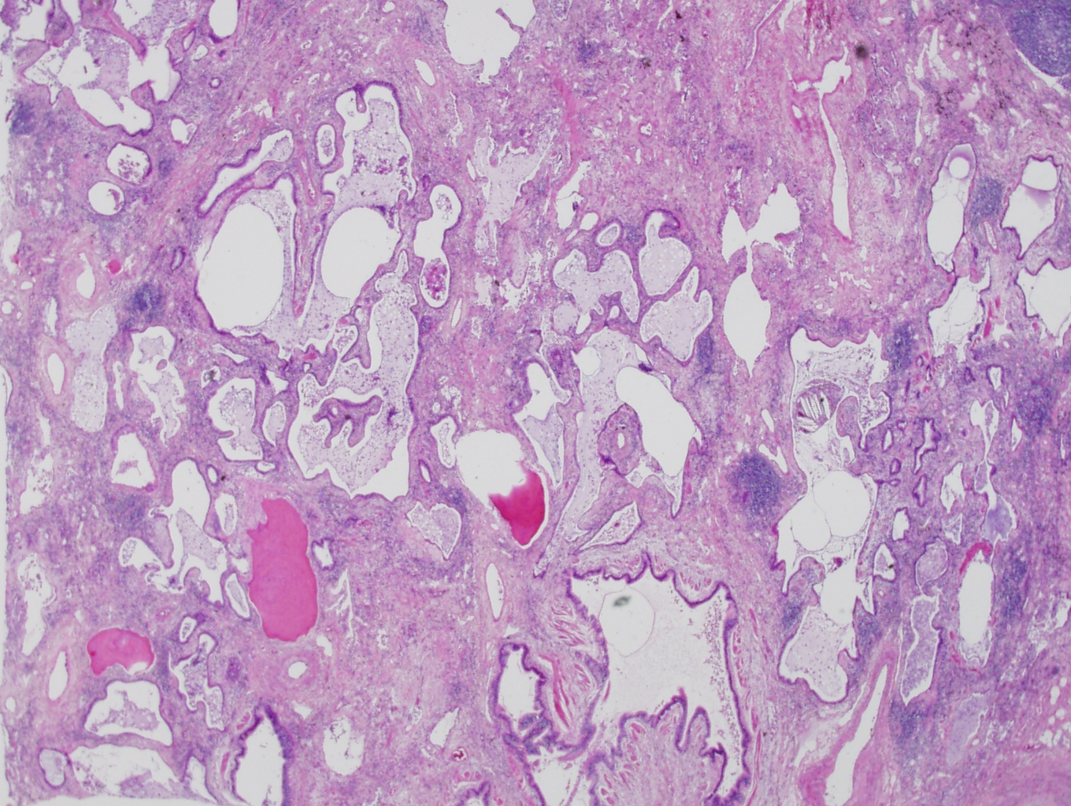

Slide 6
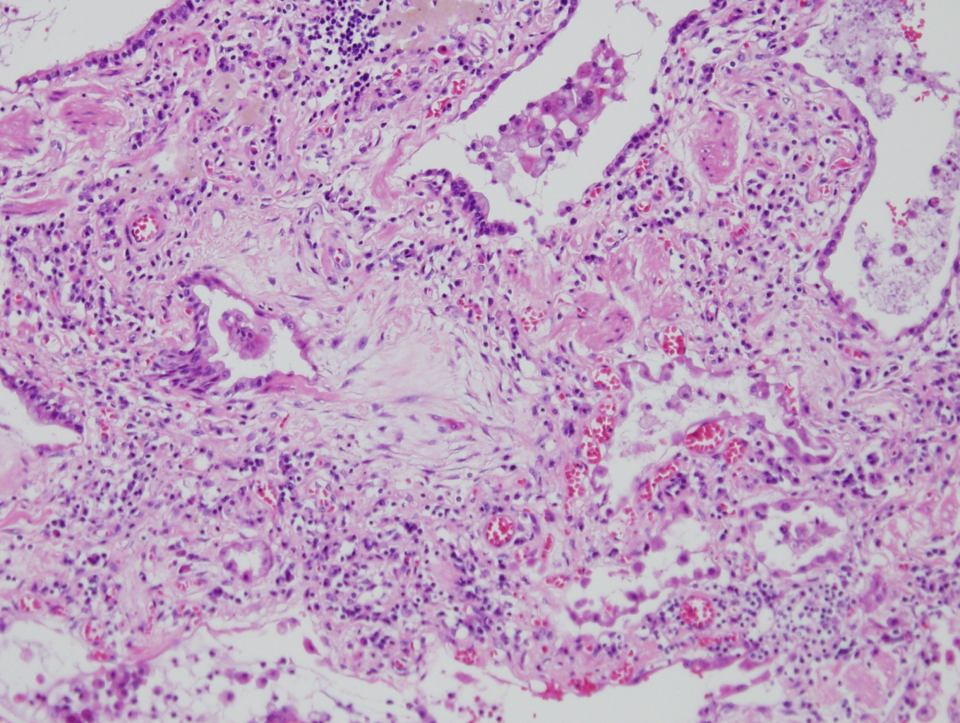

Slide 7
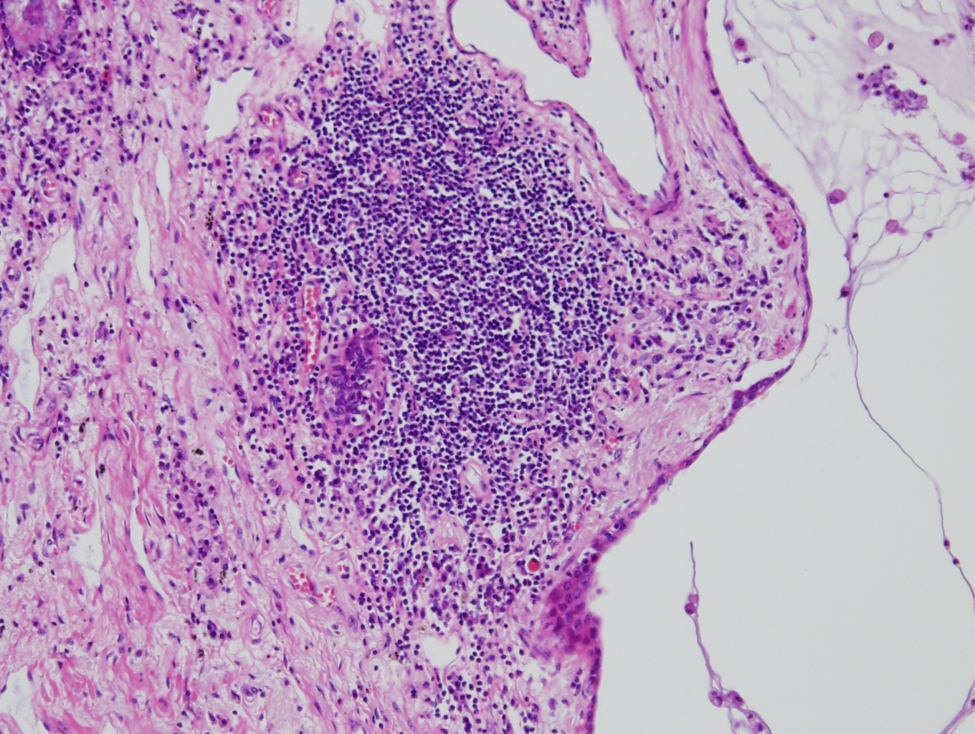

Slide 8
조O희 8356206
SS17-33654

Slide 9
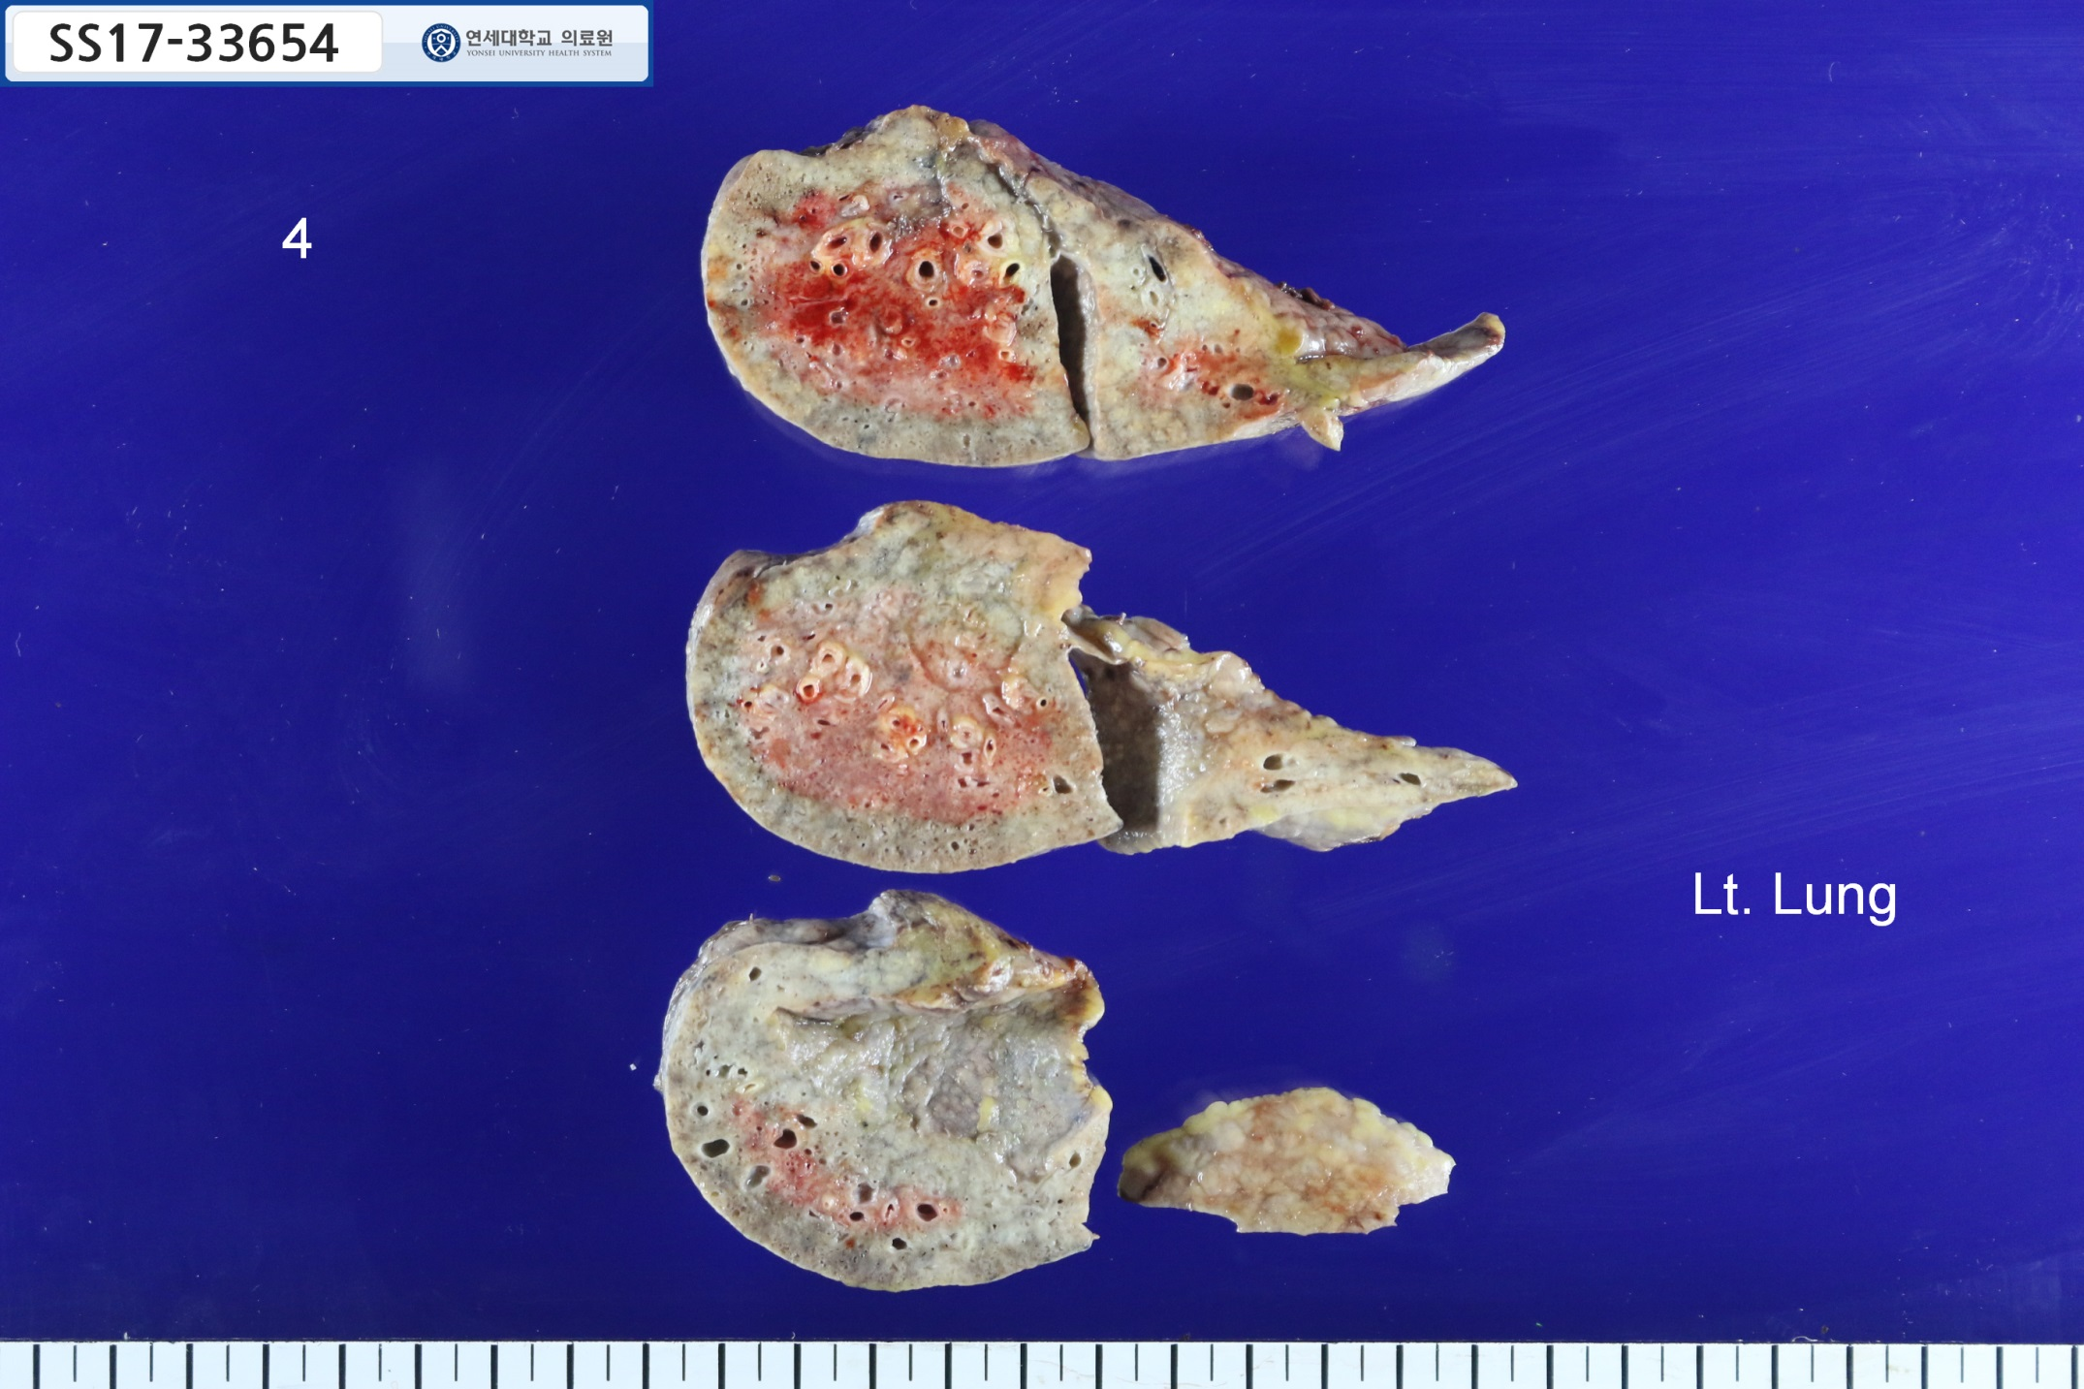

Slide 10
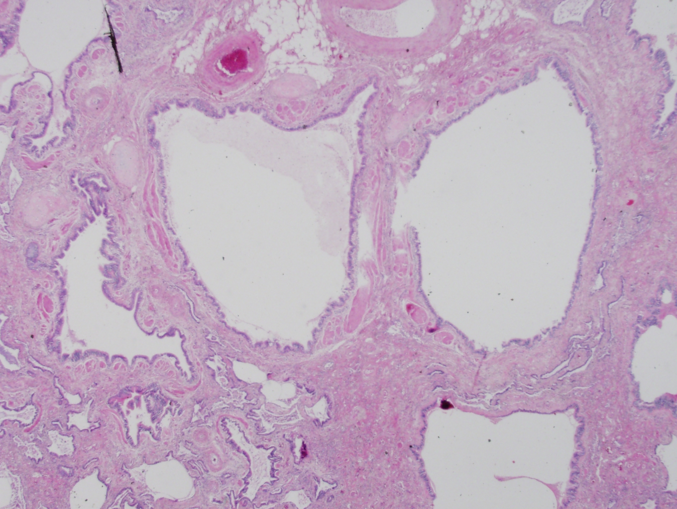

Slide 11
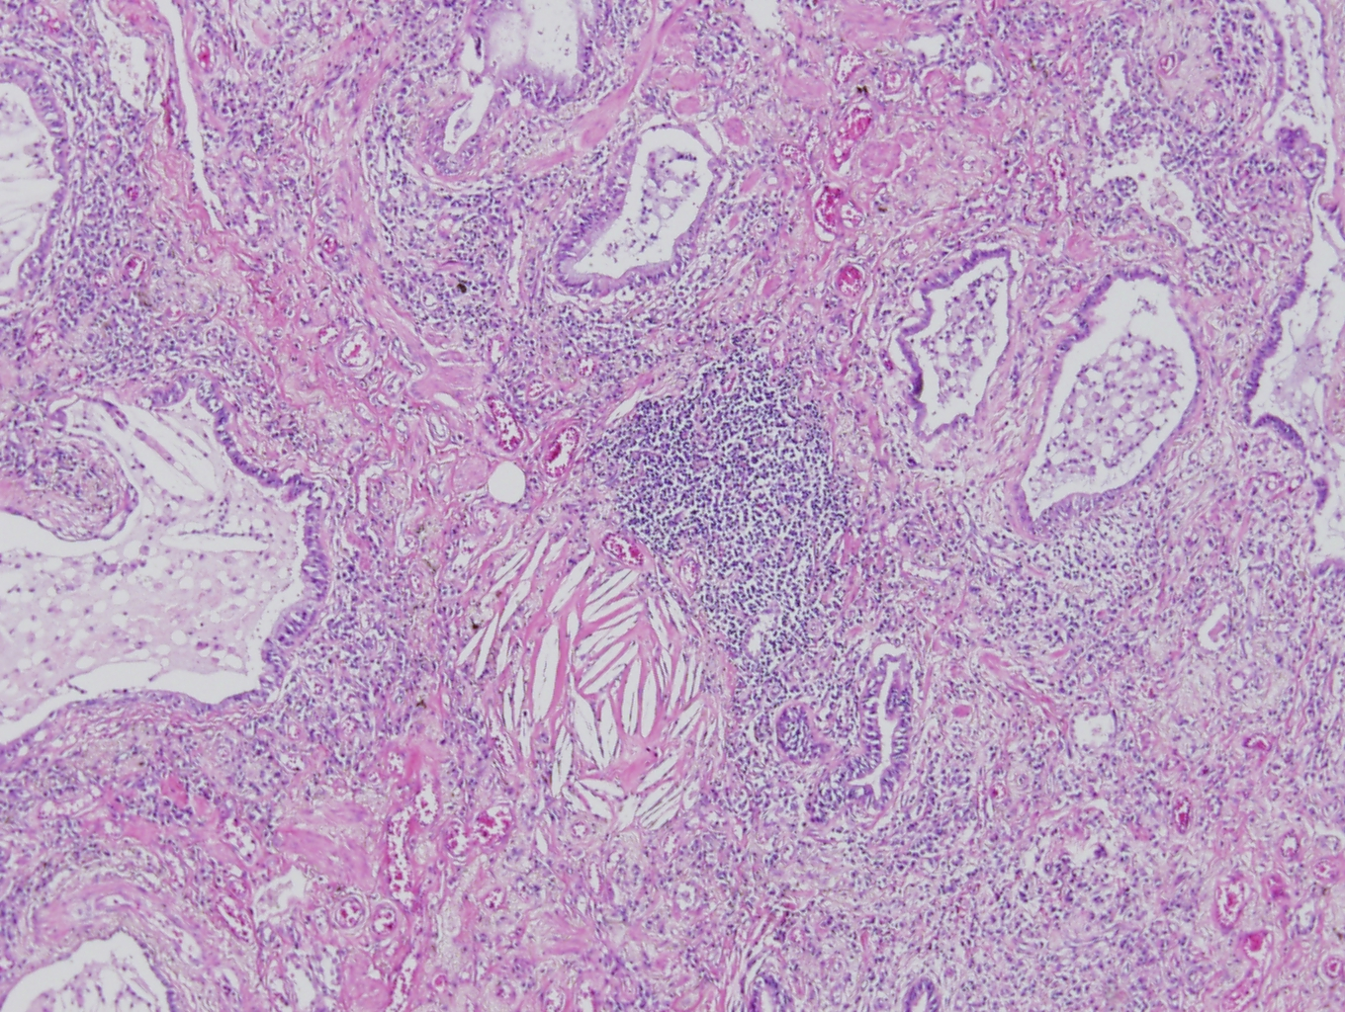

Slide 12
