Slide 1
Radiation and Autophagy in Lung cancer
In depth review
J. M. Lee,
Division of Pulmonology
Department of Internal Medicine
Yonsei University College of Medicine

Slide 2
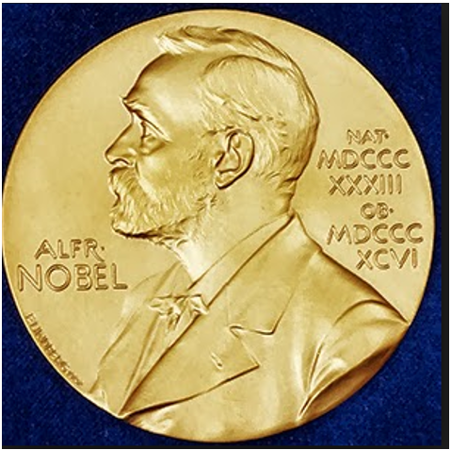
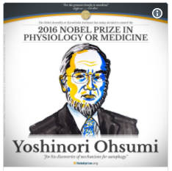
Autophagy
Autophagy
  derives from Greek, self (auto) eating (phagy)
  catabolic pathway to promote lysosomal degradation of cytoplasmic components and organelles

Slide 3
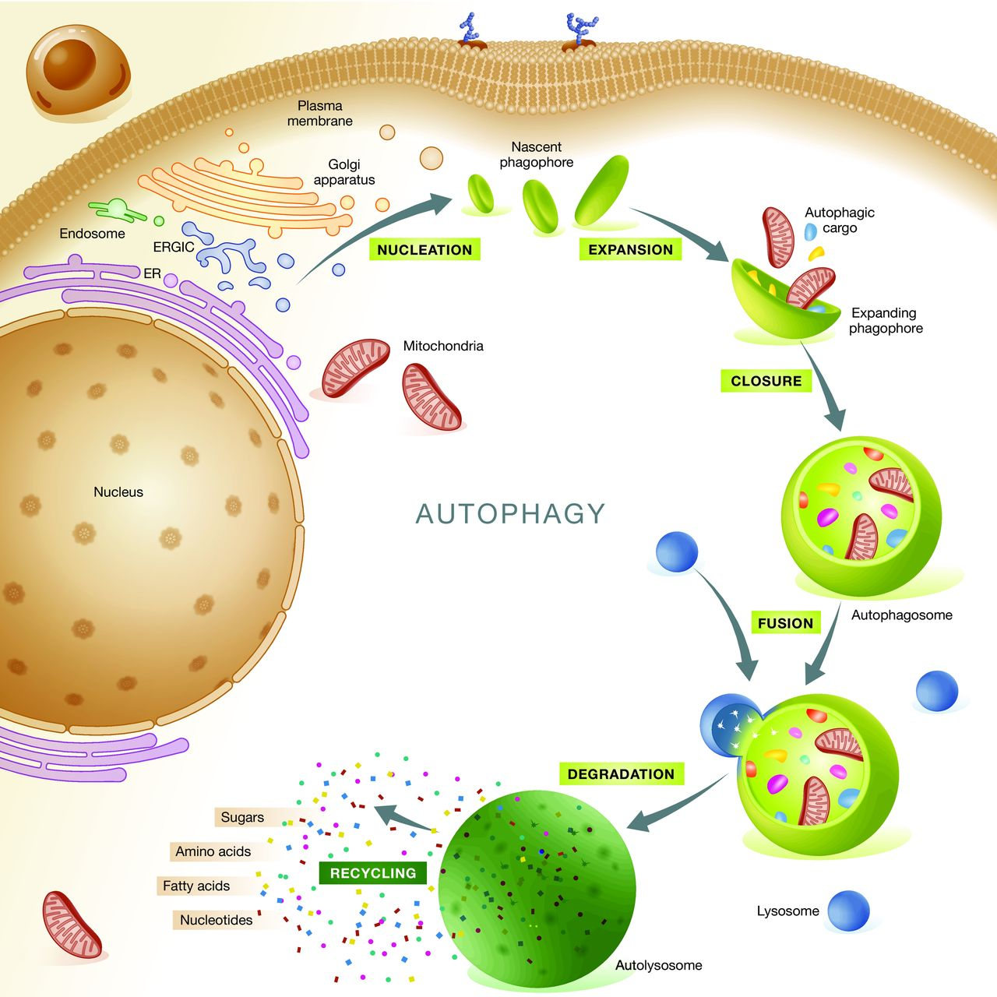
Lorenzo Galluzzi et al. EMBO J. 2015;34:856-880

Slide 4
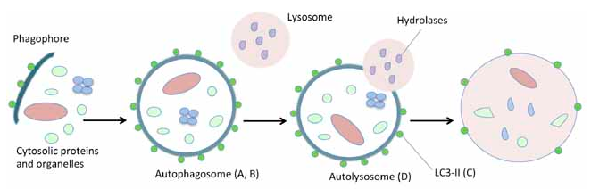
initiated by the generation of the phagophore, an isolation membrane that likewise derives from the endoplasmic reticulum
double-membrane vesicle known as autophagosome.
Autophagosomes mature by fusing with lysosomes or late endosomes and hence generate auto(phago)lysosomes.
luminal content of the auto(phago)lysosome is catabolized by acidic hydrolases, resulting in the generation of metabolic substrates that are re-exported into the cytosol via permeases of the auto(phago)lysosomal membrane
Journal of Cellular Physiology. 2013;228(1);1-8

Slide 5
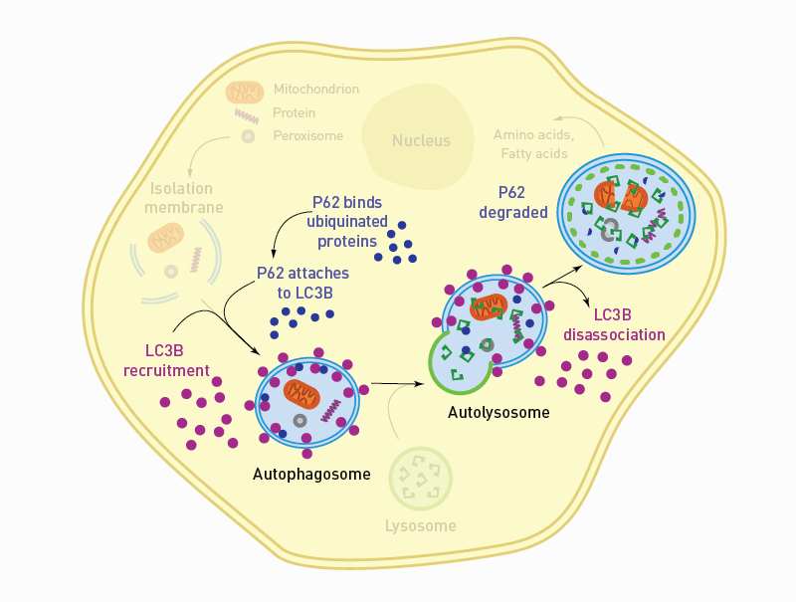

Slide 6
LC3B is recruited from the cytosol and associates with the phagophore early in autophagy. This localization serves as a general marker for autophagic membranes and for monitoring the process as it develops.
p62 is a receptor for cargo destined to be degraded by autophagy, including ubiquitinated protein aggregates destined for clearance. The p62 protein is able to bind ubiquitin and also to LC3, thereby targeting the autophagosome and facilitating clearance of ubiquitinated proteins.

Slide 7
Functions of autophagy
Autophagy
  Regulate recycling of intracellular waste material and organelles
  Promote cell survival and regulate energy balance
  In stress situations,
    accelerate autophagy to allow energy acquisition
  damaging agents, such as radiation and chemotherapy
    force cells to intensify autophagic pathways to remove damaged organelles and membranes
Functions of autophagy
  maintenance of cellular homeostasis
  cytoprotective functions by acting as a stress response mechanism
  maintaining cell viability upon shortage of external nutritional sources
  removing damaged or potentially dangerous organelles
  removing cytotoxic protein aggregates from the cell, promoting overall survival
Journal of Cellular Physiology. 2013;228(1);1-8
Br J Cancer. 2016 Jul 26;115(3):312-21
Cancer Res. 2014 Feb 1;74(3):647-51
Antioxid Redox Signal. 2014 Jan 20;20(3):460-73

Slide 8
Autophagy & Cancer
Upregulation of autophagy has been observed in many types of cancer
  Associasted with cell survival and cell death
  still unknown how autophagy switches between these two cellular fates
  probably depends on the nature and duration of treatment as well as on the involved tumor type
Overactivation of autophagy
  associated with poor post-operative overall survival
  result of increased cancer cell survival and metastatic ability
Journal of Cellular Physiology. 2013;228(1);1-8
Chest. 2011;140: 127–134.
Lung Cancer. 2015;90:98–105.

Slide 9
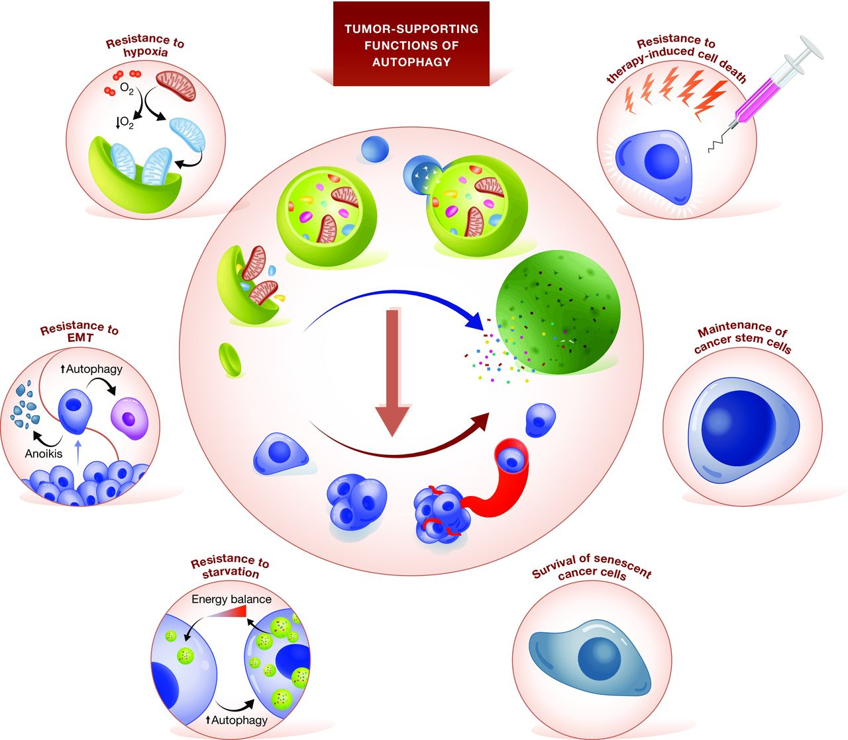
Tumor‐supporting functions of autophagy
Lorenzo Galluzzi et al. EMBO J. 2015;34:856-880

Slide 10
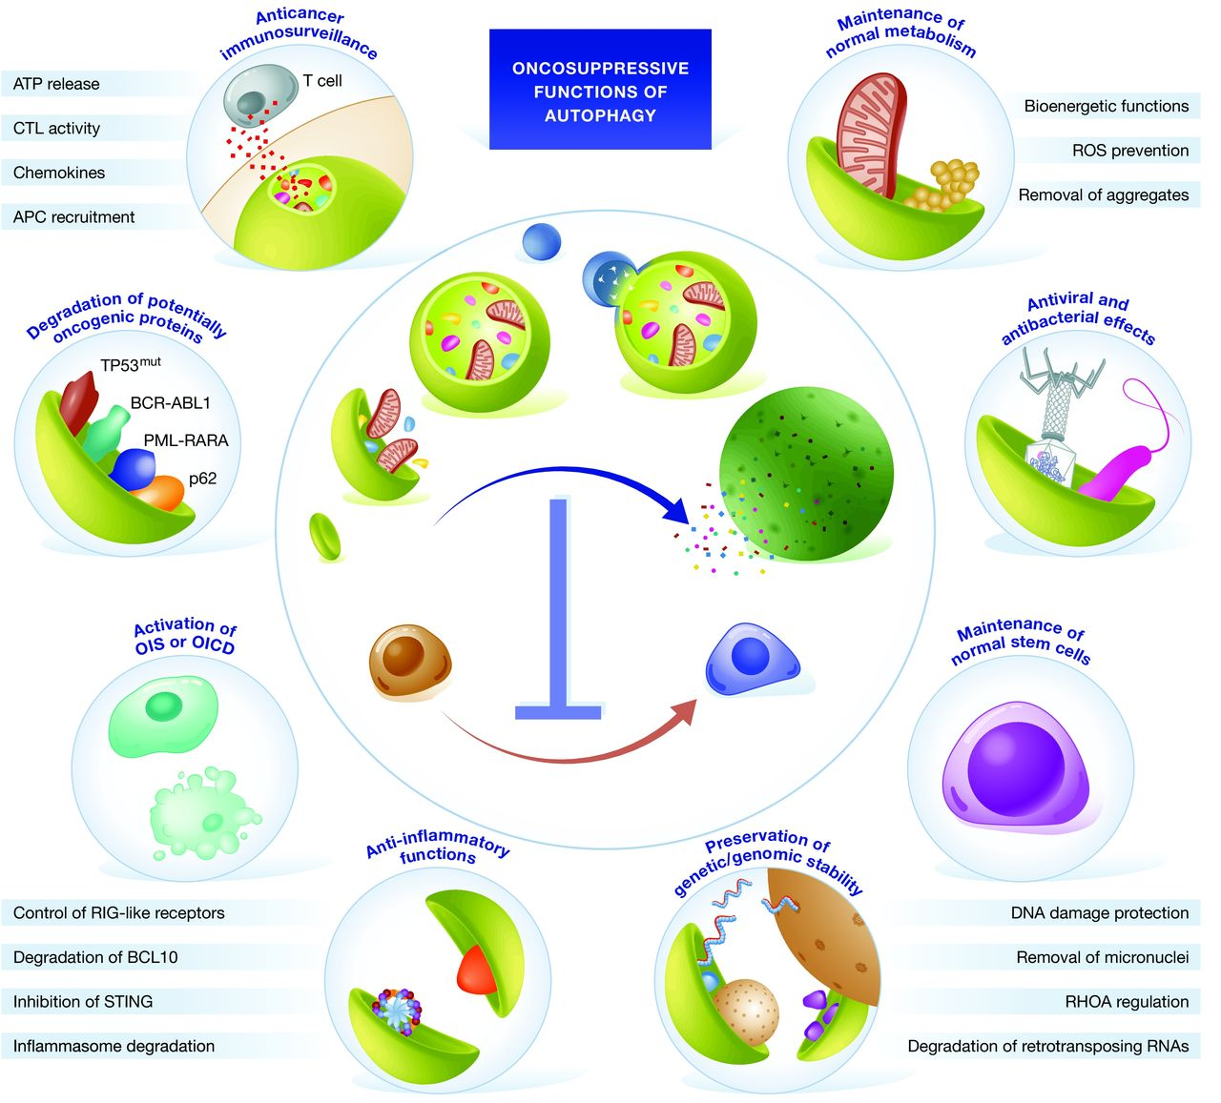
Oncosuppressive functions of autophagy
Lorenzo Galluzzi et al. EMBO J. 2015;34:856-880

Slide 11
Autophagy & Radiation in Cancer
The autophagic response of cancer cells to radiation remains unclear.
Various cells and tissues respond differentially to radiation.
Int J Oncol. 2016 Dec;49(6):2217-2226.

Slide 12
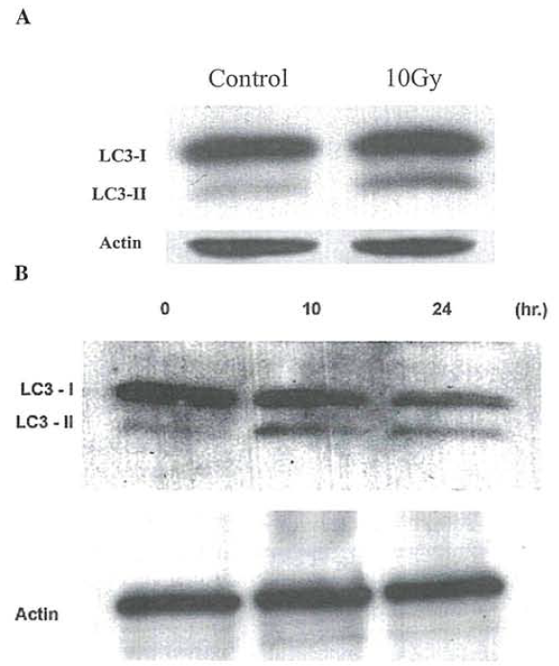
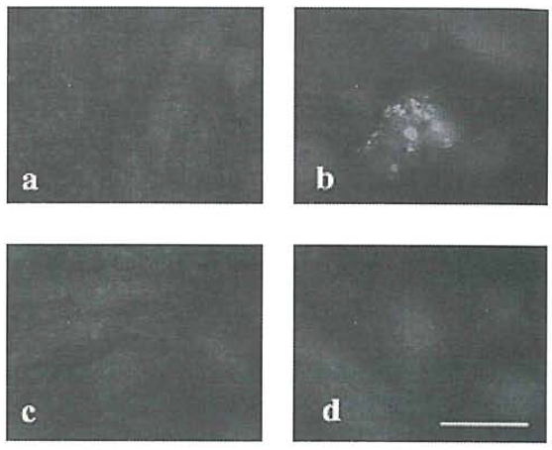
Radiation induces autophagy in glioma cells.
LC3 expression after RTx
No Tx 10Gy
3MA 10Gy+3MA
LC3 expression after starvation
LC3 expression, IF
Int J Oncol. 2005 May;26(5):1401-10.

Slide 13
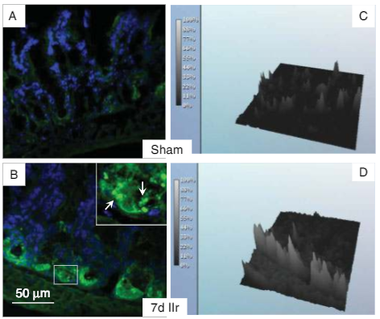
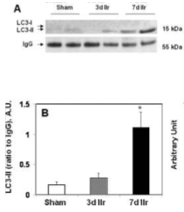
intensified autophagy in the Paneth cells of the small intestine after irradiation
Effect of ionizing irradiation on LC3 status in small intestine tissue of CD2F1 mice.
J Pathol. 2009 Oct;219(2):242-52

Slide 14
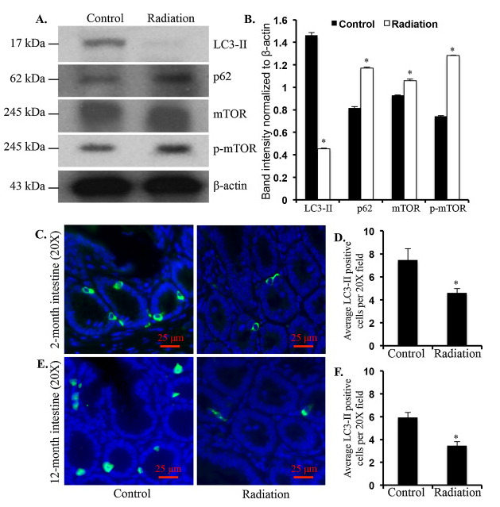
exposure to sublethal irradiation (2Gy) suppresses autophagic activity in the intestinal tissue of mice
Int J Biochem Cell Biol. 2014 Dec;57:167-76.

Slide 15
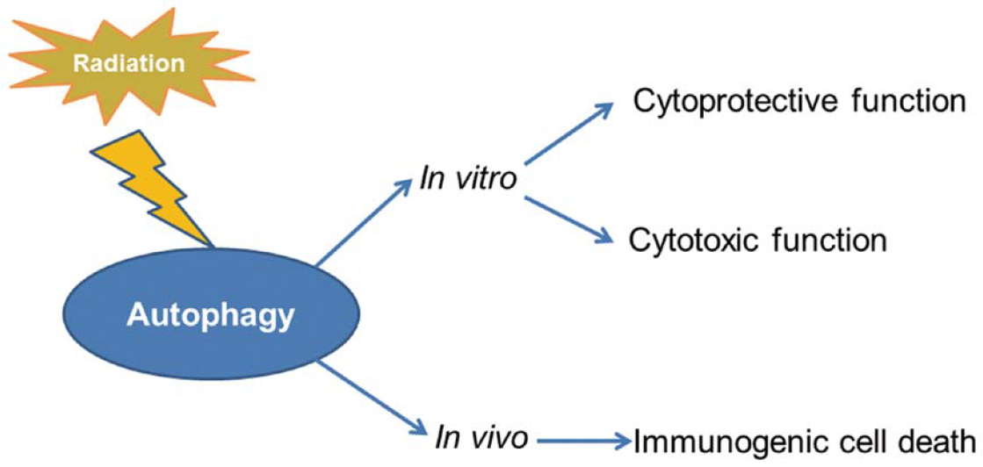
Function of radiation induced autophagy
Cytoprotective function
  reflect the capacity of the cell to eliminate toxic species such as free radicals and damaged and unwanted proteins or organelles to generate energy and metabolic precursors.
Cytotoxic function
  some studies reported that autophagy enhanced the anticancer effects of radiotherapy on patients with oral squamous cell carcinoma and glioblastoma cells.
Int J Oncol. 2016 Dec;49(6):2217-2226.

Slide 16
Autophagy & Radiation in Lung Cancer
Autophagy in lung cancer
  Overactivation of autophagy has been associated with poor post-operative overall survival in lung cancer.
  Overactivation of autophagy is associated with migratory phenotype and poor prognosis in non-small cell lung cancer.
Conflicting and limiting evidence exists on whether radiation suppresses or activates autophagic flux in lung cancer cells.
Chest. 2011;140: 127–134.
Lung Cancer. 2015; 90: 98–105.

Slide 17
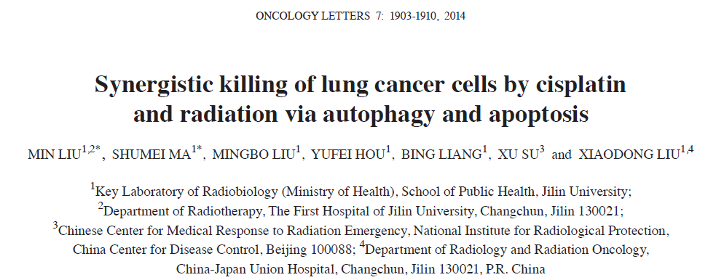
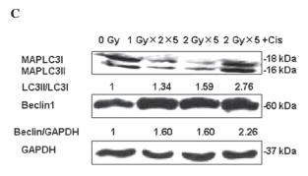
an acceleration of autophagic flux following administration of five consecutive fractions of 2 Gy in A549 lung cancer cells.

Slide 18
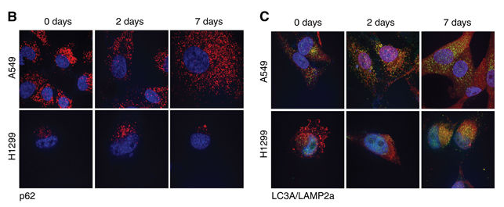
significant induction of the autophagic flux after 4 Gy of radiation
P62, LAMP2a :red
LC3A : green
British Journal of Cancer (2016) 115, 312–321

Slide 19
mouse lung irradiation induces a significant suppression of Beclin 1 and LC3A gene expression.

Slide 21
In our experiments…

Slide 22
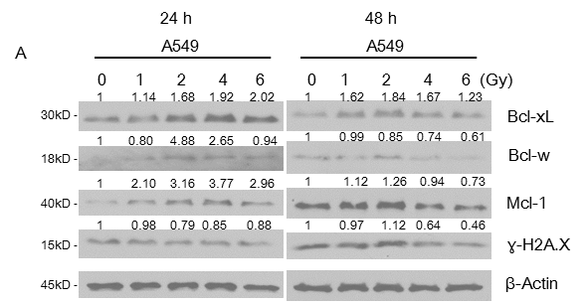
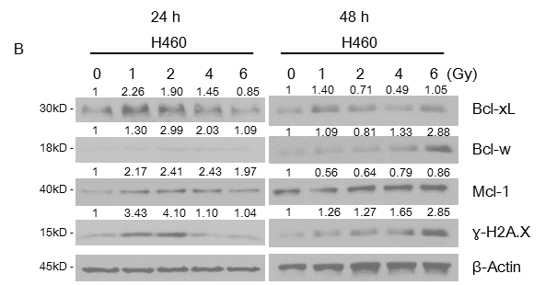
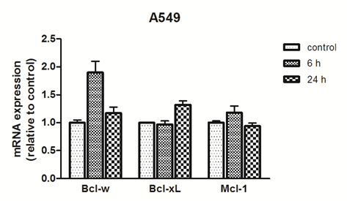
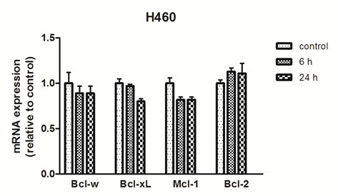
Anti-apoptotic proteins after irradiation in NSCLC cells
mRNA expression of anti-apoptotic molecules after irradiation
Notes:
KRAS mutant NSCLC cell line인 A549 와 H460 cell을 선택하여 방사선을 조사하고
24시간 및 48시간 후에 harvest 하고 anti-apoptitic protein들의 expression을 보았습니다.
두 cell 에서 모두 방사선 dose가 증가 할 수록 anti-apop protein 들이 증가 하다가 감소하는 것을 확인했습니다.

Slide 23
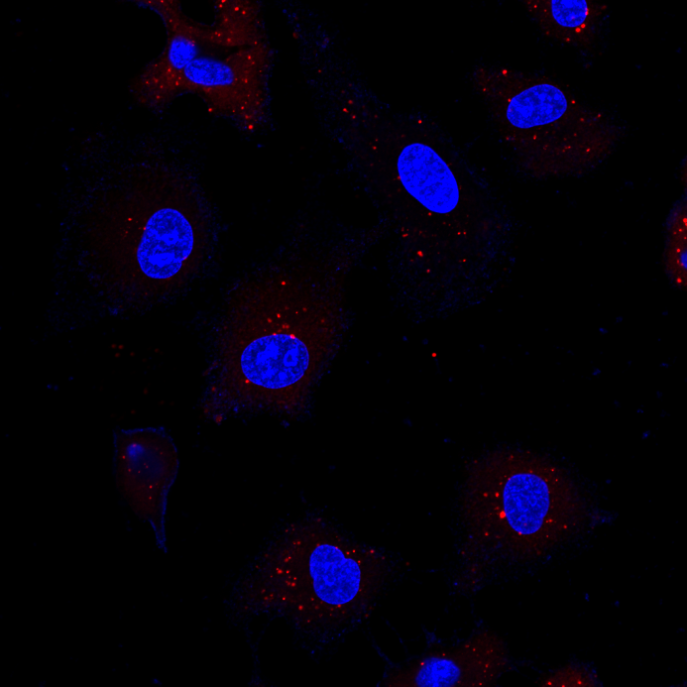
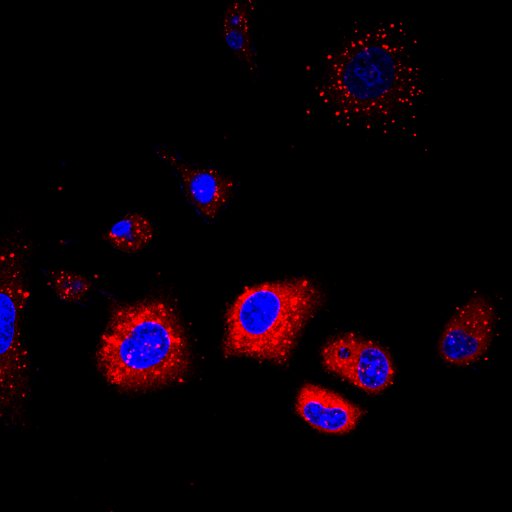
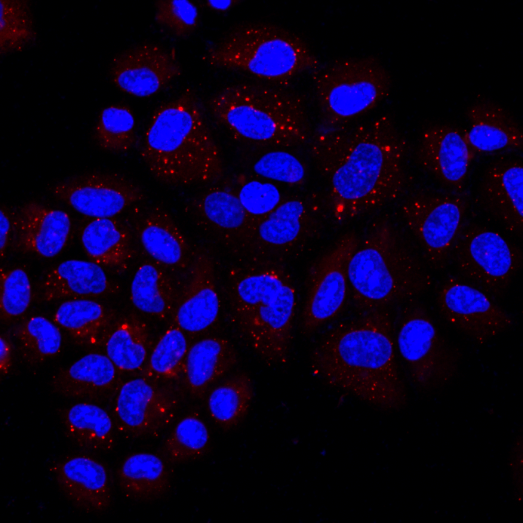
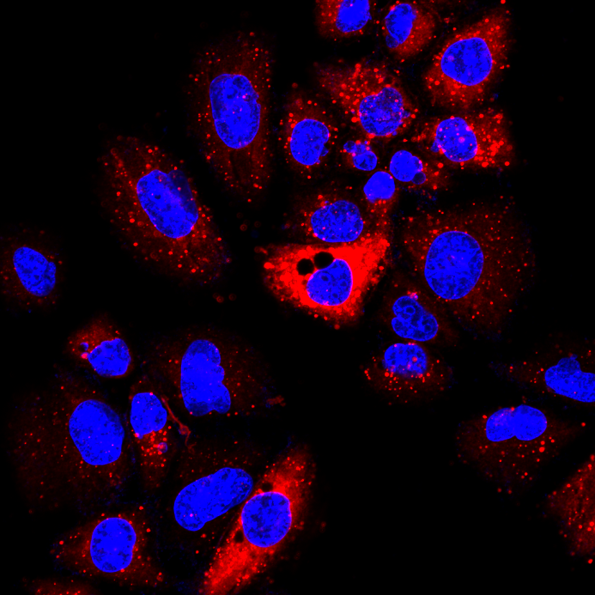
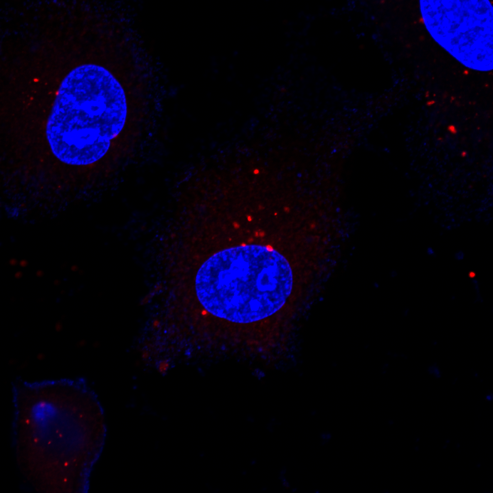
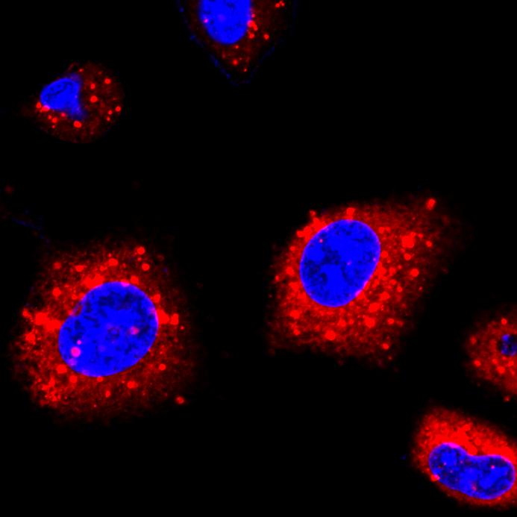
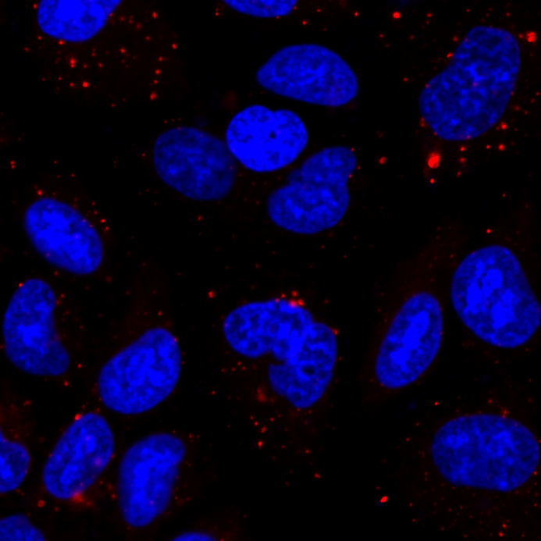
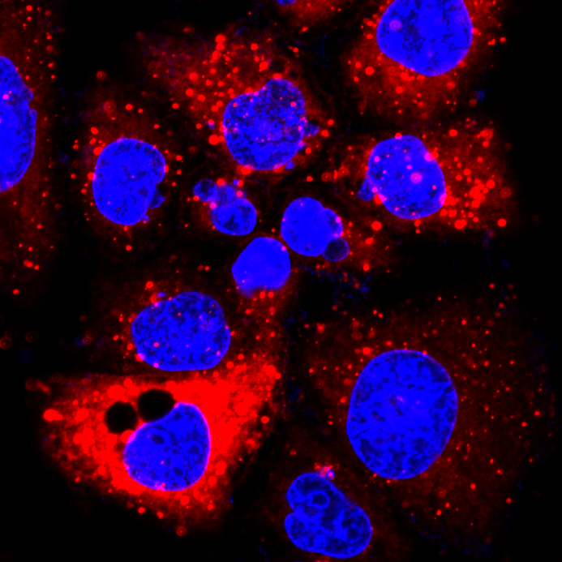
Induction of autophagy after irradiation in NSCLC cells
P62 Ab (AF555; red color)
0 Gy
4 Gy
0 Gy
4 Gy
X400
X800
A549
H460
confocal microscope(Zeizz; LSM780)

Slide 24
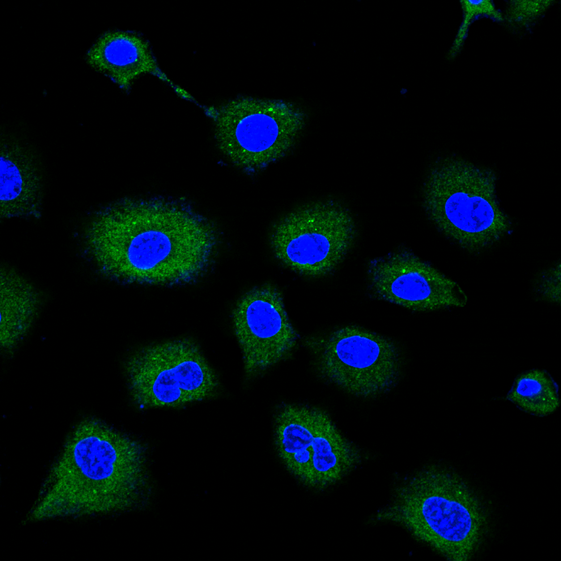
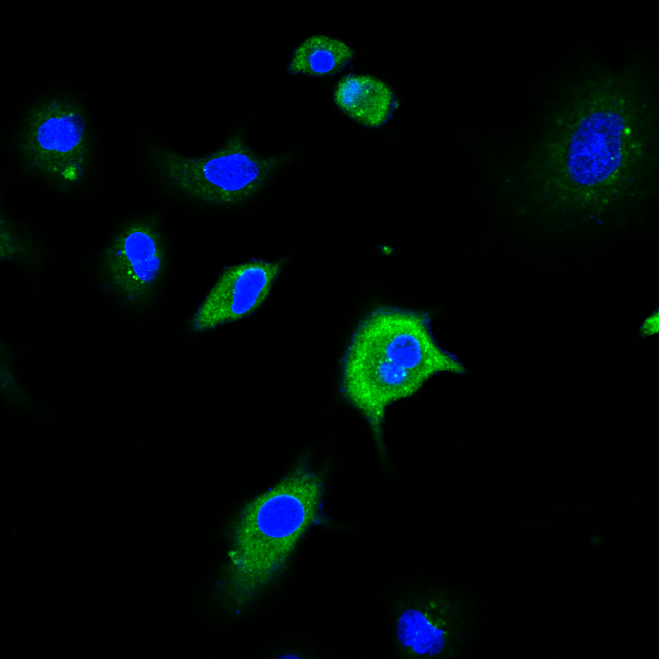
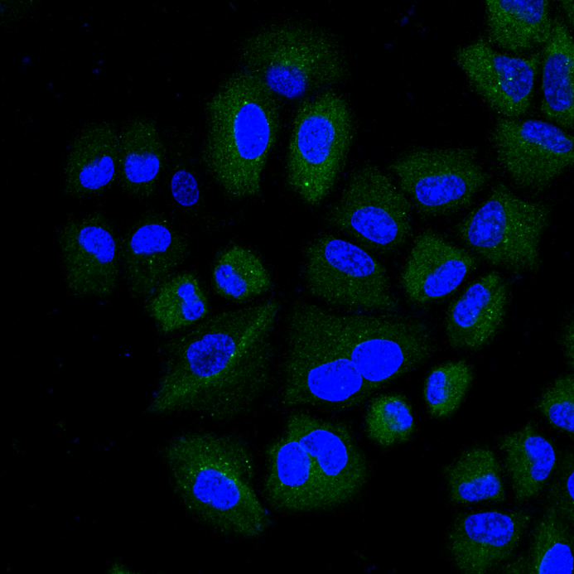
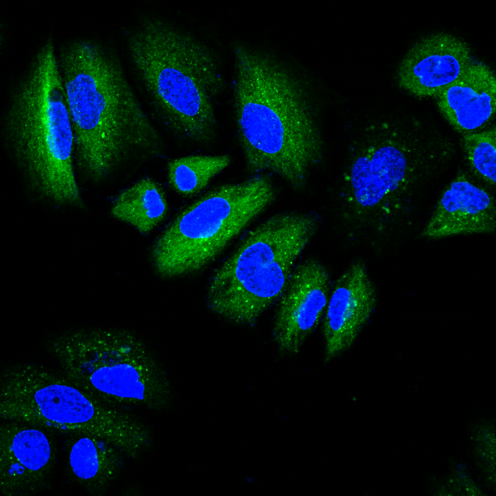
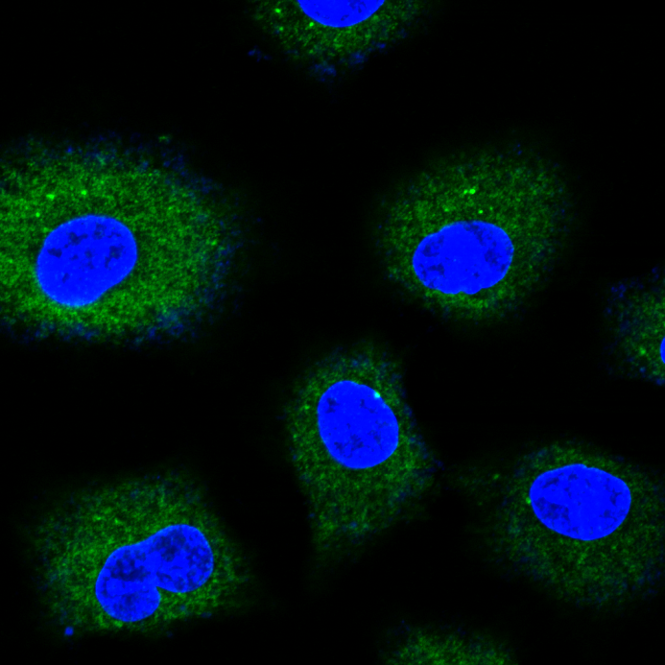
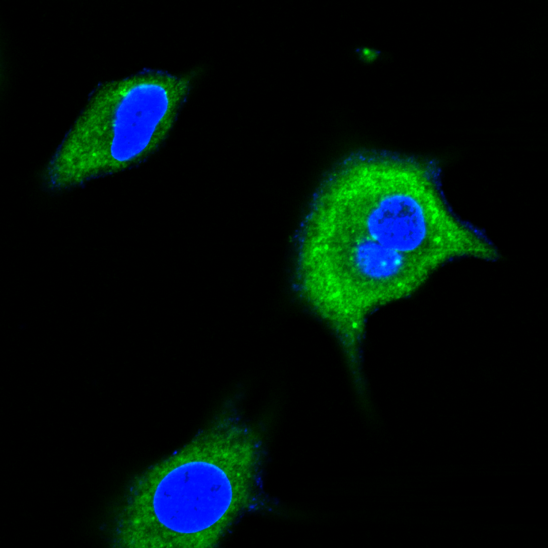
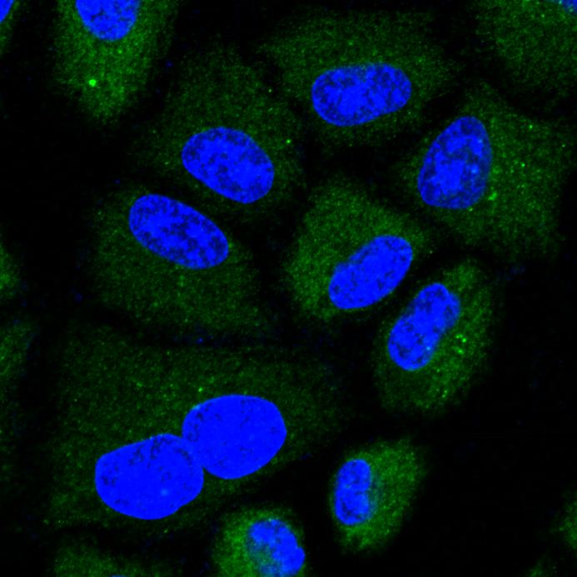
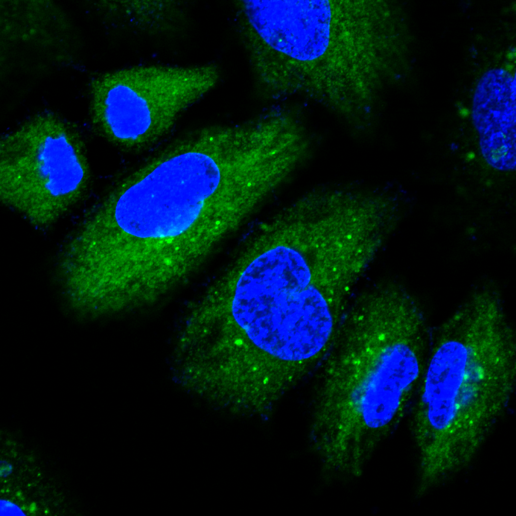
Induction of autophagy after irradiation in NSCLC cells
LC3A/B Ab (AF488; green color)
0 Gy
4 Gy
0 Gy
4 Gy
X400
X800
A549
H460
confocal microscope(Zeizz; LSM780)

Slide 25
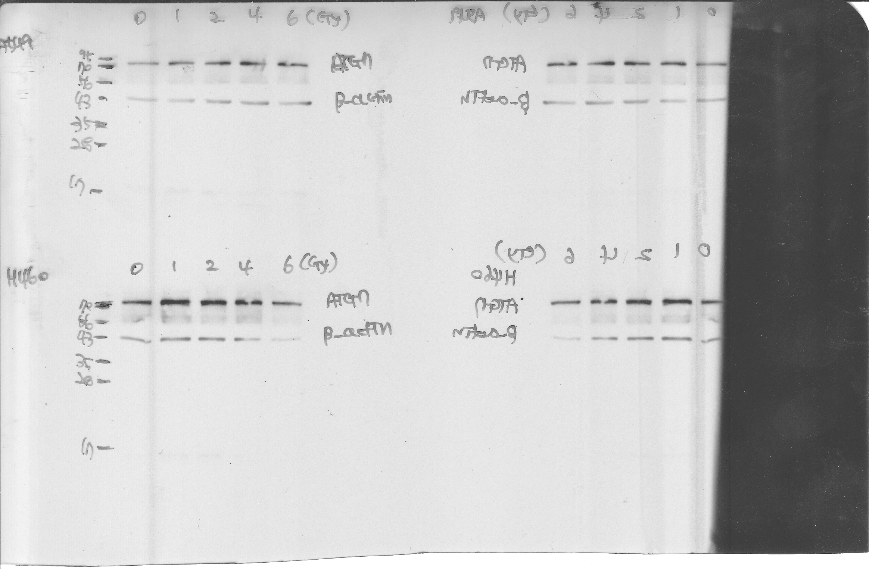
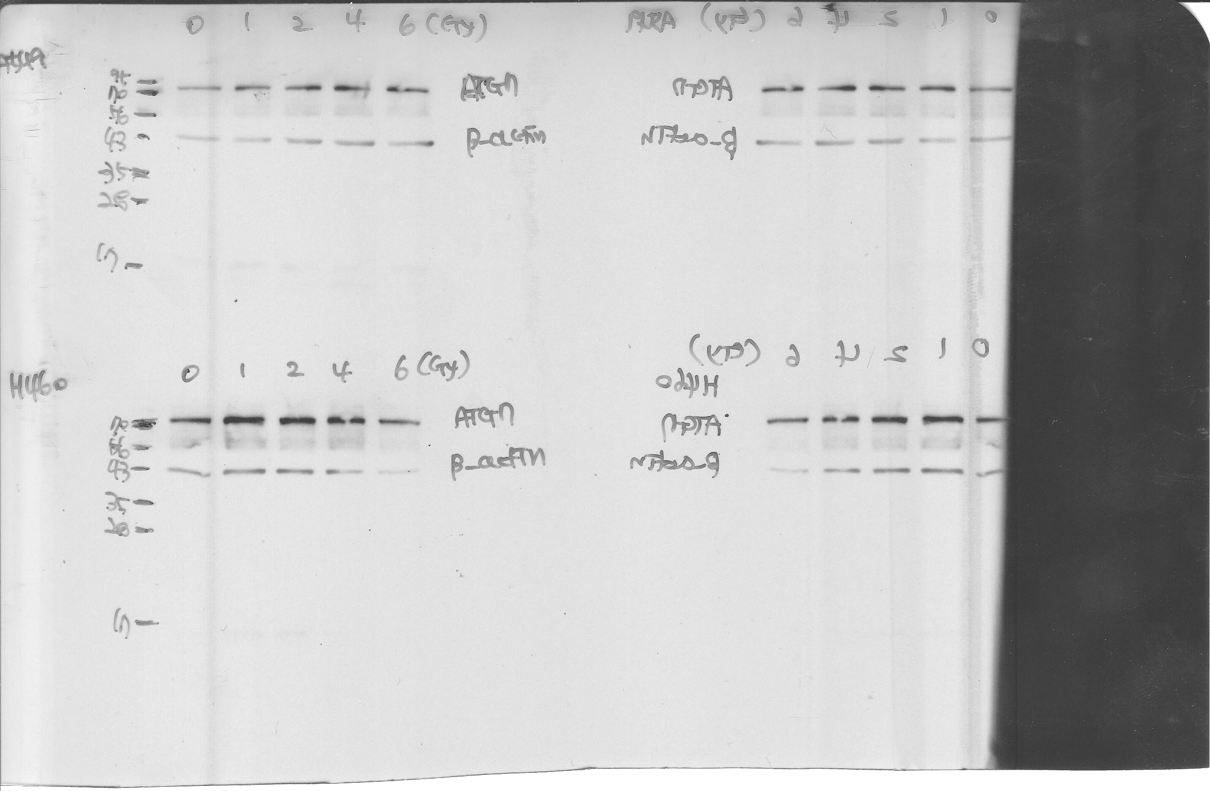
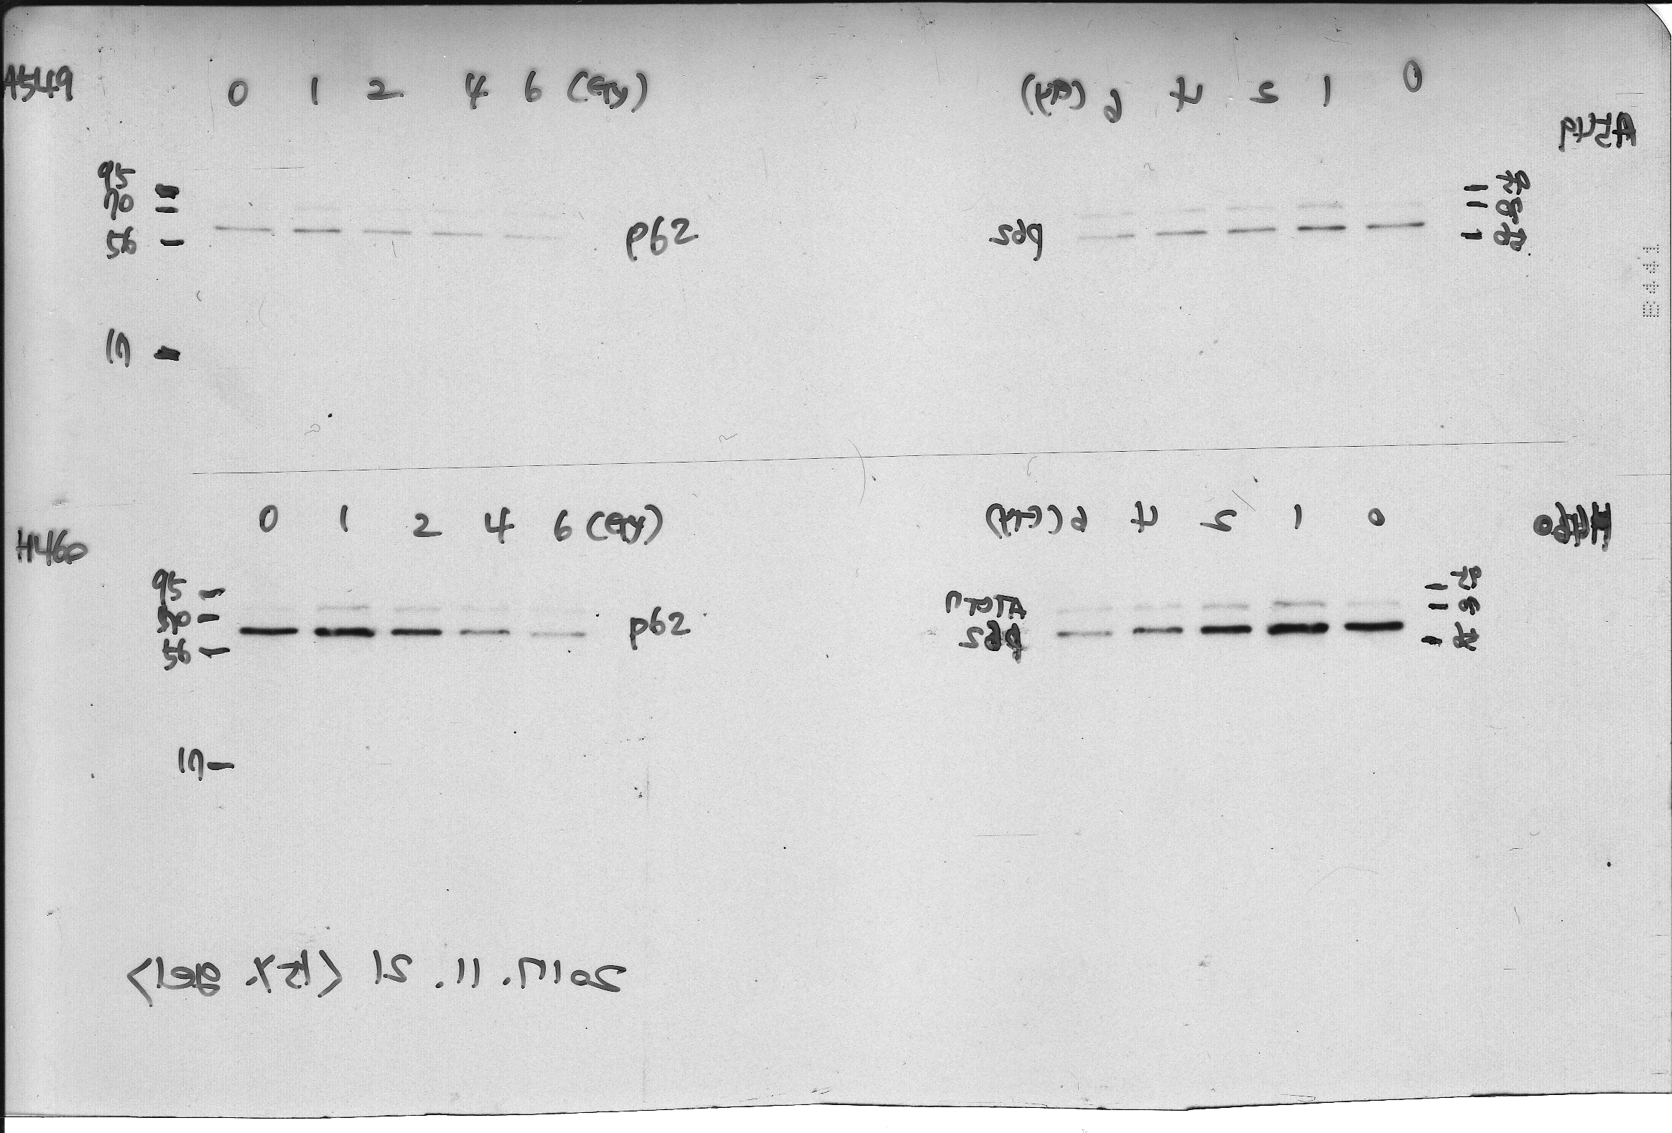
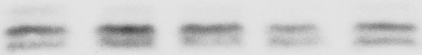
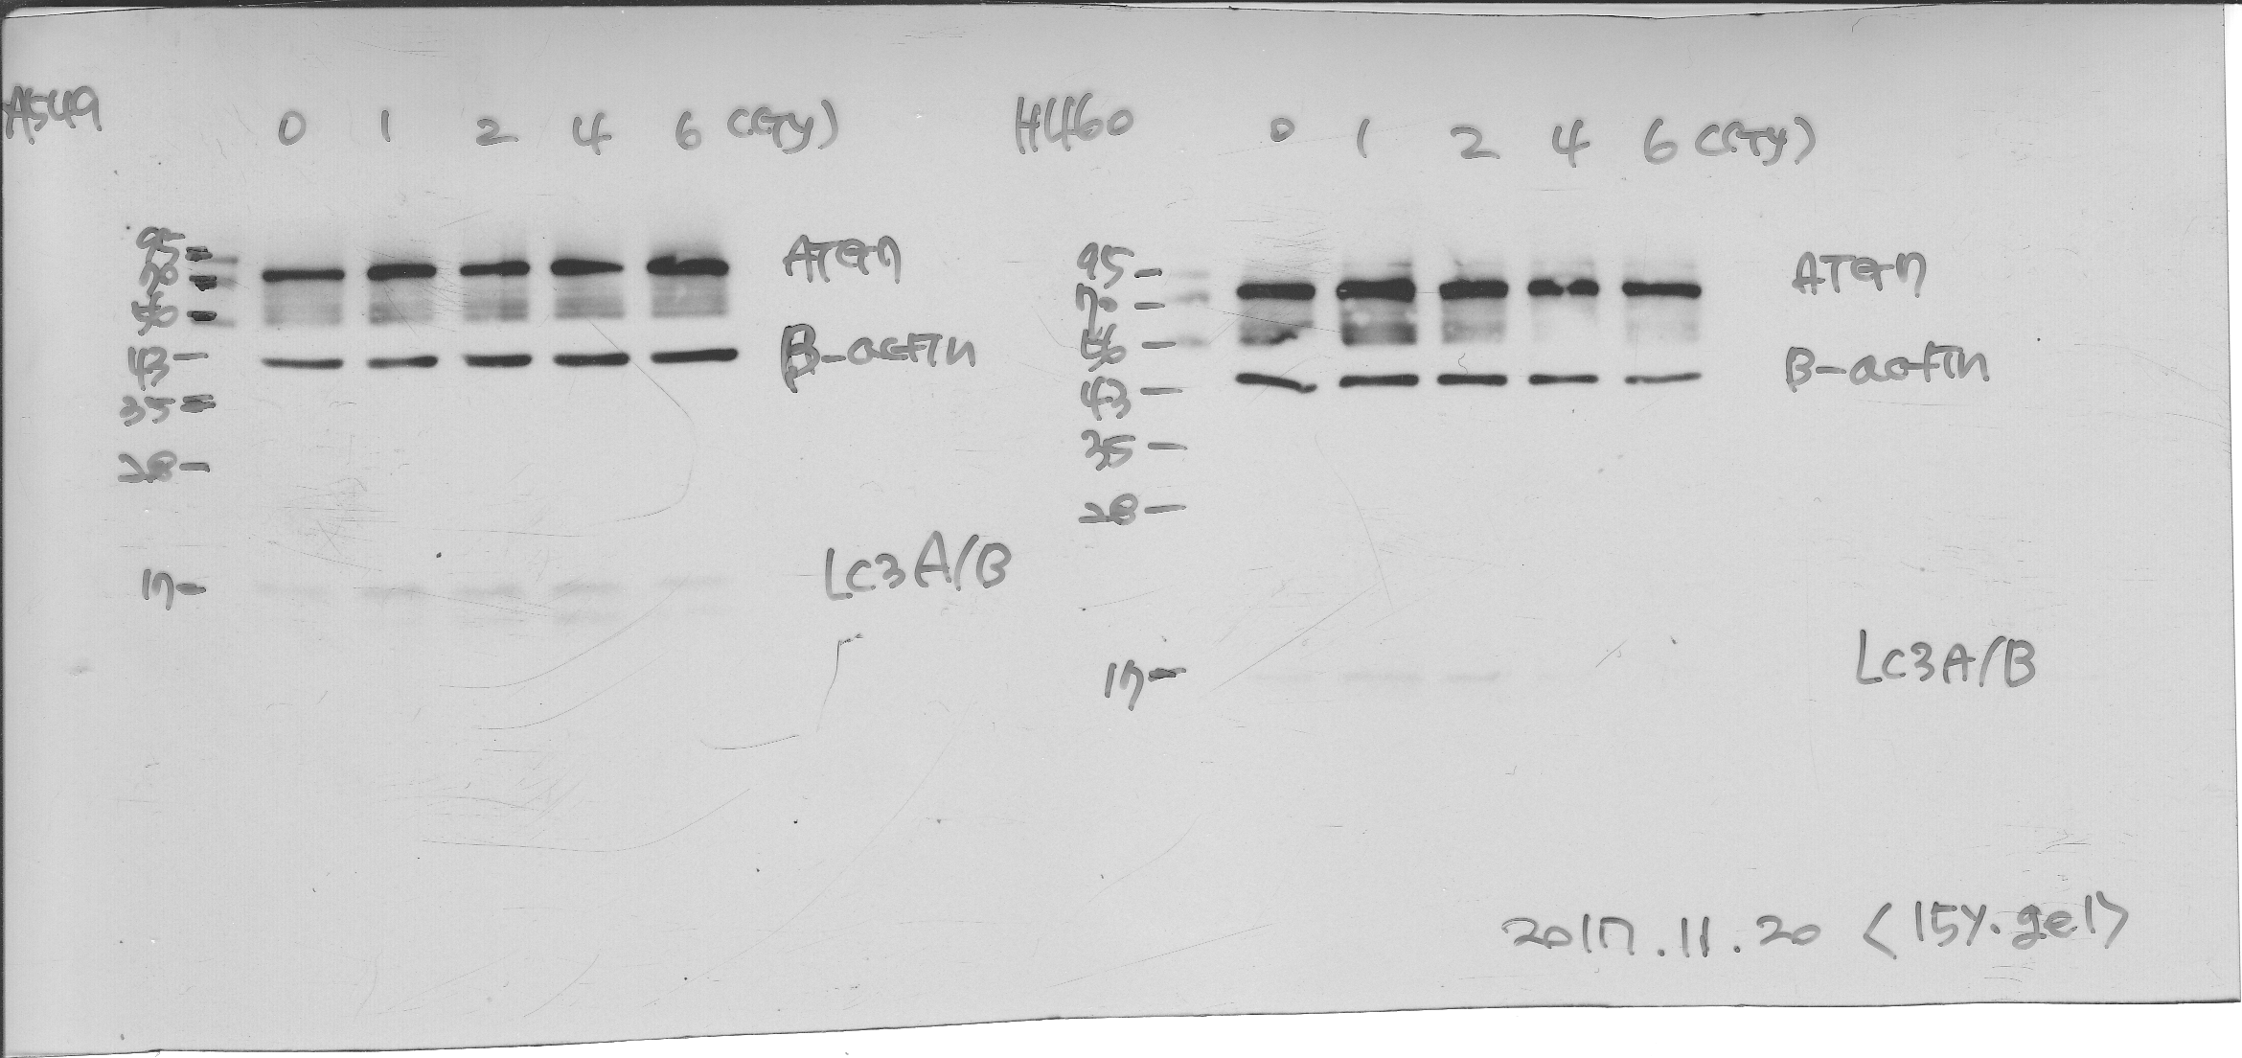
Induction of autophagy after irradiation in NSCLC cells
A549
H460
0 1 2 4 6
0 1 2 4 6 (Gy)
78kD
ATG7
62kD
p62
16kD
LC3A/B
14kD
45kD
β-Actin

Slide 26
Further experiment
Late response of autophagy after irradiation (72hr)
Autophagy induction by Rapamycin
Autophagy inhibition by Wortmannin
Autophagy and apoptosis after irradiation

Slide 27
