Slide 1
Clinical Year in Review at ATS 2023
2023-06-22 In-depth Review
강사 기민서

Slide 2
CLINICAL YEAR IN REVIEW
ALI/ARDS
PAH
ILD
COPD/Asthma
Lung cancer
COVID-19/Critical Care
Sarcoidosis

Slide 3
ALI/ARDS
A New Global Definition of ARDS
O2 saturation targets: high-normal target may be safe in ARDS.
Longitudinal phenotypes for ARDS
Ventilratory ratio (VR) and its trajectory in ARDS
Resp mechanics : Intrathoracic pr. & lung function
Notes:
ALI/ARDS

Slide 4
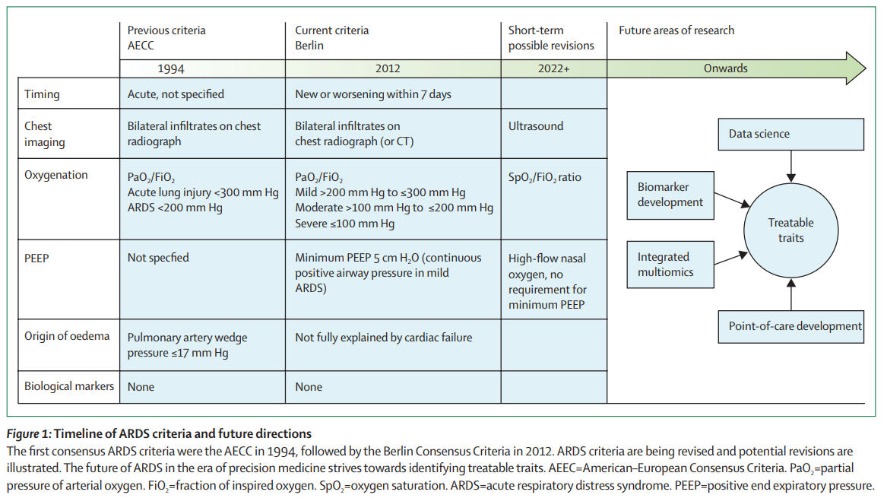
Notes:
Lancet 2022; 400: 1157–70

Slide 5
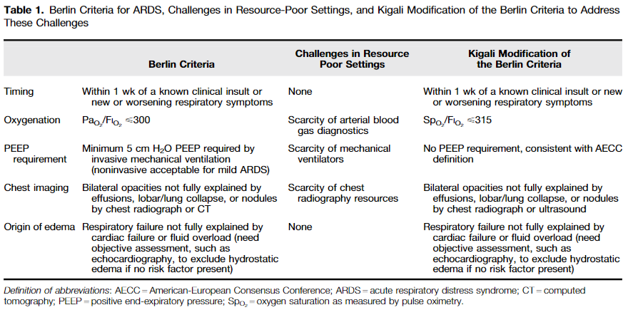
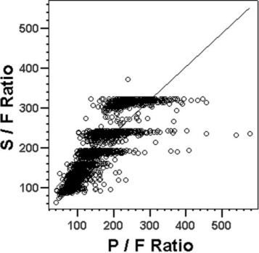
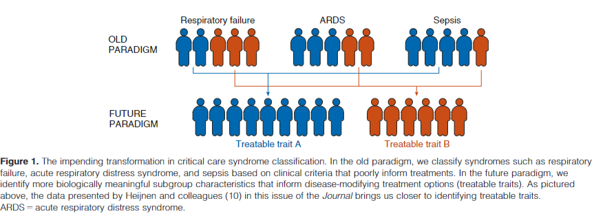
S/F ratios 235 =
P/F ratios 200
S/F ratios 315 =
P/F ratios 300
Notes:
Am J Respir Crit Care Med 2016; 193: 52–59.
Chest. 2007 Aug;132(2):410-7.
Am J Respir Crit Care Med 2021; 203: 1449–51.

Slide 6
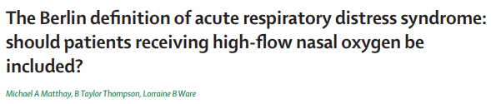
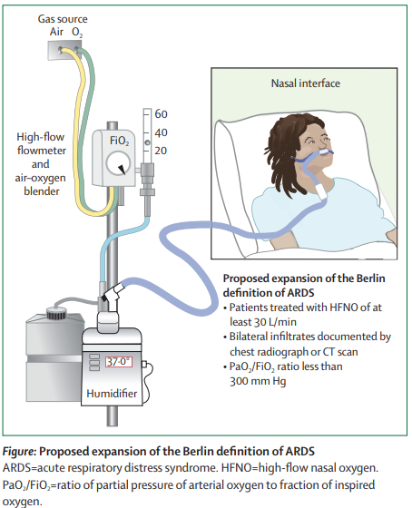
Early recognition/diagnosis/management/clinical study
Include do-not-intubate patients
Resource-limit environment
HFNO
30L/min~
→ Equivalent effect of PEEP 2~5 cmH2O
Bilateral?
Same mortality with opacities in two quadrants, independent of whether the infiltrates were bilateral or unilateral
Lancet Respir Med 2021; 9: 933–36
Eur Respir J 2020; 2003317.
Notes:
Lancet Respir Med 2021; 9: 933–36
Eur Respir J 2020; 2003317.

Slide 7
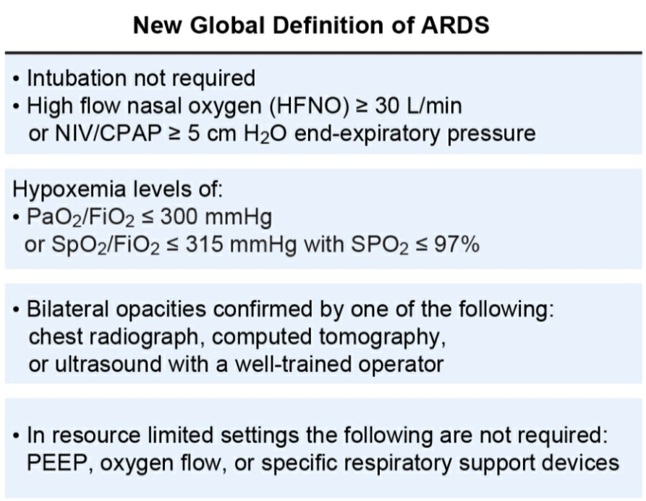
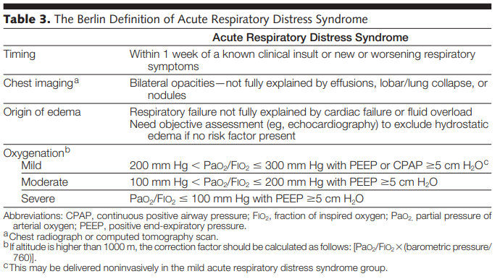
JAMA, June 20, 2012—Vol 307, No. 23
Am J Respir Crit Care Med 2023;207:A6229
Notes:
JAMA, June 20, 2012—Vol 307, No. 23
Am J Respir Crit Care Med 2023;207:A6229

Slide 8
ALI/ARDS
A New Global Definition of ARDS
O2 saturation targets: high-normal target may be safe in ARDS.
Longitudinal phenotypes for ARDS
Ventilratory ratio (VR) and its trajectory in ARDS
Resp mechanics : Intrathoracic pr. & lung function
Notes:
ALI/ARDS

Slide 9


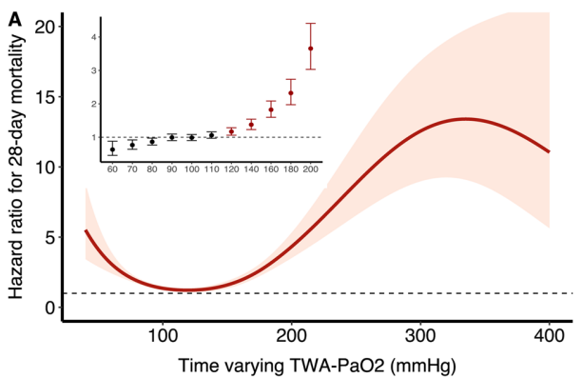
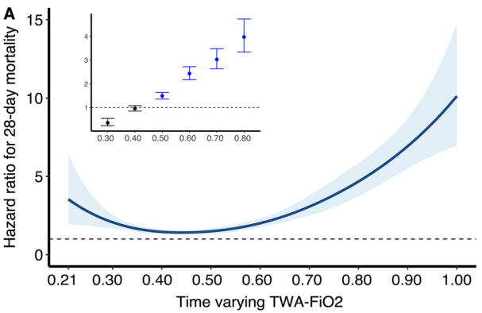

Slide 10
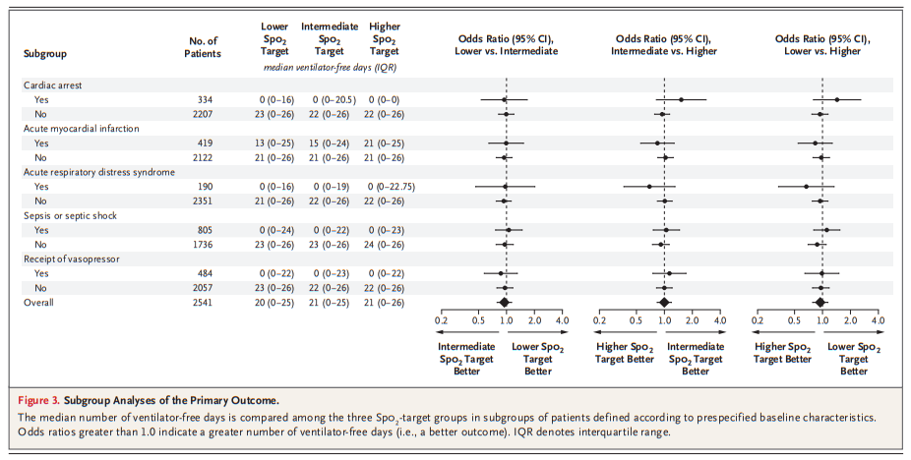
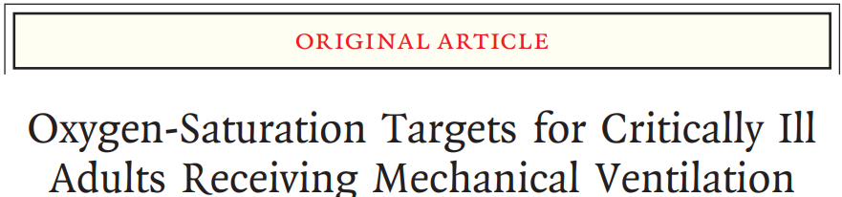
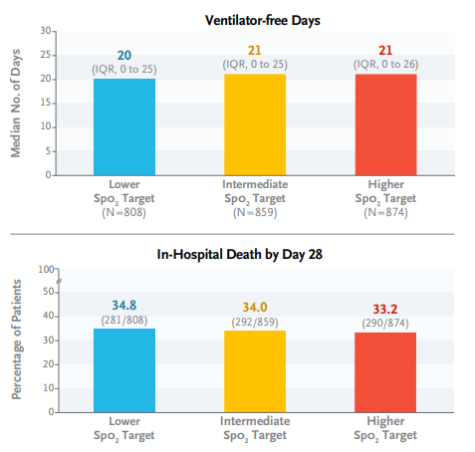
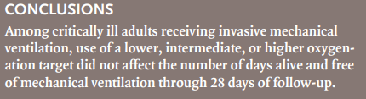
N Engl J Med 2022; 387:1759-1769
Available data suggest that high-normal target ranges can be safe in ARDS (this might be particulary important in patients with darker skin pigmentation).
Stay tuned for MEGA-ROX (n=40,000)
Notes:
dark skin pigmentation results in overestimation of arterial oxygen saturation

Slide 11
ALI/ARDS
A New Global Definition of ARDS
O2 saturation targets: high-normal target may be safe in ARDS.
Longitudinal phenotypes for ARDS
Ventilratory ratio (VR) and its trajectory in ARDS
Resp mechanics : Intrathoracic pr. & lung function
Notes:
ALI/ARDS

Slide 12
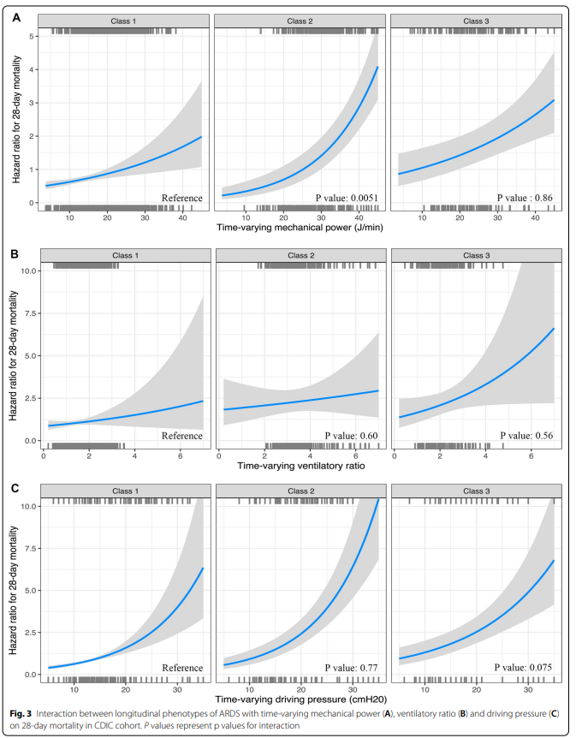
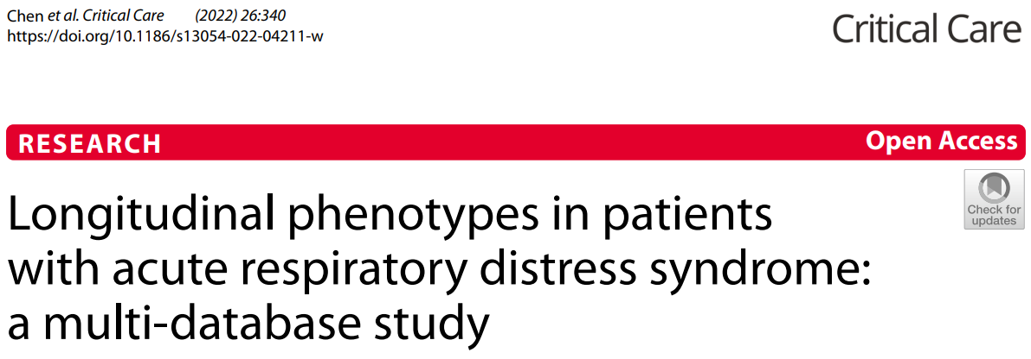
Latent class analysis (LCA) to identify longitudinal phenotypes using 24-hourly data from the frst four days of invasive ventilation

Slide 13
ALI/ARDS
A New Global Definition of ARDS
O2 saturation targets: high-normal target may be safe in ARDS.
Longitudinal phenotypes for ARDS
Ventilratory ratio (VR) and its trajectory in ARDS
Resp mechanics : Intrathoracic pr. & lung function
Notes:
ALI/ARDS

Slide 14
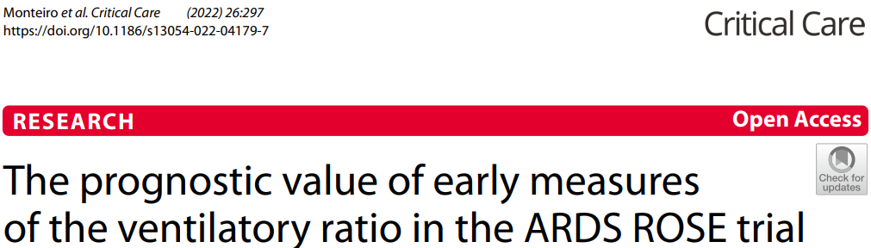
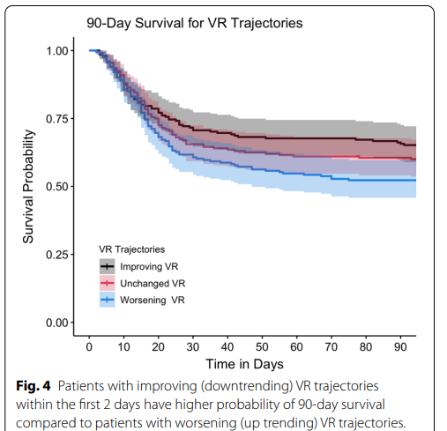
Ventilatory ratio [VR]
= (minute ventilation x PaCO₂)/(PBW × 100 × 37.5)
(cf. normal value: 1)
A simple bedside index of impaired ventilation in ARDS.
Ventilatory ratio correlates well with pulmonary dead space fraction (Vd/Vt) in ARDS.
Higher values at baseline are associated with increased risk of adverse outcomes.
Notes:
The ventilatory ratio is a simple bedside index that can be calculated using routinely measured respiratory variables and is a measure of impaired ventilation.
Ventilatory ratio correlates well with Vd/Vt in ARDS, and higher values at baseline are associated with increased risk of adverse outcomes.

Slide 15
Pulmonary hypertension
2022 ESC/ERS Guidelines for the diagnosis and treatment of pulmonary hypertension
Definition of PAH: mPAP > 20mmHg and PVR > 2WU
Clinical classification crucial for therapeutic strategy
Early diagnosis! TTE → confirmation by RHC
Risk at baseline (1yr mortality): 3 strata (low(<5%)/intermediate(5-20%)/high(>20%))
Risk at follow-up: 4 strata by WHO-FC, 6MWD, BNP (low/inter-low/inter-high/high)
  treatment escalation if needed
PAH, PH-LHD, PH-Lung disease, CTEPH (riociguat/BPA) ..
PH center referral !!!
Notes:
PAH

Slide 16
Pulmonary hypertension (PH) is a pathophysiological disorder that may involve multiple clinical conditions and may be associated with a variety of cardiovascular and respiratory diseases.
The complexity of managing PH requires a multifaceted, holistic, and multidisciplinary approach, with active involvement of patients with PH in partnership with clinicians.
The definitions for PH are based on haemodynamic assessment by right heart catheterization (RHC). Although haemodynamics represent the central element of characterizing PH, the final diagnosis and classification should reflect the whole clinical context and consider the results of all investigations.
Notes:
European Heart Journal (2022) 43, 3618–3731
2022 ESC/ERS Guidelines for the diagnosis and treatment of pulmonary hypertension

Slide 17
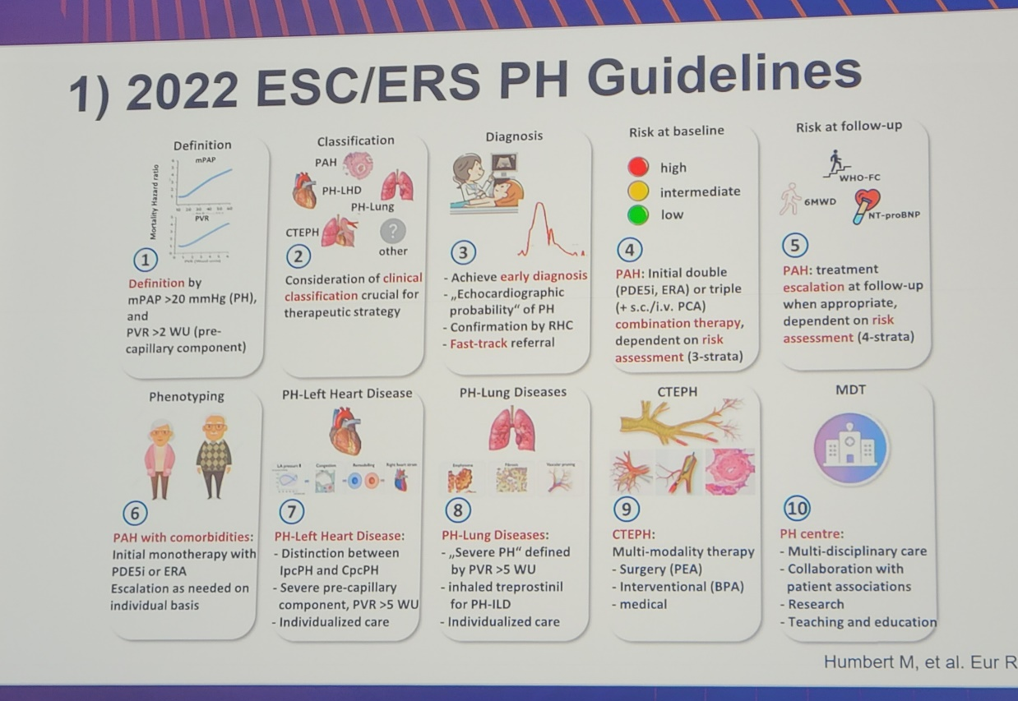

Slide 18
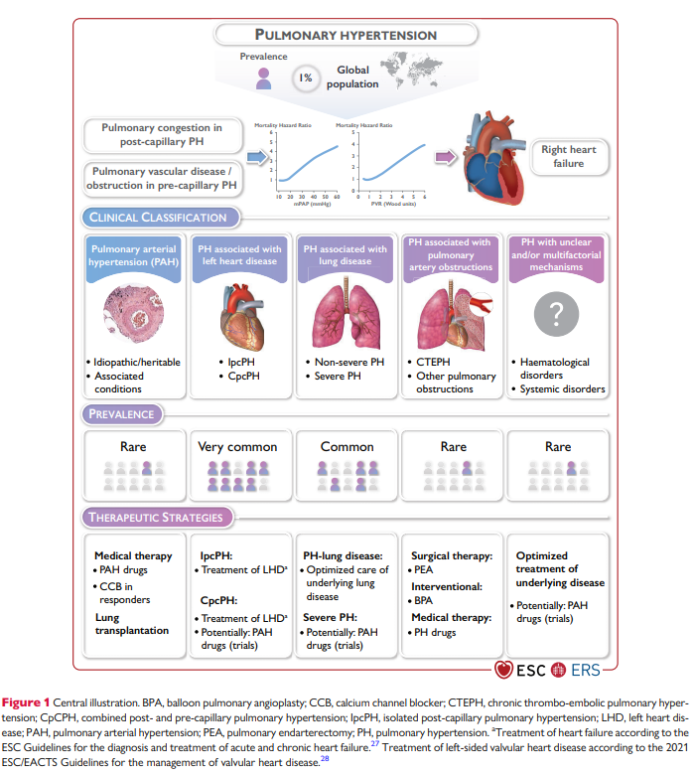

Slide 19
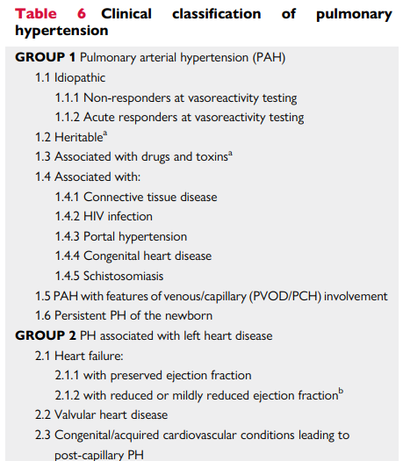
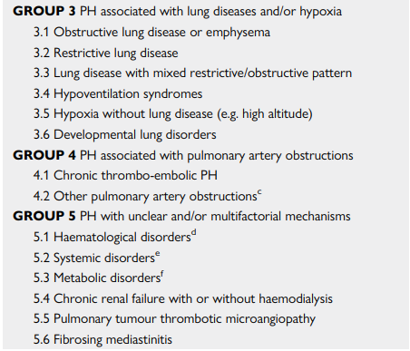
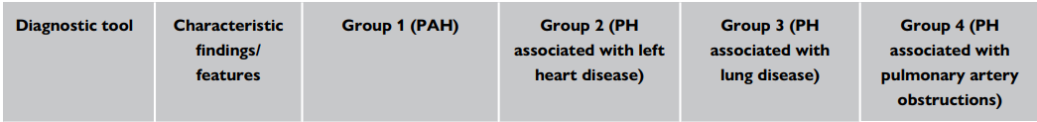

Slide 20
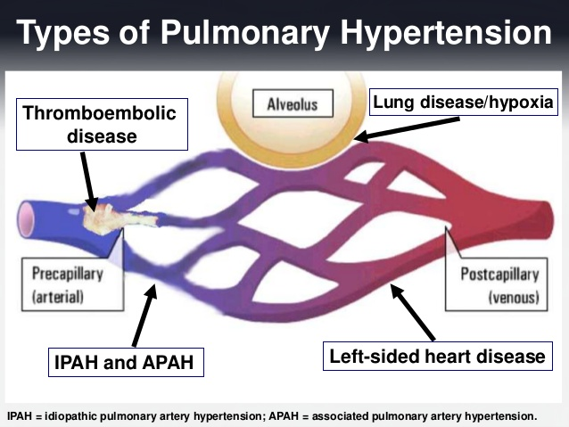
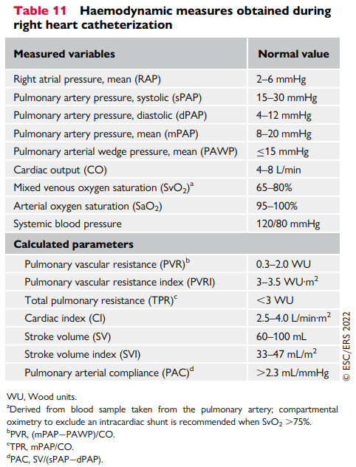
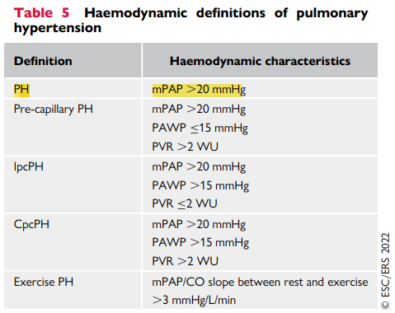

Slide 21
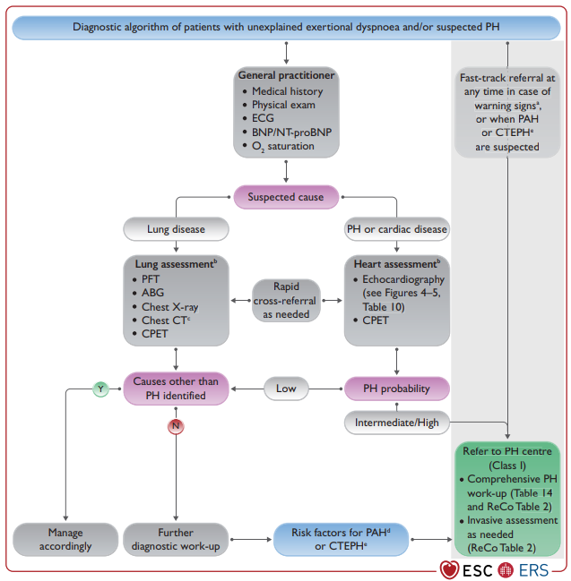
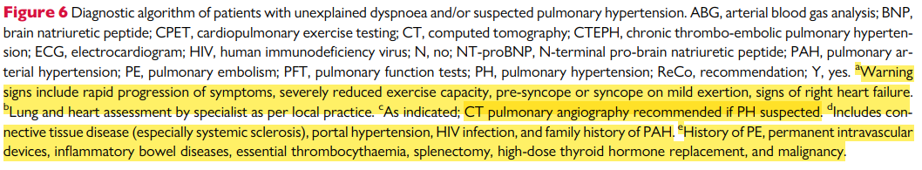

Slide 22
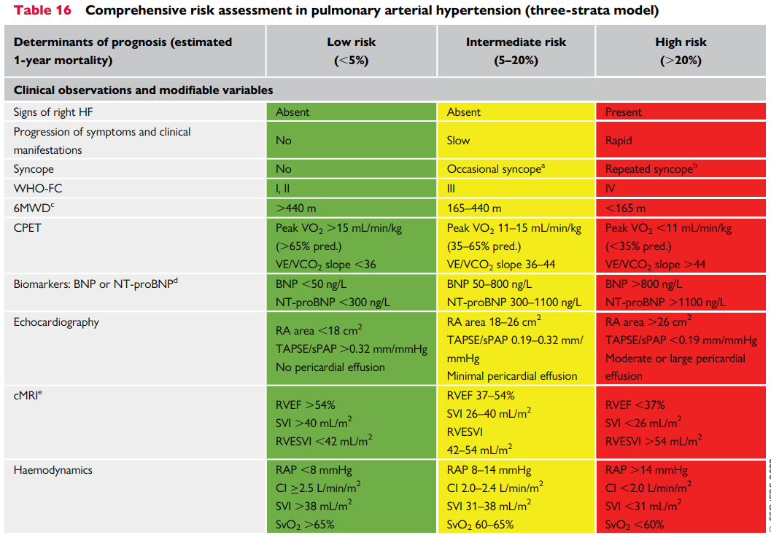
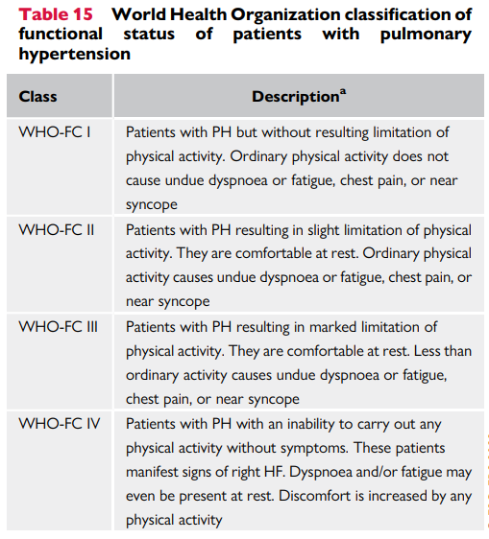
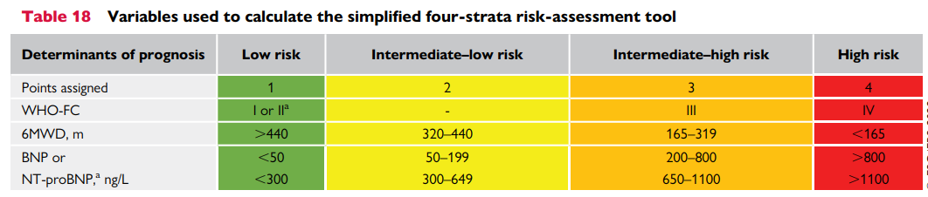

Slide 23
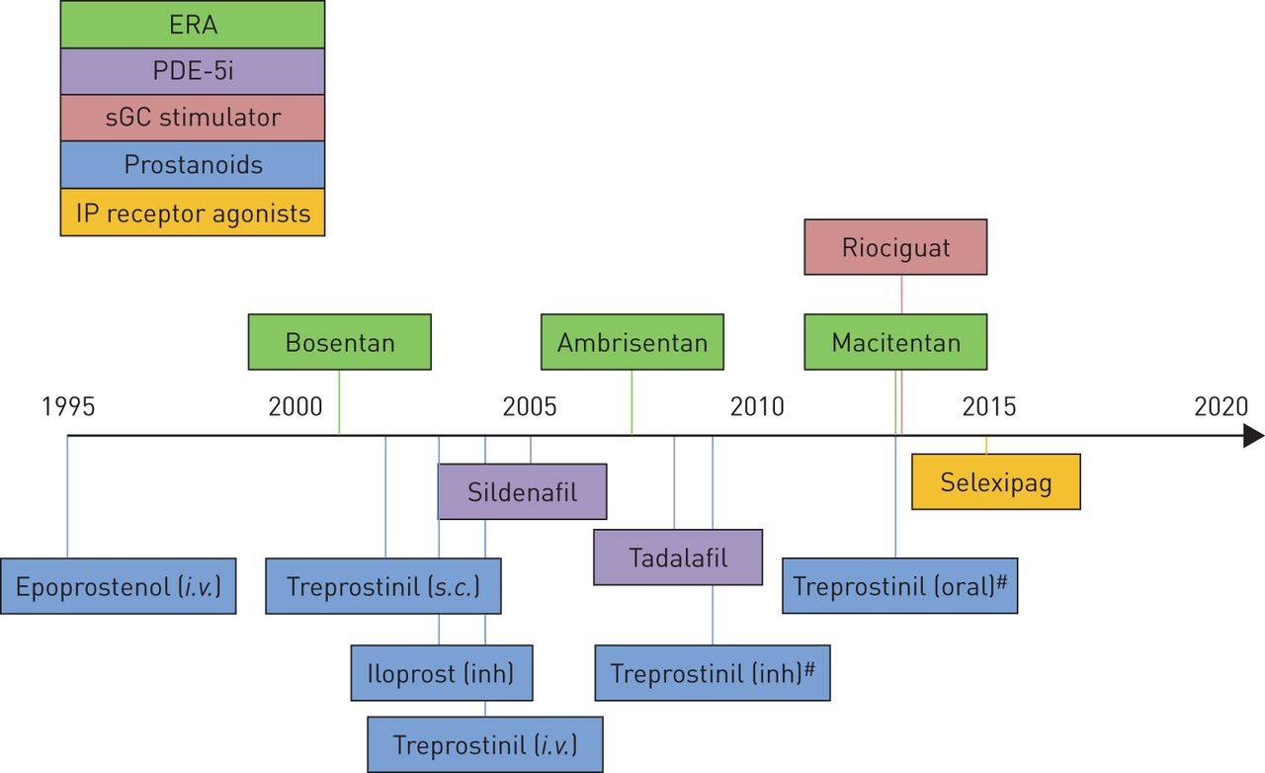
Timeline of approval of therapies for pulmonary arterial hypertension.
Sean Gaine, and Vallerie McLaughlin Eur Respir Rev 2017;26:170095
©2017 by European Respiratory Society
Notes:
Timeline of approval of therapies for pulmonary arterial hypertension. Therapies that are approved in the USA and/or European Union (EU) are included, positioned on the timeline based on the first date of their approval in either USA [2–4] or EU [5]. Therapies are administered orally unless otherwise indicated. ERA: endothelin receptor antagonist; PDE-5i: phosphodiesterase-5 inhibitor; sGC: soluble guanylate cyclase; inh: inhaled. #: not approved in the EU.

Slide 24
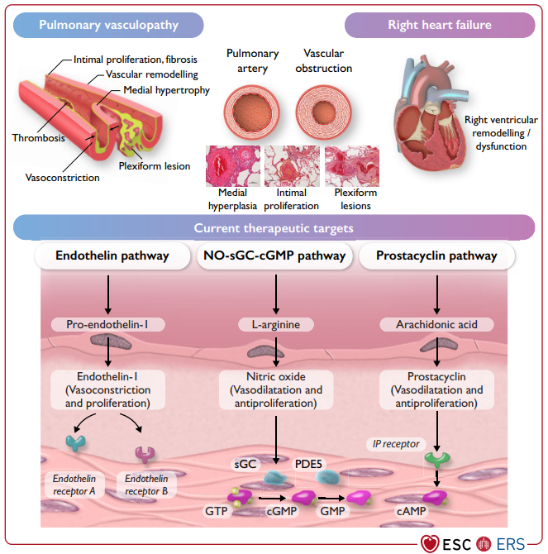
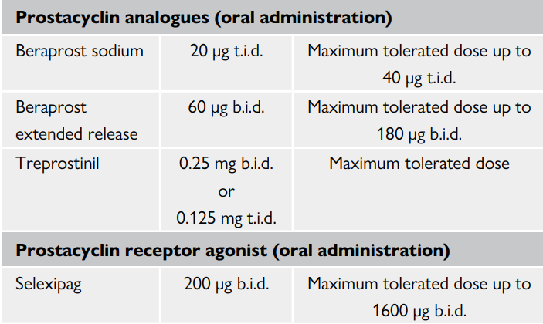
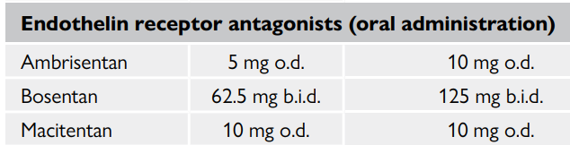
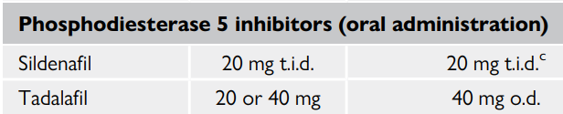


Slide 25
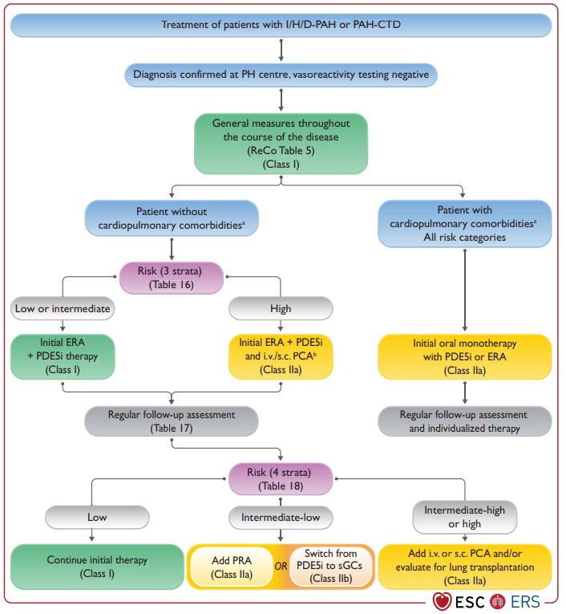
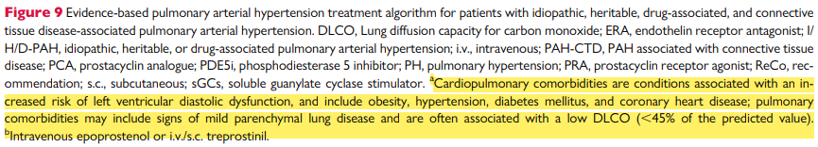

Slide 26
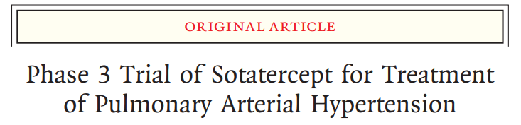
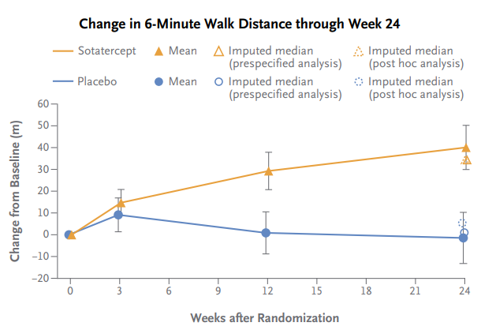
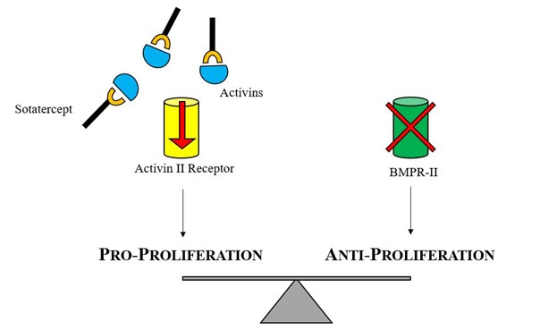
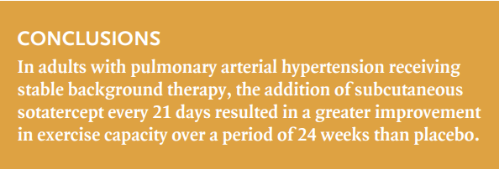
Sotatercept :
a fusion protein that traps activins and growth differentiation
Rebalancing toward vascular homeostasis
Notes:
N Engl J Med 2023; 388:1478-1490

Slide 27
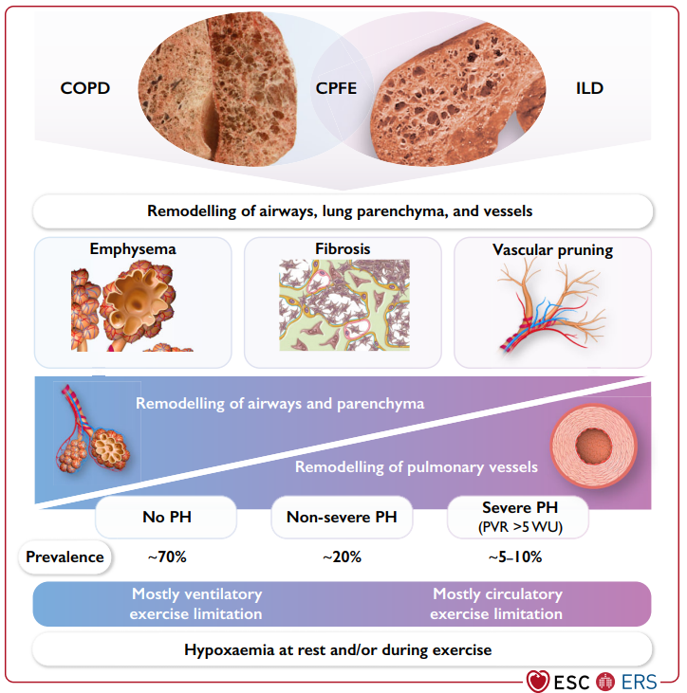

Slide 28
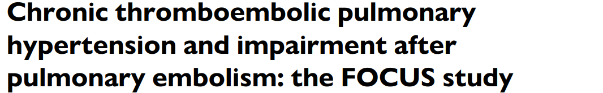

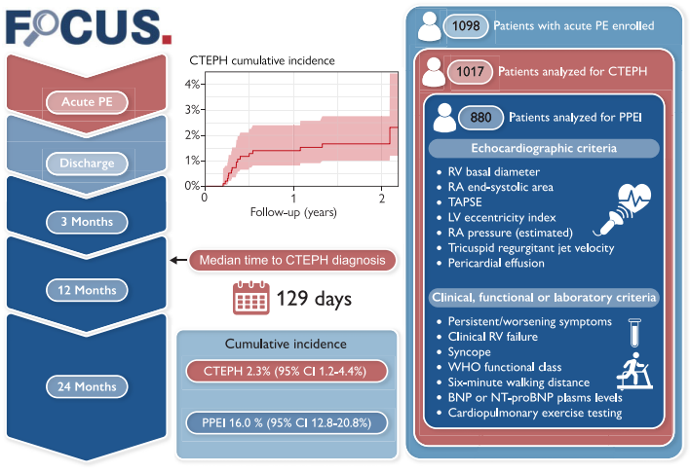
Notes:
PPEI, a combination of persistent or worsening clinical, functional, biochemical, and imaging parameters during follow-up.

Slide 29
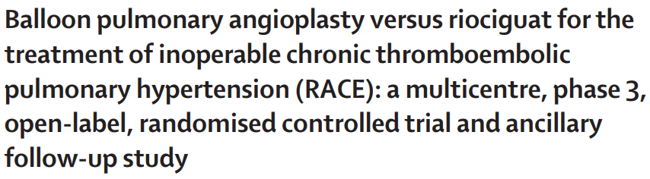

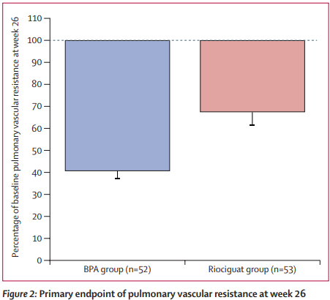
Patients with inoperable CTEPH
BPA group (n=52) vs. Riociguat group (n=53)
+ compare add-on BPA after 1st riociguat with
add-on riociguat after 1st BPA
Conclusion: Riociguat < BPA < Riociguat + BPA
But, More SAE with BPA 1st vs. riociguat 1st line (42% vs 14%, p=0.004)
→ Pretreatment with riociguat, then BPA !!
Notes:
patients with inoperable CTEPH

Slide 30
ILD
Progressive pulmonary fibrosis (PPF) criteria validation
Pirferidone in RA-ILD
Rituximab vs IV Cyclophosphamide in severe or progressive CTD associated ILD
Suspected ILD in the COPDGene study
Palliative care in ILD patients

Slide 31
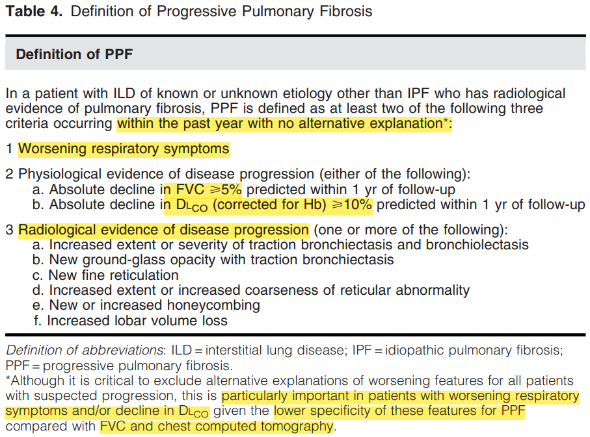
Am J Respir Crit Care Med Vol 205, Iss 9, pp e18–e47, May 1, 2022
Notes:
Am J Respir Crit Care Med Vol 205, Iss 9, pp e18–e47, May 1, 2022

Slide 32

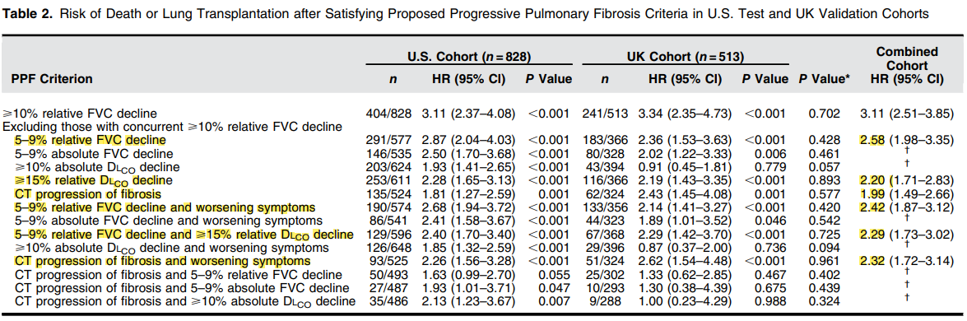


Slide 33
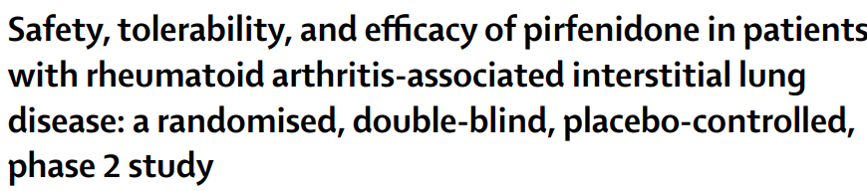



Patients with RA-ILD
Pirfenidone group (n=63) vs Placebo group (n=60)
Notes:
Pirfenidone group (n=63) Placebo group (n=60)

Slide 34



Patients aged 18–80 years with severe or progressive CTD-ILD, related to scleroderma, idiopathic inflammatory myositis, or mixed CTD
Determination of ILD progression or severity : left to individual investigators, with the guidance that patients should be those who would be considered for treatment with intravenous cyclophosphamide in routine clinical practice.
Cyclophosphamide group (n=50) vs. Rituximab group (n=51)
Primary endpoint : change in forced vital capacity (FVC) at 24 weeks compared with baseline
Notes:
primary endpoint was rate of change in forced vital capacity (FVC) at 24 weeks compared with baseline,

Slide 35

COPD
The Lancet Commission towards to elimination of the disease.
Key Areas
Overlapping risk factors: tombacco+ biomass +…
Insensitive diagnostic tools
Complex, Inadequate, unpredictable treatment
Risk/financial burden in lower income populations
Shortage of research fund
CAPTURE 2023 screening tool: not perform well
Asymptomatic COPD screening : Benefit and harm are minimal !!

Slide 36





Slide 37
COVID-19
Acute management: Awake prone positioning, Pegylated interferon lambda in high-risk COVID-19 patients
Post-acute sequelae: Vaccinations associated with a decrease in post-acute symptoms
Early
Critical care
Early mobilization
Early use of melatonin for delirium prevention: negative results

Slide 38



Interferon lambda: naturally produced type III interferons, which are an early line of defense in upper respiratory tract infections
Adult outpatients in Brazil and Canada who were at high risk for severe illness with a diagnosis of Covid-19
High-risk criterion : age ≥50 years, diabetes mellitus, and hypertension
The primary outcome : composite of Covid-19–related hospitalization (or referral to a tertiary hospital) or admission to an ED within 28 days after randomization.
Notes:
The primary outcome was a composite of Covid-19–related hospitalization (or referral to a tertiary hospital) or admission to an emergency department (ED) (observation for >6 hours) within 28 days after randomization.

Slide 39
Lung cancer
Traffic-related air pollution as an independent risk factor for lung cancer
Lung cancer screening : poor adherence especially for younger, male former smokers
Robotic-assited bronchoscopy
Treatment of Stage I Lung cancer : Segmentectomy is non-inferior and likely superior for treatment of small, peripheral lung cancers
Neoadjuvant immunotherapy for resectable lung cancer

Slide 40
Asthma
SMART > stepping up to to higher dose ICS-LABA treatment in patients with poorly controlled asthma
In terms of Greenhouse gas emission : pMDI < DPI
Exacerbation profile and risk factors in Type-2-Low severe asthma cohort
Sarcoidosis
Efzofitimod for the treatment of pulmonary sarcoidosis: safe and well tolerated

