Slide 1
7533829 ksy
Radiology
R4 YTJ

Slide 2
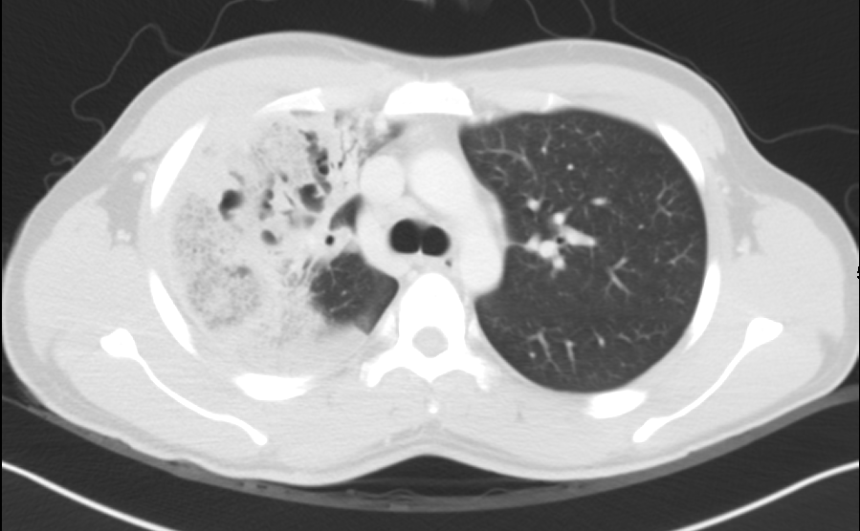
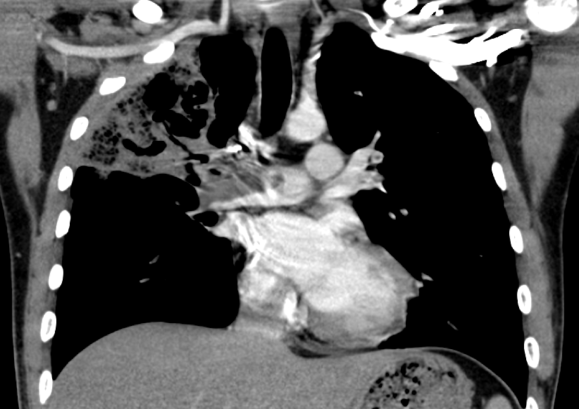
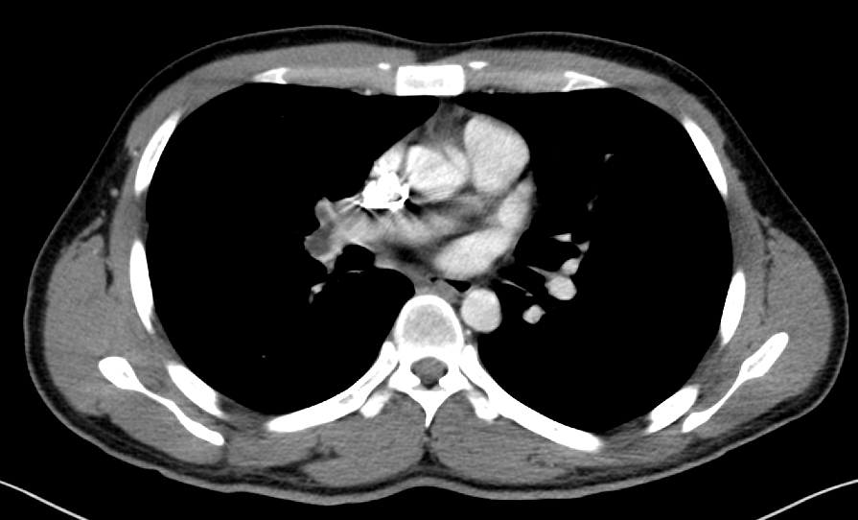
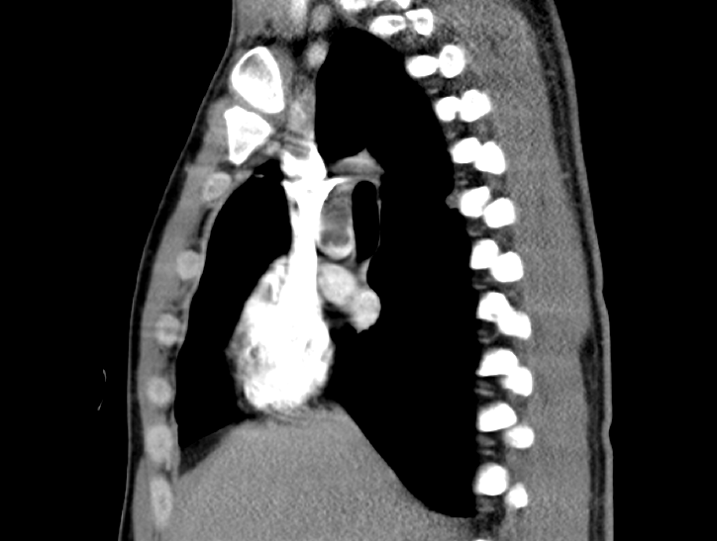
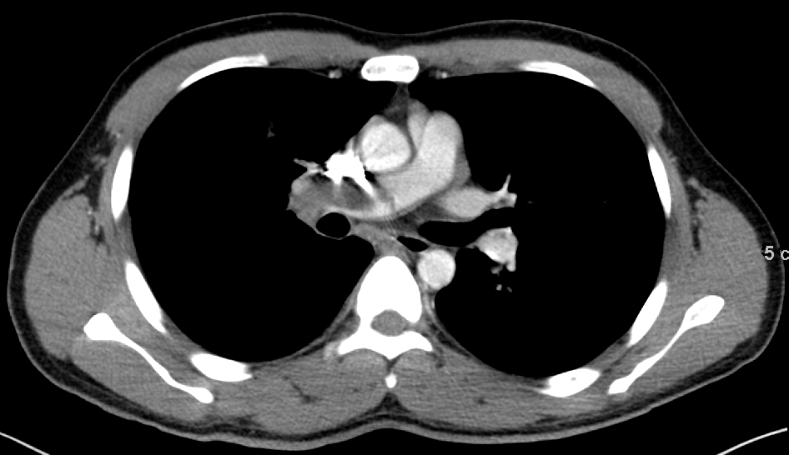
2012.07.23 outside CT
Notes:
CC: Hemoptysis.
Out-side CT taken on 2012.07.23
Filling defect in the right main pulmonary artery and secondary branches.
Tubular bronchiectasis and pleural thickening in the right upper lobe with combined GGO and consolidation.
2.6 cm consolidation/nodule in the right lower posterior subplueral area.
Several small LNs in mediastinum.
No evidence of pleural effusion.
Included upper abdomen is not remarkable.
IMP) 1. Pulmonary thromboembolism, right main and secondary pulmonary artery.
2. Underlying tubular bronchiectasis combined with bronchopneumonia/bronchitis in right upper lobe.
3. Nonspecific subpleural consolidation/nodule, r/o organizing pneumonia.

Slide 3
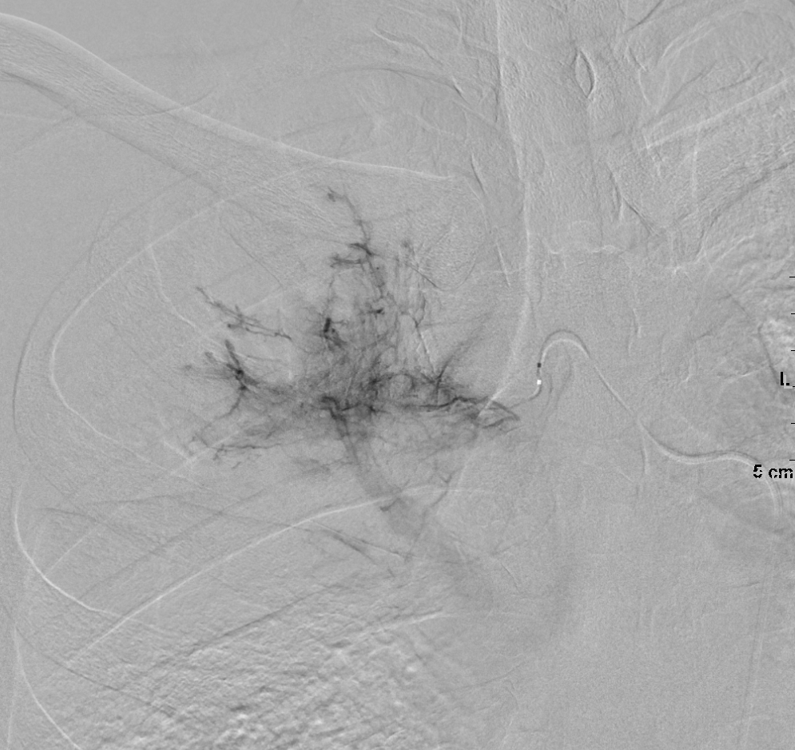
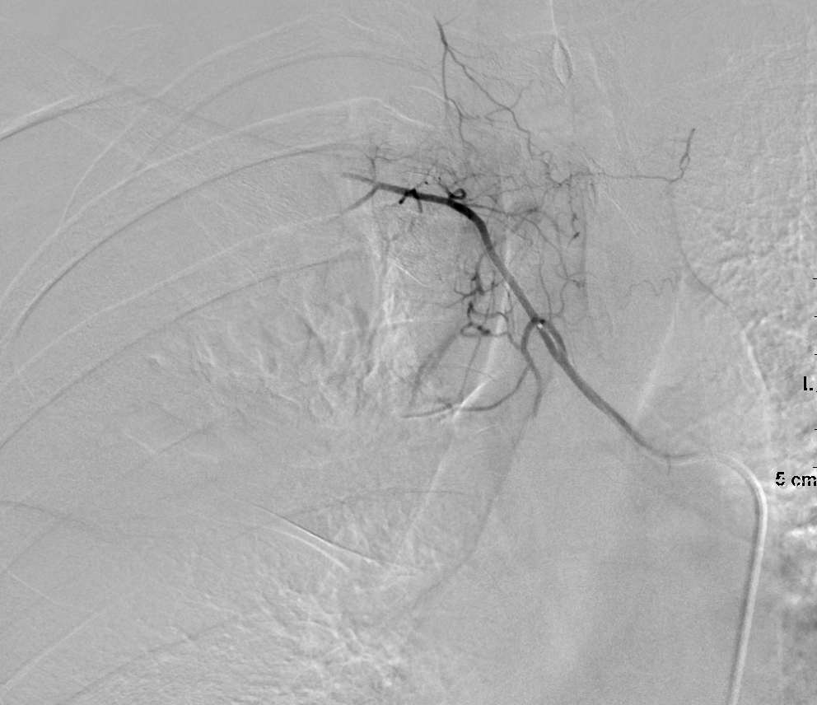
2012.07.25 bronchial artery embolization
Notes:
<Bronchial artery embolization note>
Lt. CFA에 5F sheath를 삽입 후 5F Shepherd hook catheter로 descending thoracic aortography and Rt. subclavian arteriography를 시행함.
Findings ;
Rt. upper lobe을 supply하는 bronchial artery에 hypertrophy가 관찰됨.
Treatment ;
Microcatheter로 Rt. upper lung을 supply하는 bronchial artery를 selection하여 PVA particle 355-500um로 embolization을 시행함.
Lt. CFA의 puncture site는 perclose로 closure를 시행함.

Slide 4
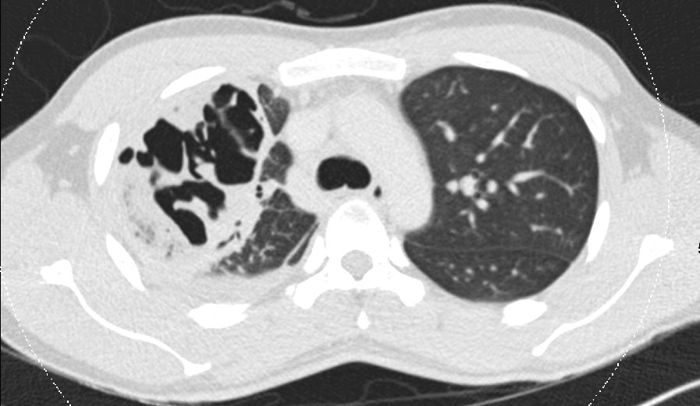
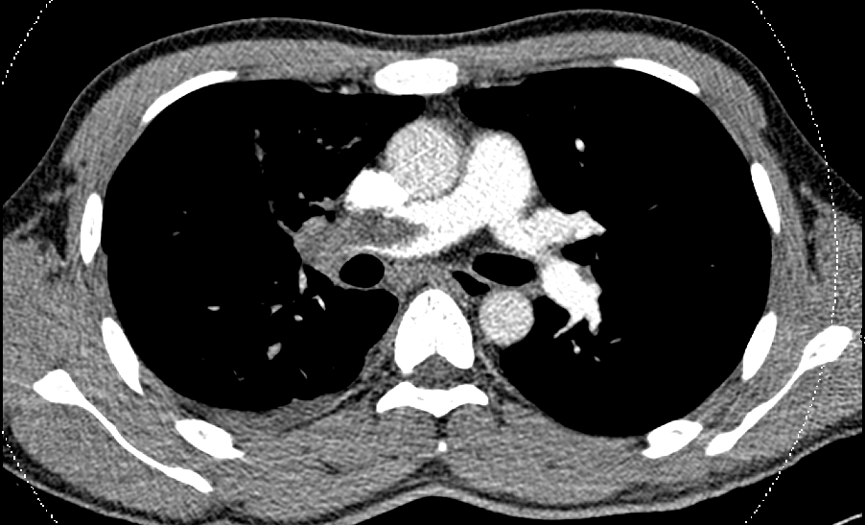
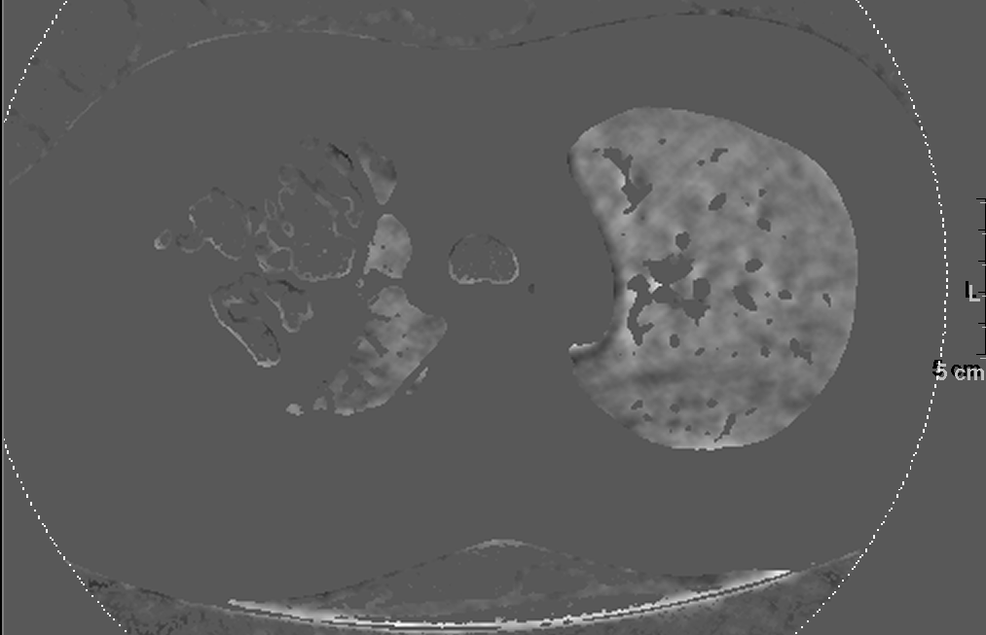
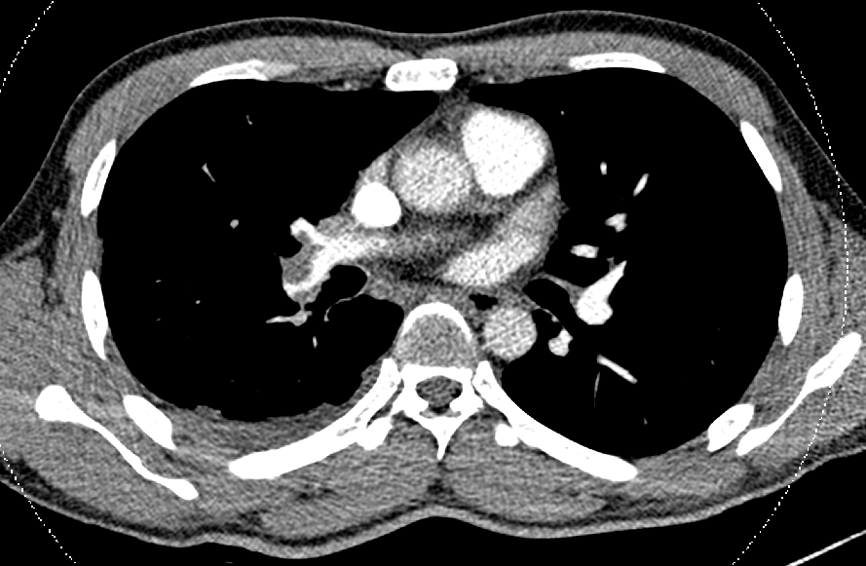
2012.08.02 CT
Notes:
Hx. DVT, pulmonary thromboembolism, pneumonia 로 입원치료중
Compared with the previous outside CT scan dated on 2012-07-23,
No significant interval change of thromboembolism in Rt. main, RLL and LLL lobar pulmonary arteries.
Newly appearing Rt. pleural effusion.
No change in the huge cavitary lesion with consoldiation in RUL
Newly appeared multiple ill-defined centrilobular GGO and nodules in both lungs.
IMP: 1. No significant interval change of thromboembolism in Rt. main, RLL and LLL lobar pulmonary arteries.
2. Likely pulmonary infarction in the RUL, no significant interval change.
3. r/o combined bronchiolitis in both lungs.

Slide 5
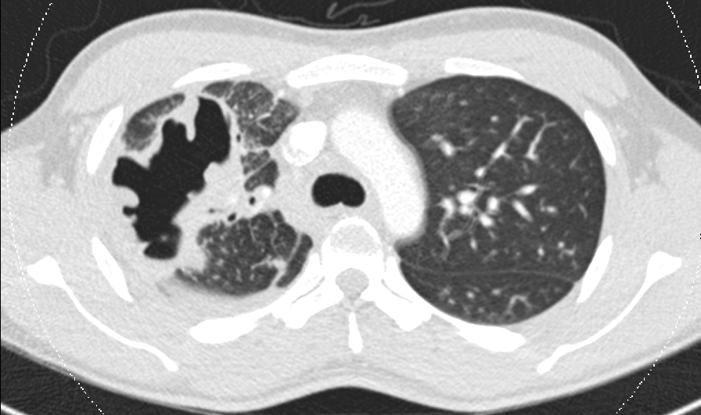
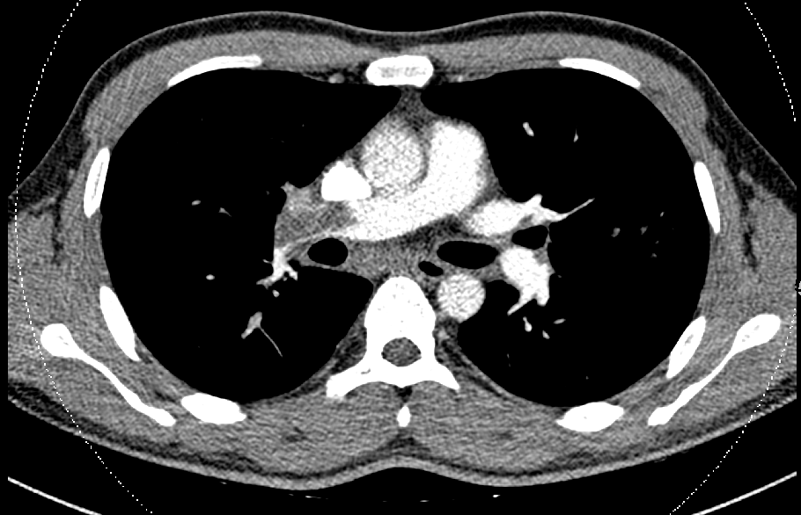
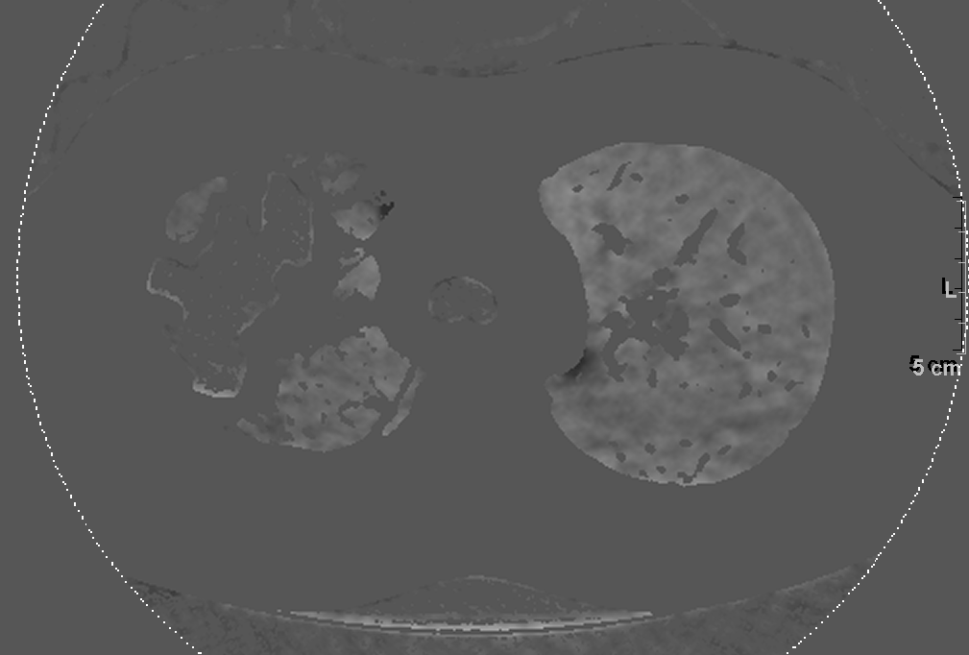
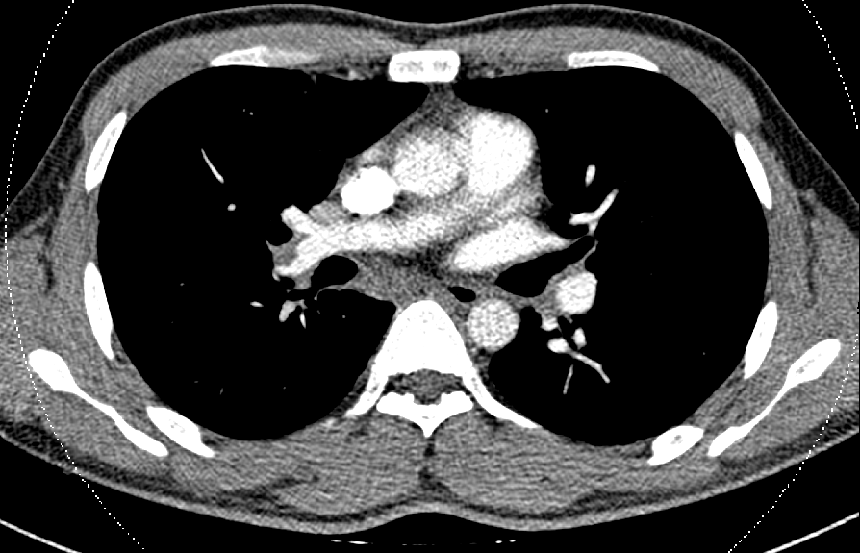
2012.08.11 CT
Notes:
Hx. DVT, pulmonary thromboembolism, pneumonia 로 입원치료중
C.C. Fever
Compared with the previous CT scan dated on 2012-08-02,
No significant interval change of thromboembolism in Rt. main, RLL lobar pulmonary arteries.
No significant interval change of the huge cavitary lesion combined with consolidation in RUL, but aggravation of multiple ill-defined centrilobular GGO and nodules in both lungs.
No change in subpleural nodule or consolidation in RLL posterior basal segment.
Resolved Rt. pleural effusion.
IMP: 1. No significant interval change of thromboembolism in Rt. main, RLL lobar pulmonary arteries, probably combined with lung infarction with infection.

Slide 6
07. 23
08. 02
08. 02
08. 11
08. 11

