Slide 1
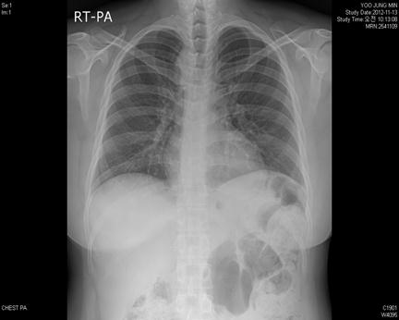
유O민, F/40, 2541109, Rt aortic arch

Slide 2
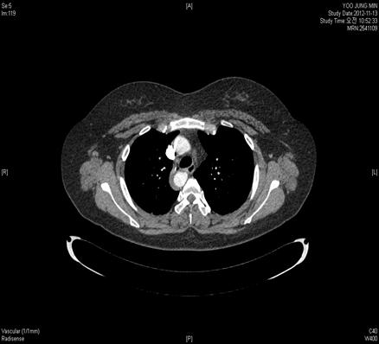
유O민, F/40, 2541109, Rt aortic arch

