Slide 1
Chest Conference
Department of Pathology

Slide 2
SS12-44586
7533829 김O열 M/31

Slide 3
Right upper lobe

Slide 4
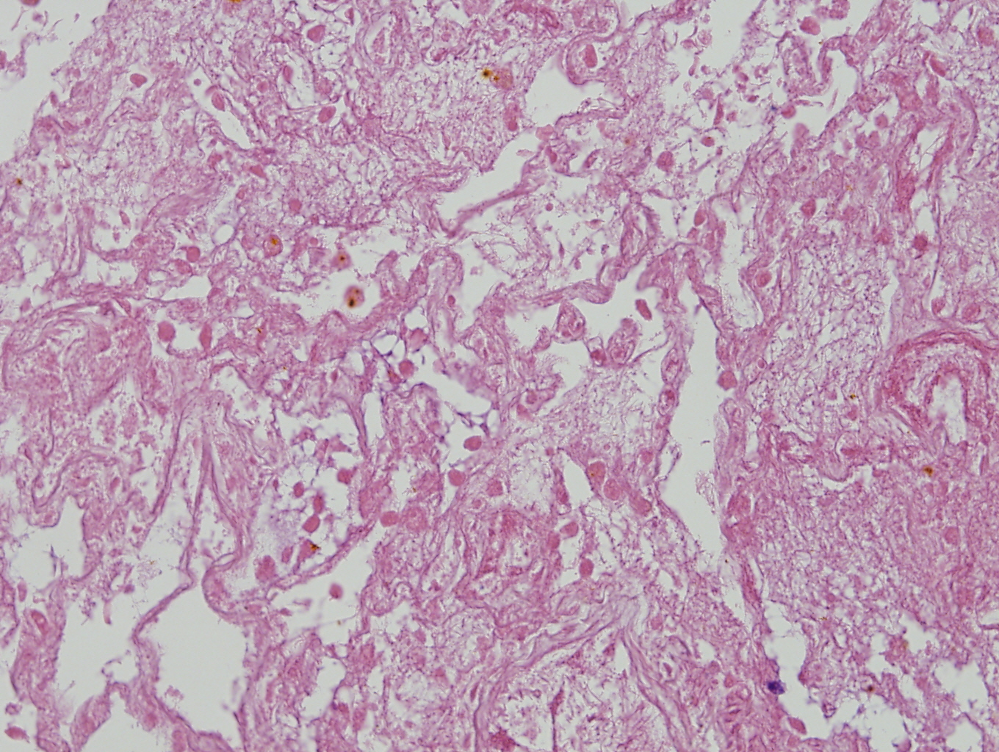
Ischemic necrosis

Slide 5
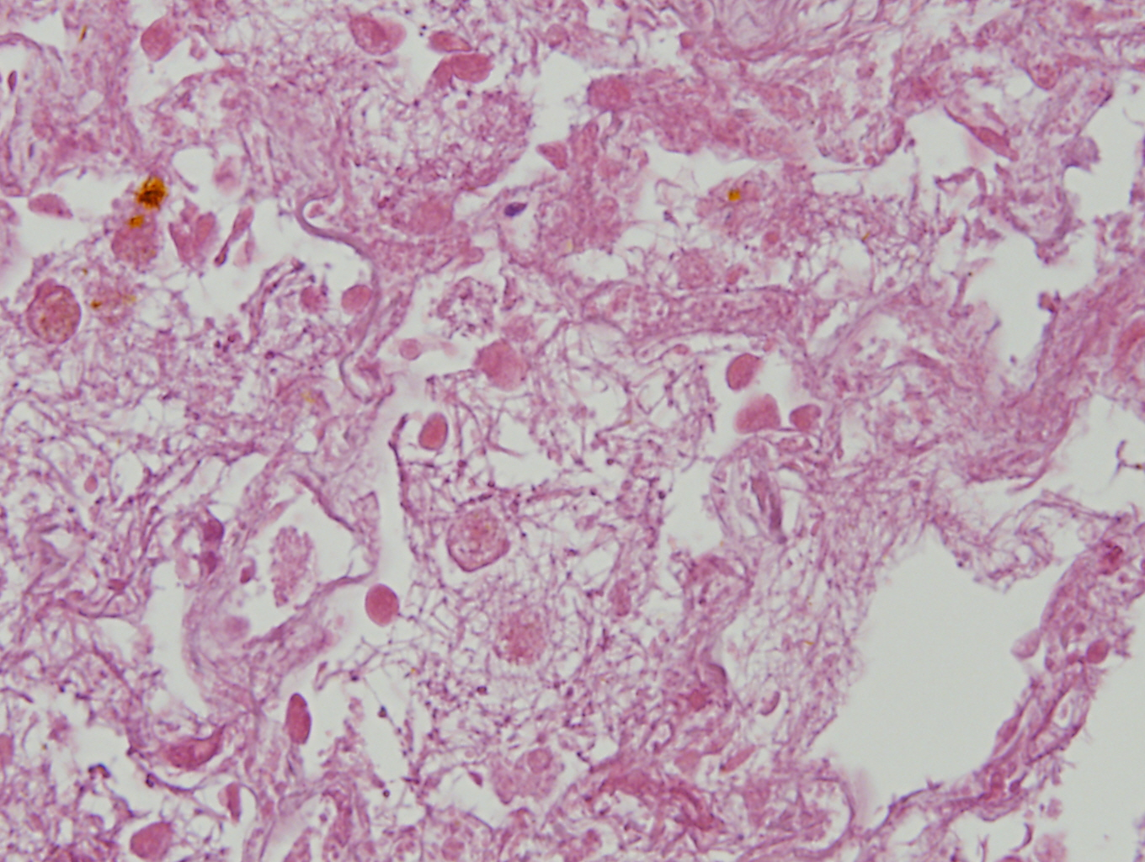

Slide 6
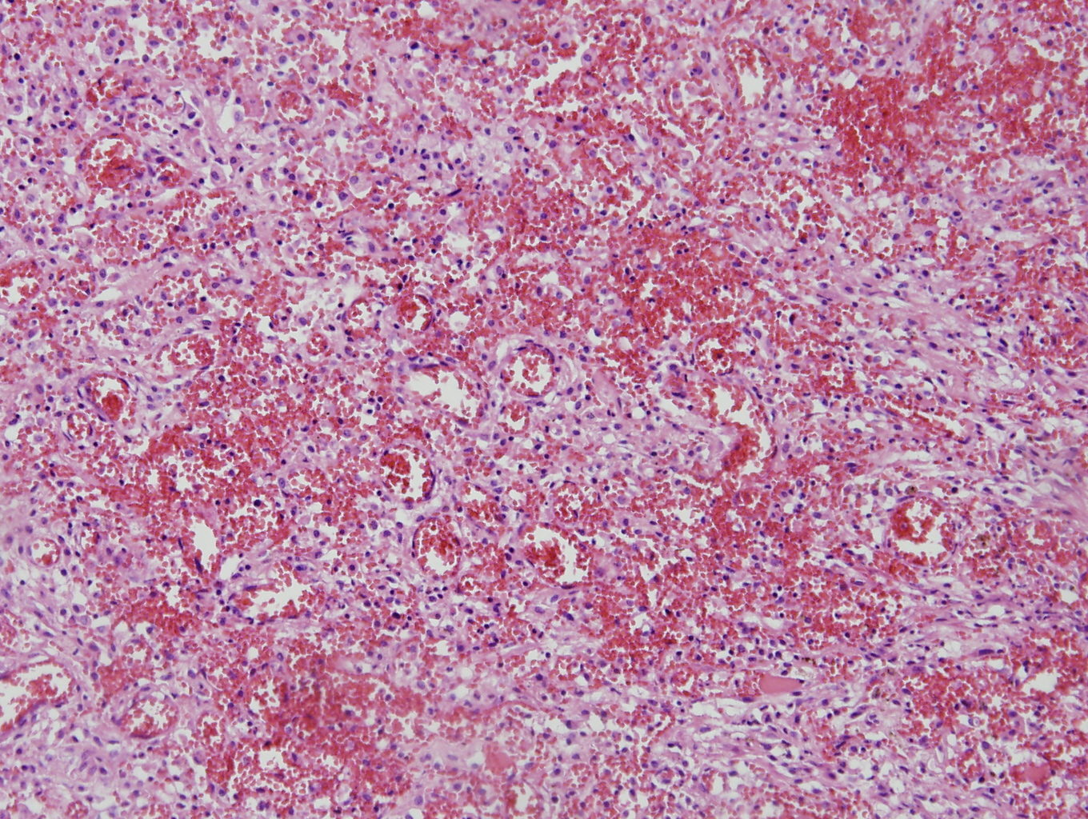
Congestion

Slide 7
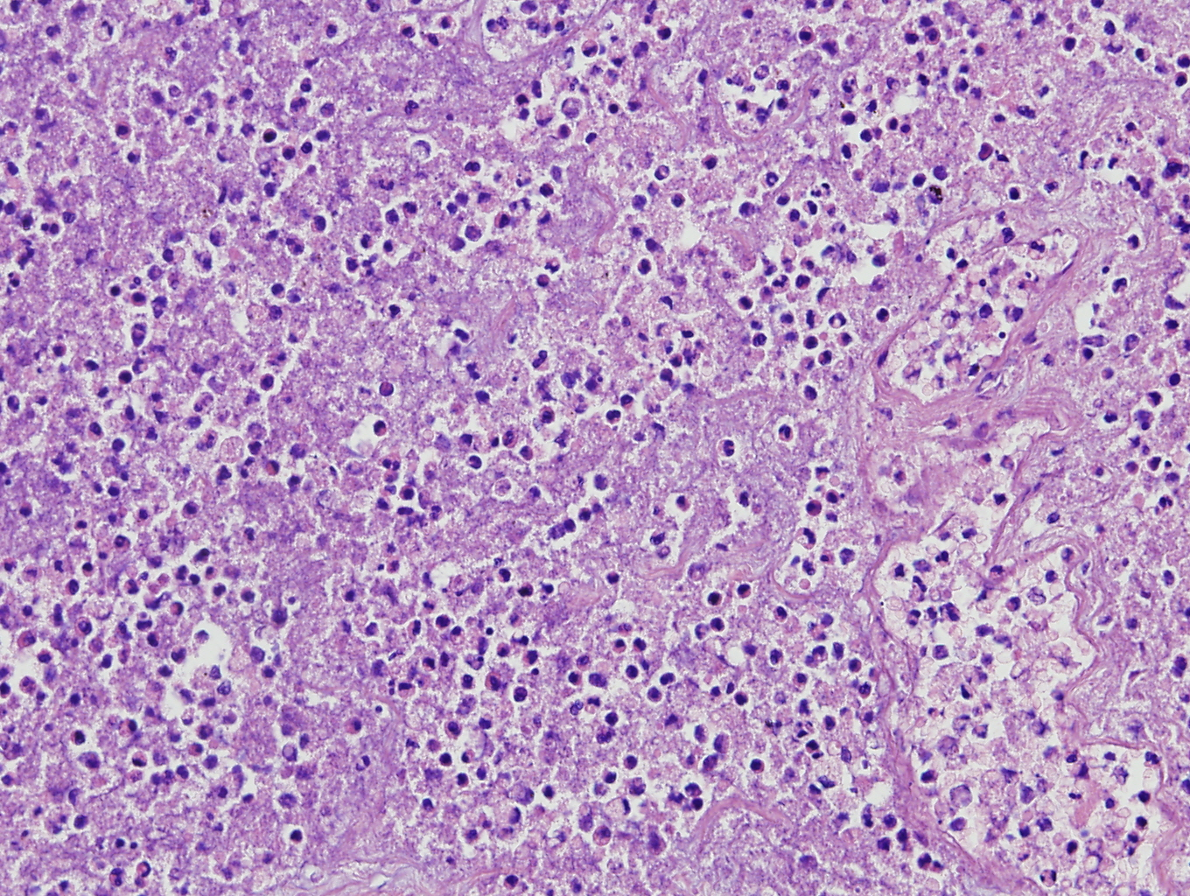
Inflammation

Slide 8
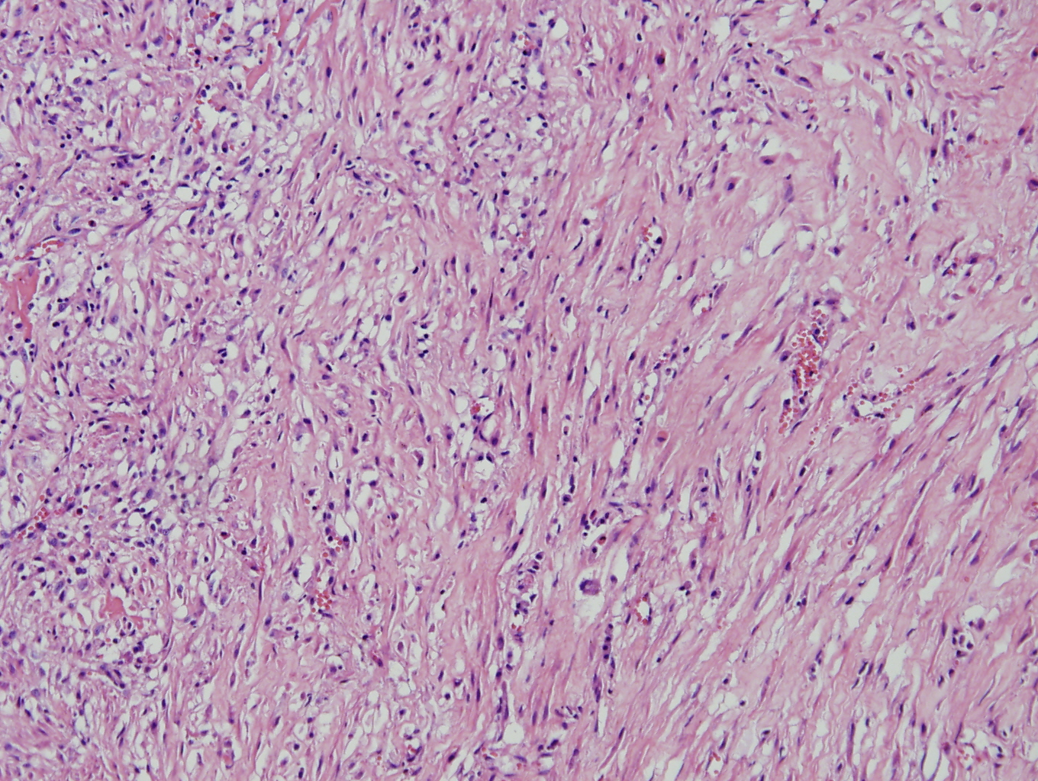
fibrosis

Slide 9
Right lower lobe

Slide 10
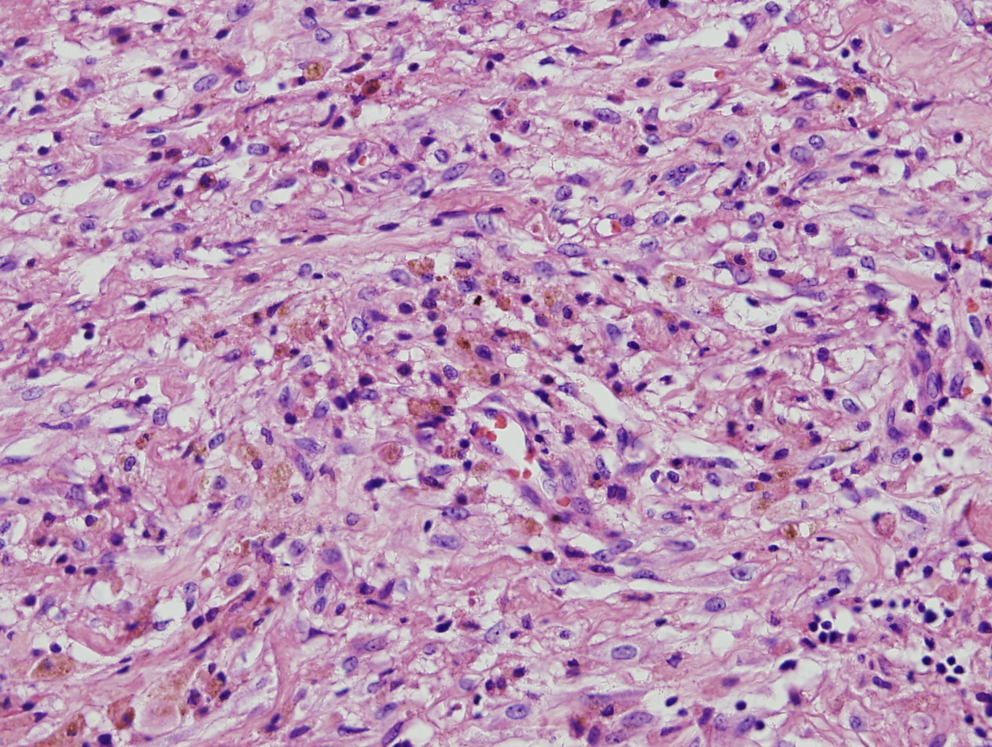

Slide 11
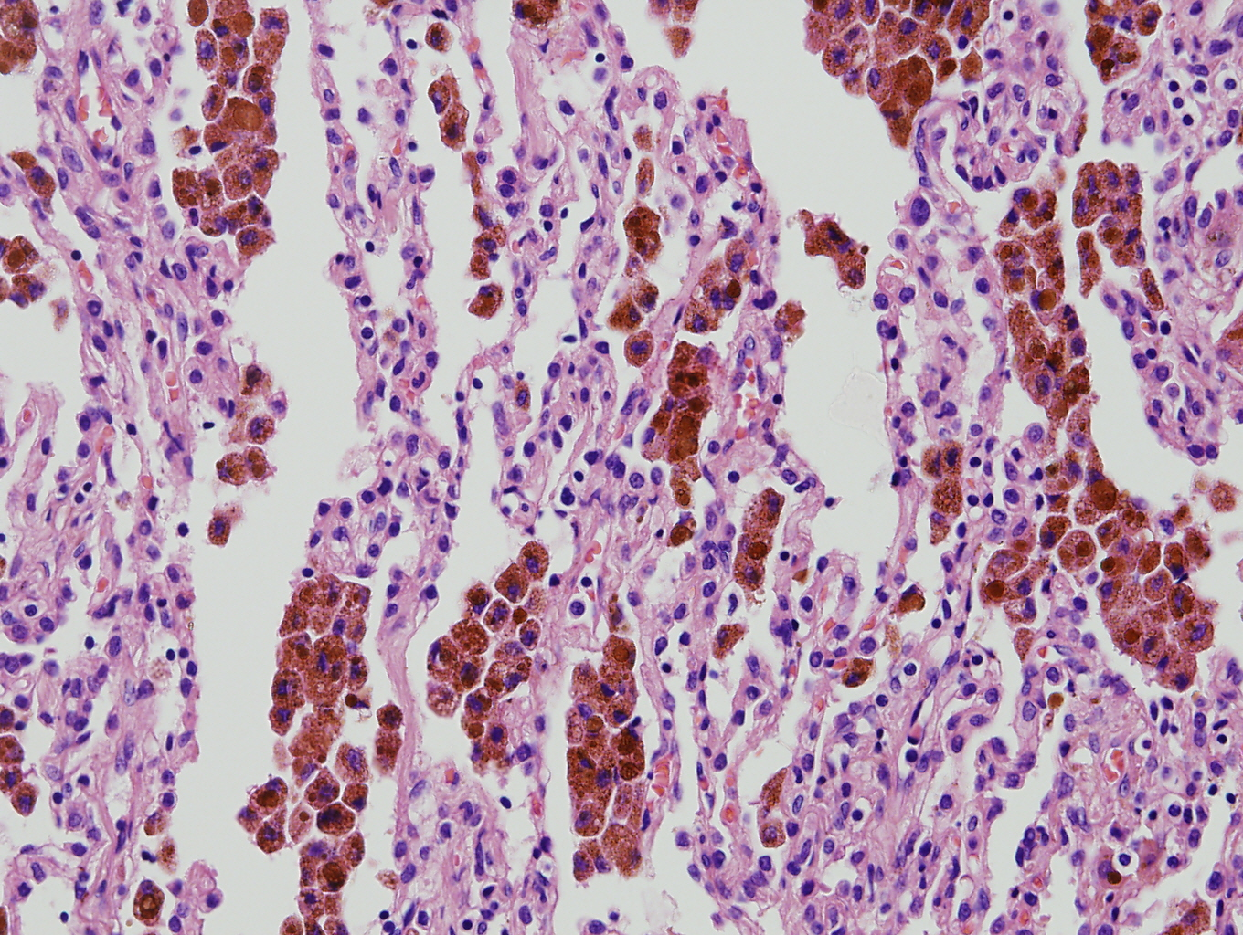

Slide 12
Right middle lobe

Slide 13
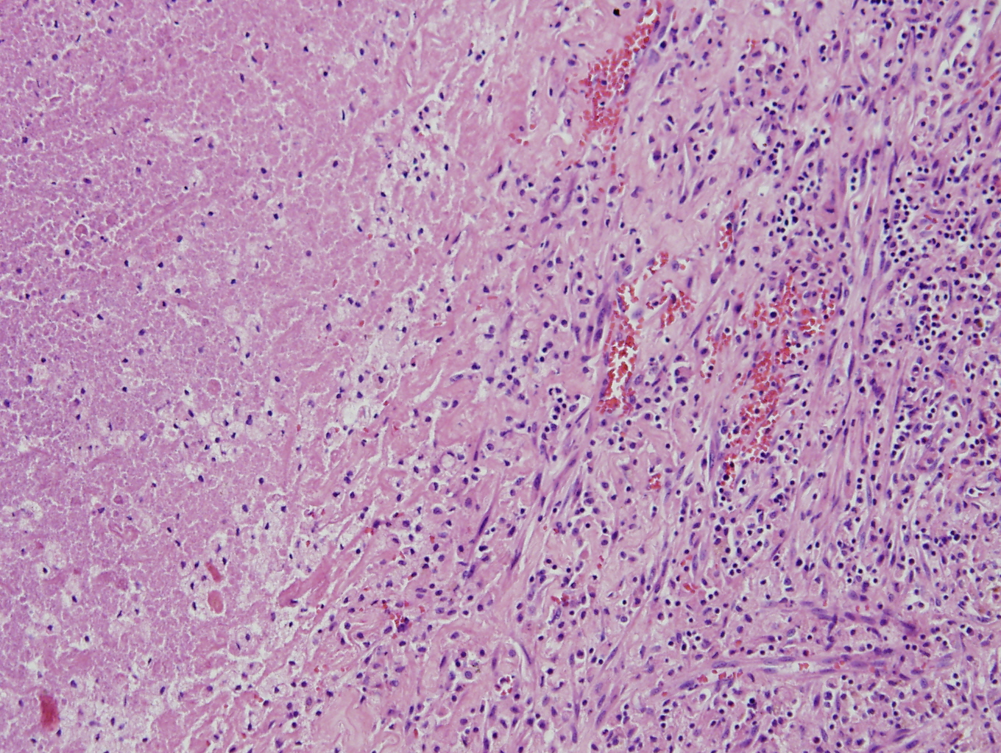

Slide 14
Lung, right upper lobe:
Infarction with inflammation and fibrosis, accompanied with
bronchiectasia and organizing pneumonia
Lung, right lower lobe:
Infarction with hemosiderin deposition
Lung, right middle lobe:
Infarction with inflammation
Lymph node, labeled upper lobar:
Focal infarction
Soft tissue, labeld parietal pleura:
Fibrosis with chronic inflammation

