Slide 1
Case discussion

Slide 2
7515324 길O숙 F/56
cheif complain
: Fever, increased size of mass lesion in lung
MR, s/p MVR (2009)
Cerebellar infarction (2011.7)
ICH (2011.7)
Infective endocarditis (2011.12)
SICMP (2012.6)

Slide 3
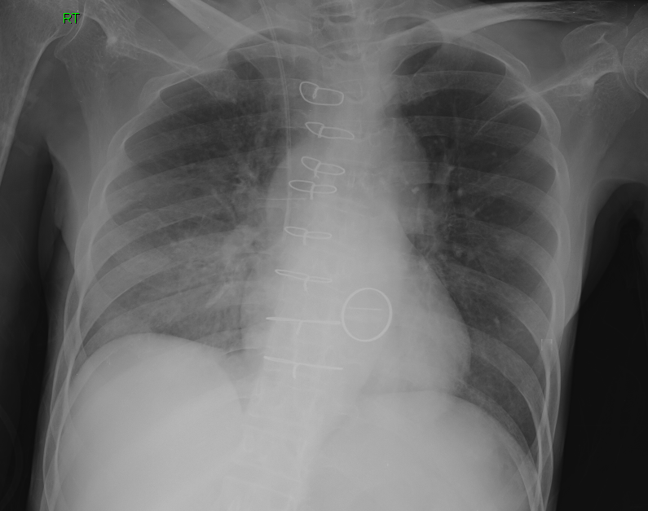
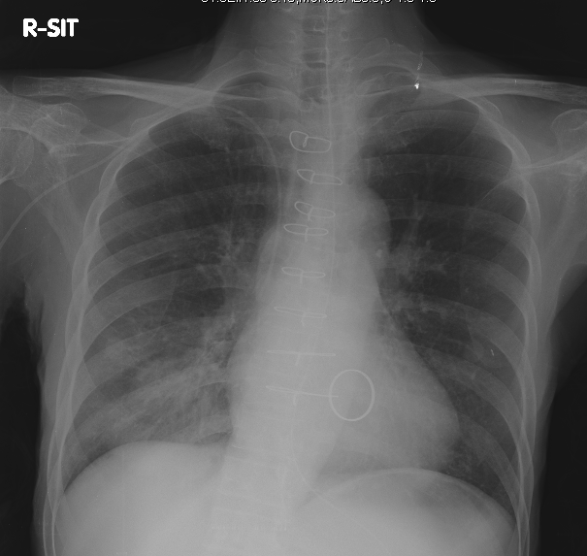
7515324 길O숙 F/56
image
2012.6.21
2012.7.23

Slide 4
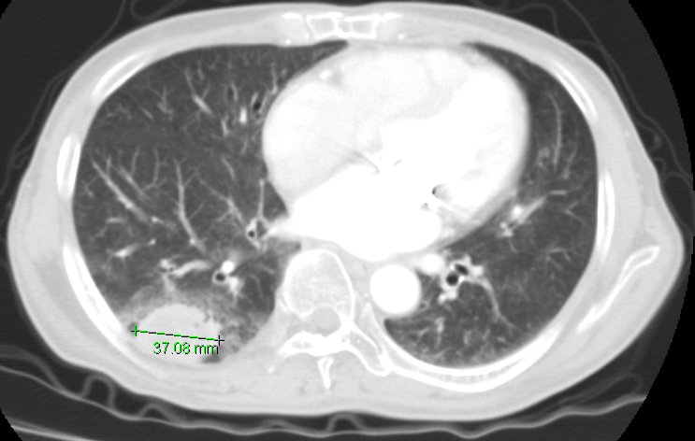
7515324 길O숙 F/56
image
2012.4.23
Notes:
Hx: fever, r/o pneumonia, s/p MVR
외부 병원에서 시행한 2012.04.23 chest CT,
Mass like consolidation with internal necrosis, surrounding GGO and small nodules at RLL posterior basal segment.
Borderline sized LNs at Rt. hilar and paratracheal area, likely reactive LNs.
IMP> r/o infectious condition, such as pneumonia fungal infection, actinomycosis.
ddx) primary lung cancer.
Rec) Biopsy correlation.

Slide 5
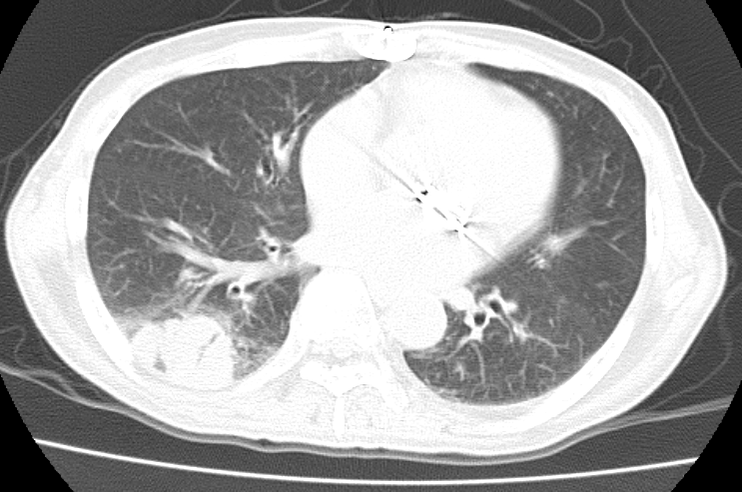
7515324 길O숙 F/56
image
2012.5.9
Notes:
Hx: fever, r/o pneumonia, s/p MVR
Out-hospital chest CT taken on 2012.05.09
Compared with previous CT taken on 2012.04.23,
Increase in size of mass like consolidation (3.7cm --> 4.3cm) with internal necrosis, surrounding GGO and small nodules at RLL posterior basal segment.
No remarkable change of borderline sized LNs at Rt. hilar and paratracheal area, likely reactive LNs.
Resolution of small amount of pleural effusion, Rt.
IMP> r/o infectious condition, such as fungal infection, actinomycosis.
ddx) primary lung cancer.
Rec) Biopsy correlation.

Slide 6
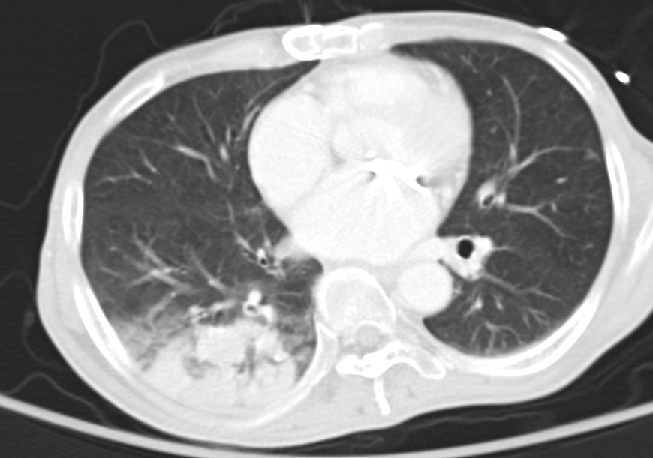
7515324 길O숙 F/56
image
2012.6.21
Notes:
Hx : Fever, Old CVA.
1. Aggravated pneumonia in RLL. ddx. antinomycosis.
- aggravated consolidation in RLL with surrounding GGO and adjacent pleural thickening.
2. Multisegmental bronchiectasis in both lungs.
Several benign calcified/non-calcified granulomas in Lt lung.
No pathologic LNs in both mediastinum and hilum
No pleural effusion.

Slide 7
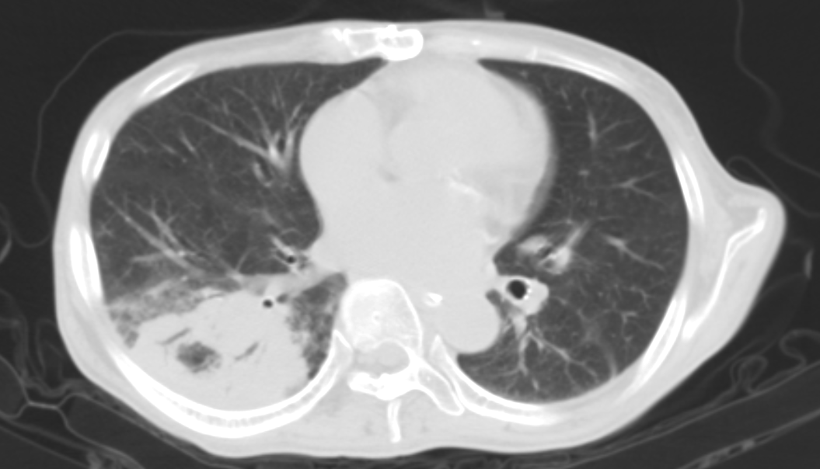
7515324 길O숙 F/56
image
2012.7.9
Notes:
Hx: S/P MVR(2009.7), 2011.5 cerebellar infarction, ICH
2011.겨울 infective endocarditis로 1개월간 항생제 치료, intermittent fever,
Noncontrast CT;
Compared to serial prior chest CTs,
Further enlarged mass-like consolidation(6.8cm in diameter) with surrounding GGO in RLL.
Small amount of Rt pleural effusion.
Borderline sized mediastinal LNs.
IMP: Progression of RLL mass-like consolidation, more likely lung cancer
- DDx. chronic pneumonia

Slide 8
7515324 길O숙 F/56
Lab
: CEA 3.23 (0.0~5.0ng/mL)
: CYFRA 21-1 1.82 (0~3.3ng.mL)
Lung,right, gun biopsy (2012.7.13)
: Dense lymphoplasmacytic infiltration
Special and immunohistochemical staining result
-DPAS: no identifiable fungal organism
-IgG: diffuse positive
-IgG4: negative (no evidence of IgG4-related disease)

Slide 9
7515324 길O숙 F/56
impression
: RLL consolidation
r/o pneumonia
r/o lung cancer
r/o actinomycosis

Slide 10
7515324 길O숙 F/56
diagnosis access
: 2012.7.26 biopsy with VATS 예정.

Slide 11
7515324 길O숙 F/56
final diagnosis

Slide 12
7515324 길O숙 F/56
conclusion

Slide 13
2676209 홍O영 F/34
cheif complain
: miliary TBc 의심하에 HERZ (12.5.16~) 하였으나 CXR상 변화 없음.
자녀가 tuberous sclerosis

Slide 14
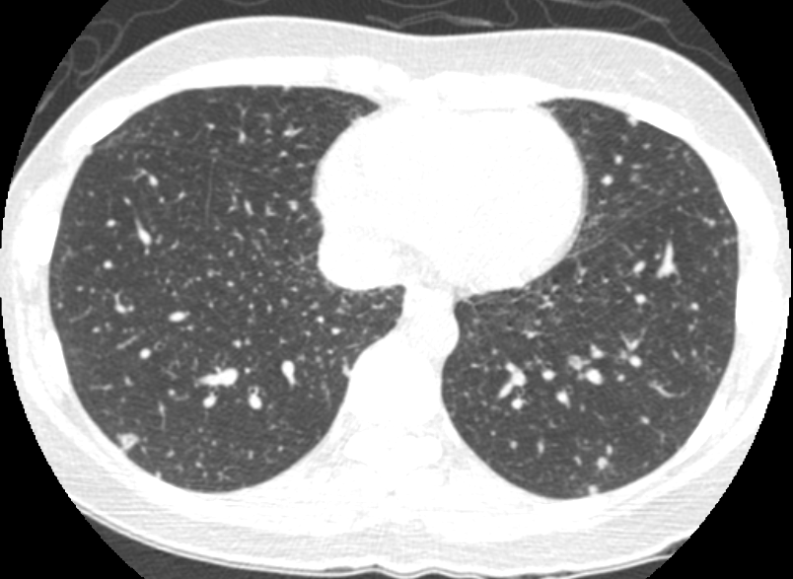
2676209 홍O영 F/34
Image
2012.5.11
Notes:
CC: 검진 CXR상 abnormal CXR. (자녀:tuberous sclerosis)
Innumerable small lung nodules scattered in both entire lungs. R/O miliary TBc.
A lobular consolidation in RLL posterior segment, inflammatory in origin.
No lymph node enlargement on hilum, mediastinum and supraclavicular fossa.
IMP) R/O miliary TBc.

Slide 15
2676209 홍O영 F/34
Lab
: Mycobacterium culture(액체배지법) No growth for 6 weeks
: Mycobacterium culture(고체배지법) No growth for 8 weeks
: AFB fluorescent smear Negative
Duchenne's Muscular Dystrophy (DMD) : pending

Slide 16
2676209 홍O영 F/34
Impression
: R/O Miliary tuberculosis

Slide 17
2676209 홍O영 F/34
diagnosis access
: Lung, right upper lobe, transbronchial lung biopsy : Chronic nonspecific inflammation
: Lung biopsy under VATS, RLL and RML : : Multifocal micronodular pneumocyte hyperplasia

Slide 18
2676209 홍O영 F/34
final diagnosis
: Multifocal micronodular pneumocyte hyperplasia

Slide 19
2676209 홍O영 F/34
conclusion

