Slide 1




Acute Respiratory Distress Syndrome
The Berlin Definition
JAMA.2012;307(23):2526-2533
The ARDS Definition Task Force*
강사 송주한

Slide 2
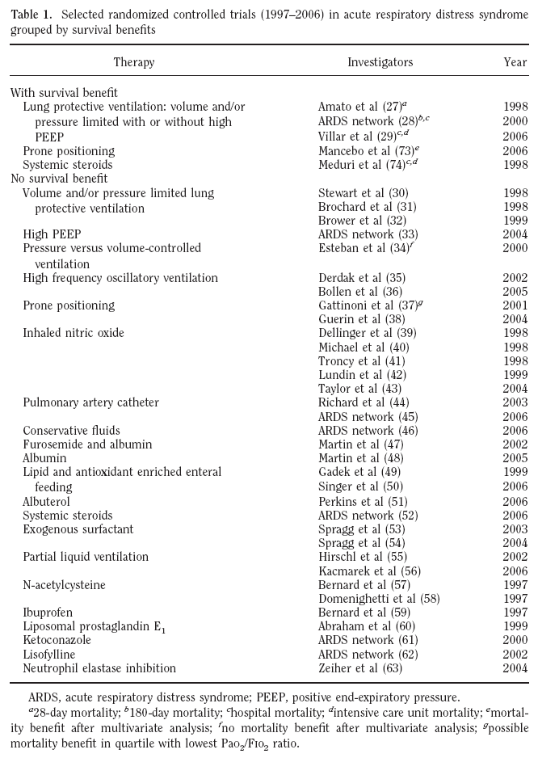
Trials with survival benefit
Trials with no survival benefit
1) ineffective interventions
2) broad definition of ARDS with heterogeneous group of patients
  Phua J, Stewart TE, Ferguson ND. Crit Care Med. 2008;36(10):2912-2921

Slide 3
<BACKGROUND>
Laennec’s 1821 description of “idiopathic anasarca of the lungs”
Initial description of acute respiratory distress syndrome
  12 patients with acute respiratory distress, cyanosis refractory to oxygen therapy, decreased lung compliance and diffuse infiltrates on the chest X-ray
    Ashbaugh et al Acute respiratory distress in adults, Lancet.1967
The development of the lung injury score by Murray and colleagues in 1988
  An expanded definition of the adult respiratory distress syndrome.
  Murray JF, Matthay MA, Luce JM, et al: Am Rev Respir Dis 1988; 138:720–723

Slide 4
<BACKGROUND>
American-European Consensus Conference(AECC) definition in 1994
  Acute onset of hypoxemia (PaO2/FiO2≤ 200mmHg)
  Bilateral infiltrates on frontal chest radiography
  PAOP≤18 mmHg when measured, or no evidence of left atrial hypertension
  ALI, a new overarching entity(PaO2/FiO2 ≤ 300 mmHg)
    Bernard GR et al. The American-European Consensus Conference on ARDS: definitions, mechanisms, relevant outcomes, and clinical trial coordination. AmJ Respir Crit Care Med. 1994; 149(3 pt 1):818-824

Slide 5
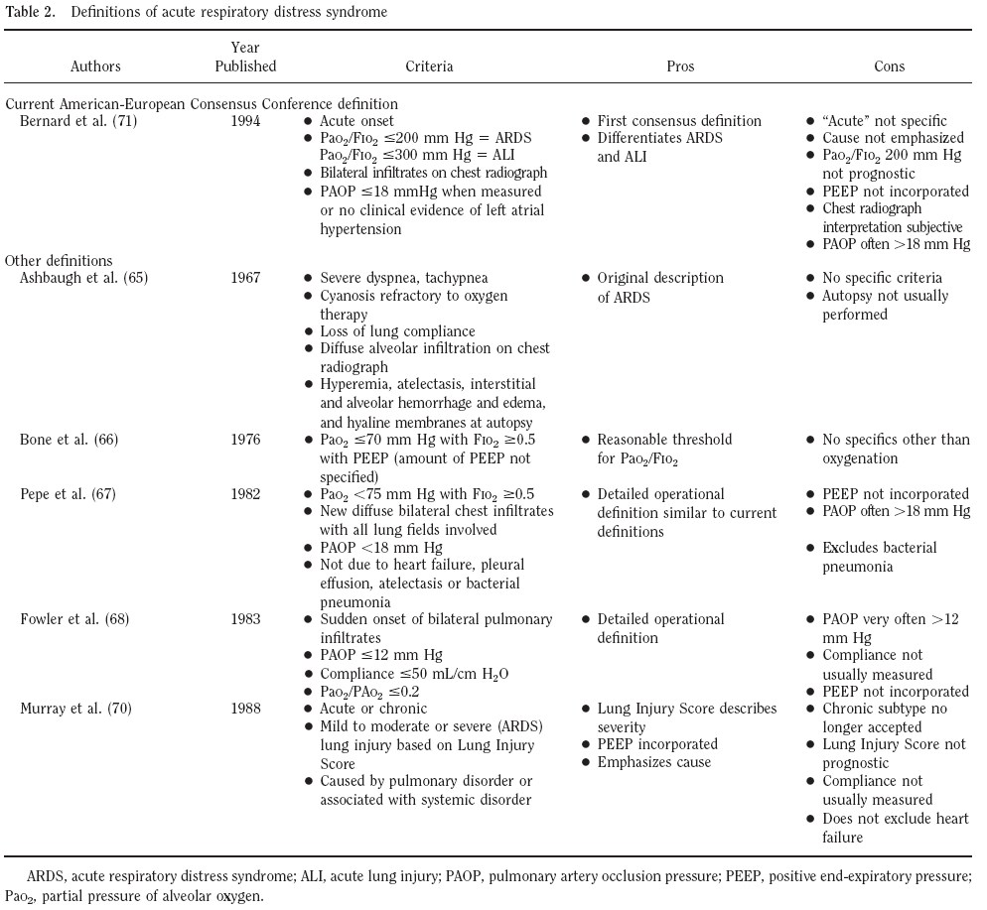
  Phua J, Stewart TE, Ferguson ND. Acute respiratory distress syndrome 40 years later: time to revisit its definition. Crit Care Med. 2008;36(10):2912-2921

Slide 6
<OBJECTIVES>
Update the definition using new data (epidemiological, physiological, and clinical trials)
Address the current limitations of the AECC definition
Explore other defining variables

Slide 7
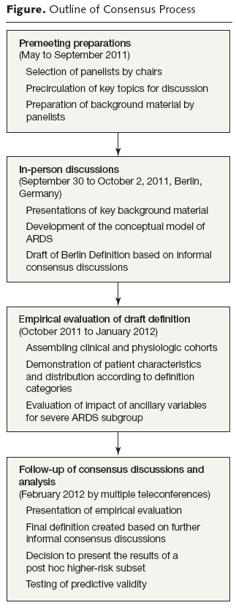
<METHODS>

Slide 8
CONSENSUS PROCESS
Emphasize
  Feasibility
  Reliability
  Face validity
    How clinicians recognize ARDS
  Predictive validity
    Ability to predict response to therapy, outcomes
    or both

Slide 9
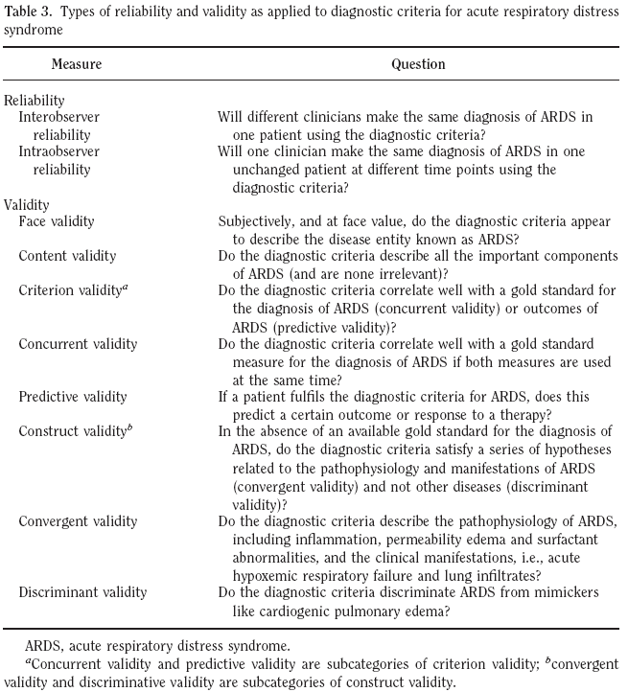
  Phua J, Stewart TE, Ferguson ND. Crit Care Med. 2008;36(10):2912-2921

Slide 10
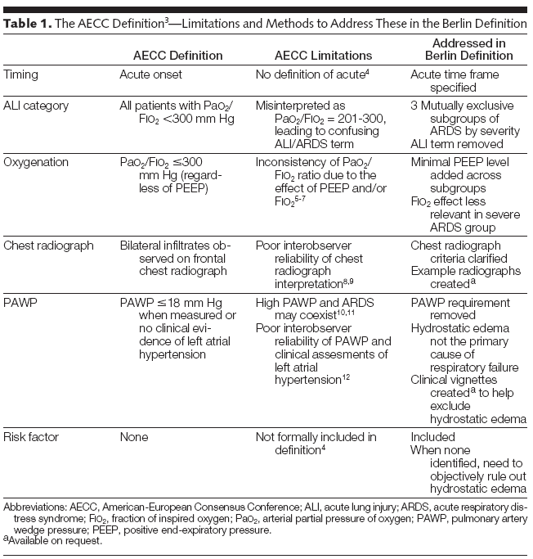
JAMA, Published online May 21, 2012

Slide 11
OXYGENATION
PaO2/FiO2 is not constant across a range of FiO2 and may vary in response to ventilator settings, particularly PEEP

Slide 12
CHEST RADIOGRAPH
Inter-observer reliability is only moderate even when applied by experts
  Rubenfeld 1999 , meade 2000

Slide 13
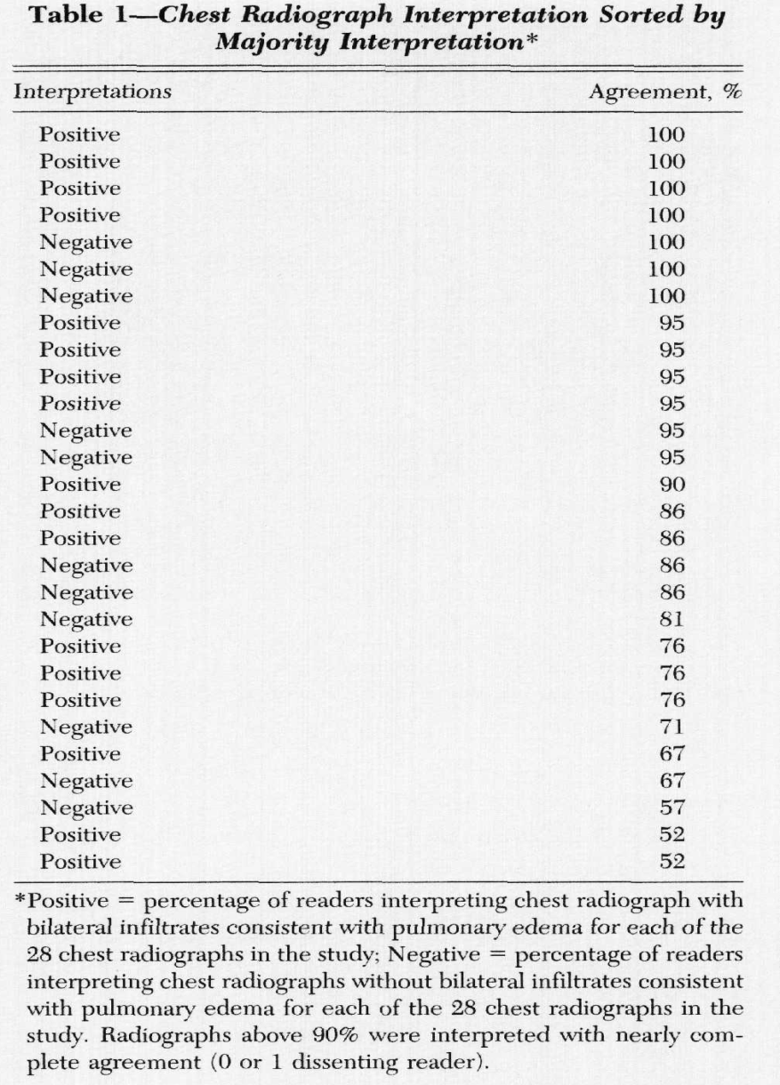
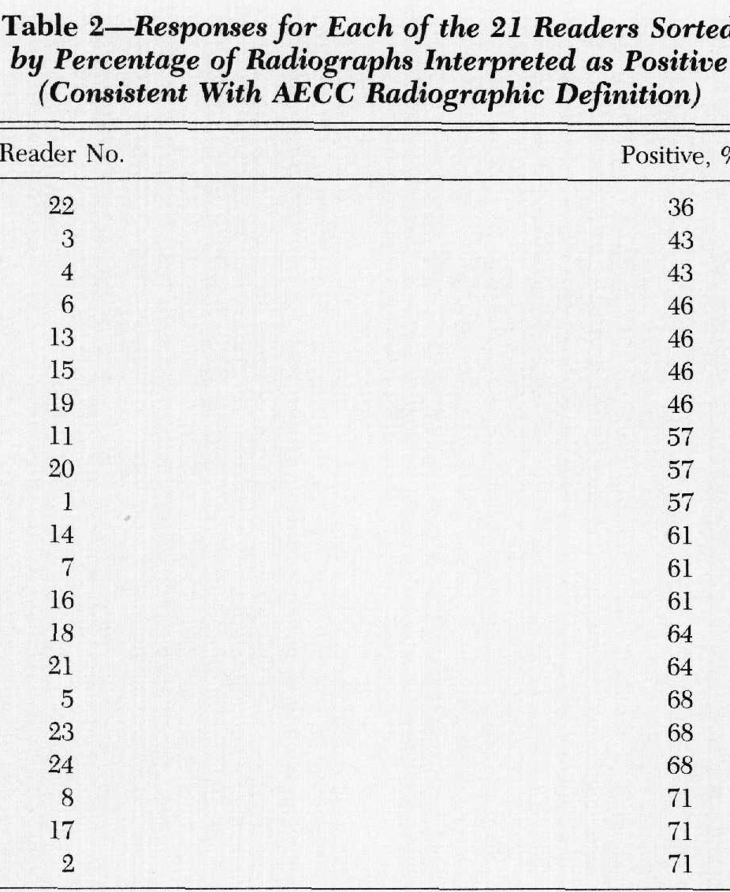
  Rubenfeld et al. interobserver variability in applying a radiographic definition for ARDS.CHEST 1999

Slide 14
WEDGE PRESSURE
Patients with ARDS may have an elevated PAWP(when measured); often because of transmitted airway pressures and/or vigorous fluid resuscitatioin
          Ferguson et al. high values of the pulmonary artery wedge pressure in patients with acute lung injury and acute respiratory distress syndrome. 2002

Slide 15
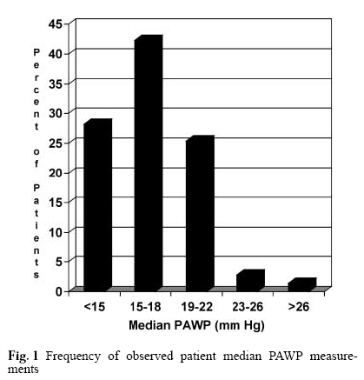
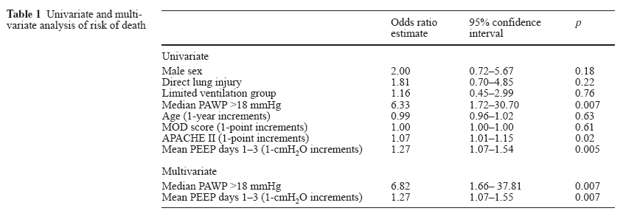
Ferguson et al. high values of the pulmonary artery wedge pressure in patients with acute lung injury and acute respiratory distress syndrome. 2002

Slide 16
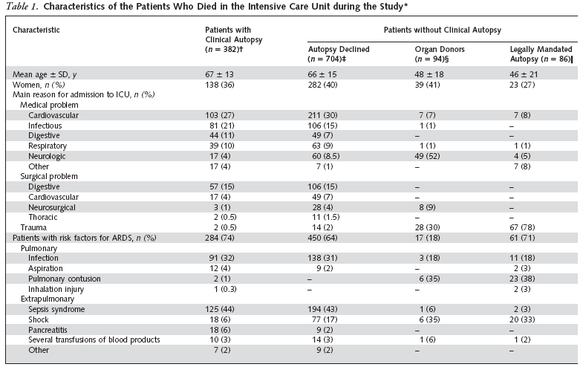
SENSITIVITY and SPECIFICITY
When AECC criteria are compared with diffuse alveolar damage:
  Esteban et al. comparison of clinical criteria for the acute respiratory distress syndrome with autopsy findings. Ann Intern Med 2004;141:440-5

Slide 17
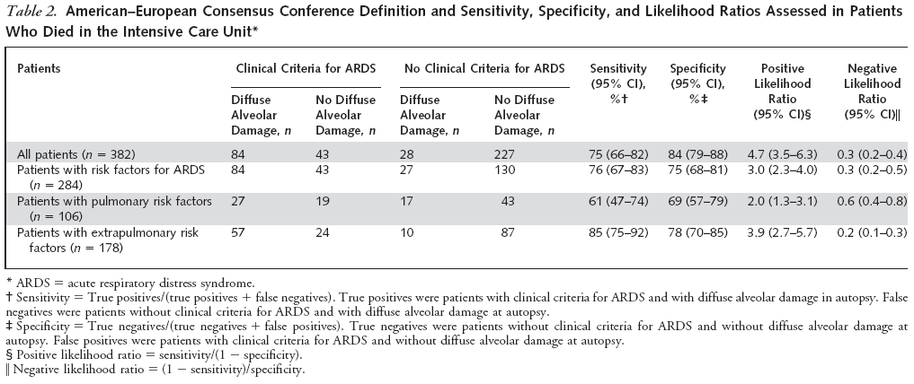
SENSITIVITY and SPECIFICITY
  Esteban et al. comparison of clinical criteria for the acute respiratory distress syndrome with autopsy findings. Ann Intern Med 2004;141:440-5

Slide 18
PERCEPTION OF ALI
AS NOT SEVERE AS ARDS
ARDS is under recognized by clinicians as defined using the AECC criteria. Especially, PaO2/FiO2<300 mmHg
  Ferguson et al. airway pressures, tidal volumes, and mortality in patients with acute respiratory distress syndrome Crit care med 2005
  Kalhan et al. Underuse of lung protective ventilation: analysis of potential factors to explain physician behavior 2006
  Rubenfeld et al. barriers to providing lung protective ventilation to patients with acute lung injury 2004

Slide 19
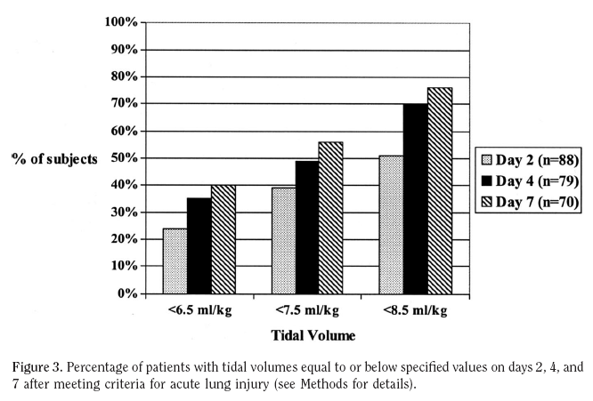
  Kalhan et al. Underuse of lung protective ventilation: analysis of potential factors to explain physician behavior 2006

Slide 20
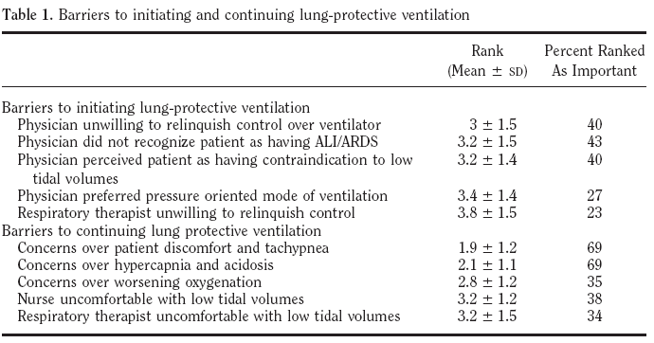
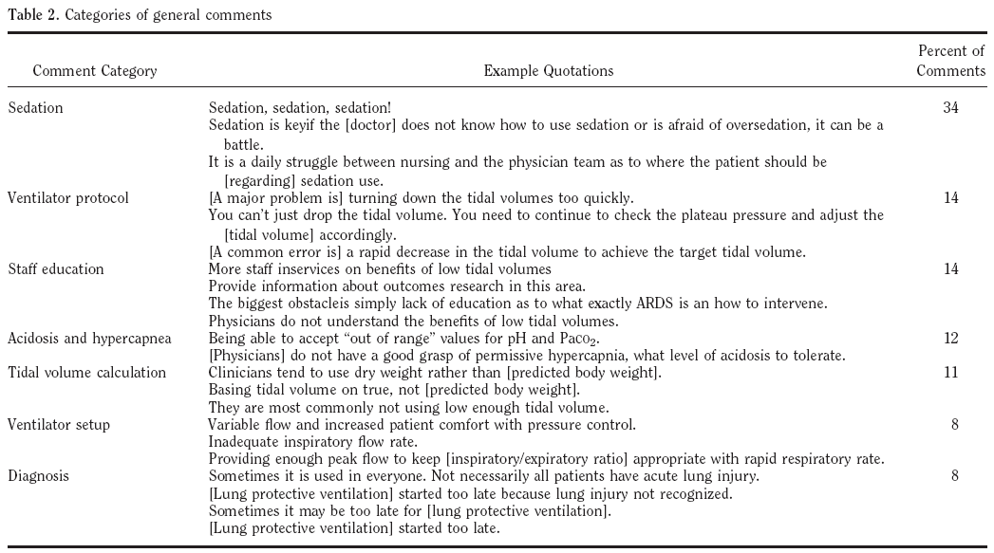
  Rubenfeld et al. barriers to providing lung protective ventilation to patients with acute lung injury 2004

Slide 21
Empirical Evaluation of
Draft Definition
Cohort assembly
Variables
Analytic Framework and Statistical methods

Slide 22
COHORT ASSEMBLY
Studies
  Large multicenter prospective cohorts consecutive patients or randomized trials or
  Smaller single-center prospective studies with unique radiological or physiological data that enrolled adult patients with ALI as defined by AECC
  2) Collected granular data necessary to apply the individual criteria of both the draft Berlin Definition and the AECC definition
  3) Authors of these original studies were willing to share data and collaborate
  7 distinct data sets
  (4 multicenter clinical studies for the clinical database, 3 single center physiological studies for the physiological database)

Slide 23
VARIABLES
Mortality
  Hospital mortality or 90 day mortality
Duration of mechanical ventilation
  Ventilator free days at 28days after the diagnosis of ALI
Indirect marker of severity of lung injury
  Duration of mechanical ventilation in survivors
Progression of severity of ARDS within 7 days

Slide 24
VARIABLES
Chest radiograph
  More extensive involvement : 3-4 quadrants
  vs Minimal involvement: 2 quadrants(bilateral opacities)
Static compliance of the respiratory system(CRS)
  Tidal volume/Pplat(cmH2O) - PEEP(cmH2O)
Corrected expired volume per minute(VECORR)
  Minute ventilation x arterial partial pressure of carbon dioxide(PaCO2) /40mmHg
Total lung weight
  Quantitative CT images
Shunt

Slide 25
Analytic Framework and Statistical Methods
Determine the distribution of patient characteristics across the defined severity categories
Evaluate the value of proposed ancillary variables in defining ARDS subgroup in the draft definition
  More severe radiographic criterion
  Higher PEEP levels
  Static respiratory compliance
  VECORR
Determine the predictive validity for mortality of the final Berlin Definition
Compare the final Berlin definition to the AECC definition

Slide 26
<RESULTS>
DRAFT CONSEUNSUS DEFINITION
The ARDS conceptual model
  Acute, diffuse and inflammatory lung injury
  Increased pulmonary vascular permeability
  Increased lung weight
  Loss of aerated lung tissue
Clinical hallmarks
  Hypoxemia
  Bilateral radiographic opacities with increased venous admixture
  Increased physiologic dead space
  Decreased lung compliance
Morpholocial hallmarks
  Diffuse alveolar damage(edema, inflammation, hyaline membrane, hemorrhage)

Slide 27
DRAFT DEFINITION CRITERIA
Mild, Moderate, Severe
Ancillary variables
  Timing
  Chest imaging
  Origin of edema
  Oxygenation
  Additional physiologic measurements

Slide 28
ANCILLARY VARIABLES
TIMING
Indentified within 72hours of recognition of the underlying risk factor
Identified with ARDS within 7days
  known clinical insult
  New or worsening respiratory symptoms

Slide 29
ANCILLARY VARIABLES
CHEST IMAGING
Retained bilateral opacities consistent with pulmonary edema on chest radiograph
→ could be demonstrated explicitly on CT scan instead of radiograph
Severe ARDS:
  more extensive opacities(3 or 4 quadrants on chest radiograph)

Slide 30
ANCILLARY VARIABLES
ORIGIN OF EDEMA
Removed pulmonary artery wedge pressure criteria
Not fully explained by cardiac failure or fluid overload as judged by the treating physician using all available data
No ARDS risk factor, some objective evaluation (echocardiography) is required to help eliminate the possibility of hydrostatic edema
ARDS risk factor
Direct | Indirect
Pneumonia Aspiration of gastric contents Inhalation injury Pulmonary contusion Near drowning | Nonpulmonary sepsis Major trauma Multiple transfusions Severe burns Pancreatitis Noncardiogenic shock Drug overdose

Slide 31
ANCILLARY VARIABLES
OXYGENATION
ALI term removed
  Because, misuse of this term & PEEP
Mild ARDS: PEEP minimum 5cmH2O
Severe ARDS: PEEP minimum 10cmH2O

Slide 32
ANCILLARY VARIABLES
ADDITIONAL PHYSIOLOGIC MEASUREMENTS
Increased deadspace
  Minute ventilation standardized at a PaCO2 of 40mmHg
Severe ARDS
  Low respiratory system compliance(<40ml/cmH2O)
  High VECORR(>10L/min)
CT scanning, inflammatory markers, genetic markers
  Lack of routine availability , safety, sensitivity, specificity

Slide 33
DRAFT DEFINITION
 | Mild | Moderate | Severe
Timing | Acute onset within 1 week of a known clinical insult or new/worsening respiratory symptoms
Hypoxemia | PaO2/FiO2 201-300 with PEEP/CPAP≥5 | PaO2/FiO2≤200 with PEEP≥5 | PaO2/FiO2≤100 with PEEP≥10
Origin of edema | Respiratory failure not fully explained by cardiac failure or fluid overload
Radiological abnormalities | Bilateral opacities | Bilateral opacities | Opacities involving at least 3 quadrants
Additional physiological derangement | N/A | N/A | VECORR>10 L/min Or CRS<40 ml/cmH2O

Slide 34
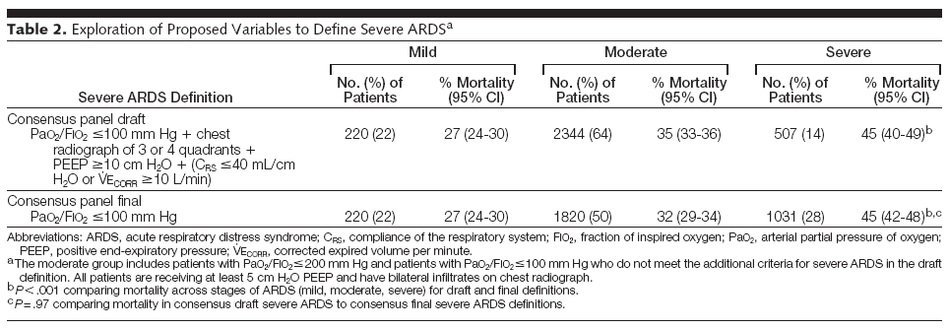
In a post hoc analysis, [ Mortality ]
Higher subgroup, PaO2/FiO2≤100mmHg & CRS ≤20ml/cmH2O or VECORR≥13L/min
52% in higher-risk subgroup among severe ARDS(15% of all ARDS) vs. 37% in not higher-risk subgroup(13% of all ARDS)

Slide 35
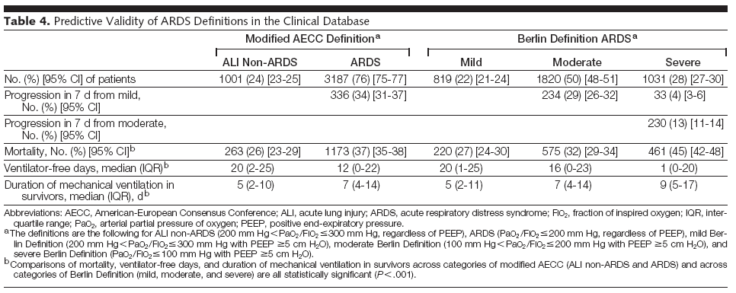
Empirical Evaluation of the Draft Definition

Slide 36
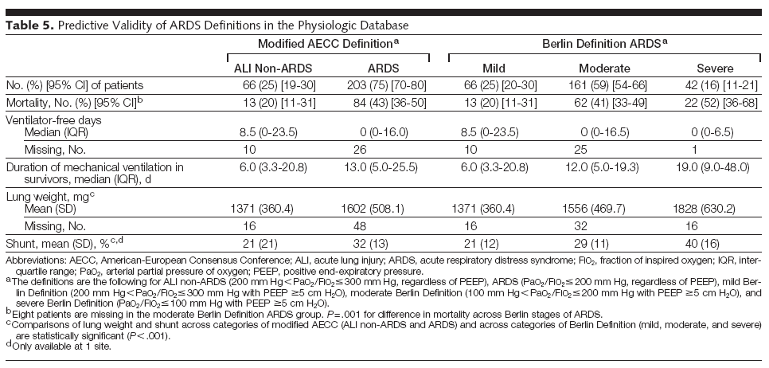
Empirical Evaluation of the Draft Definition

Slide 37
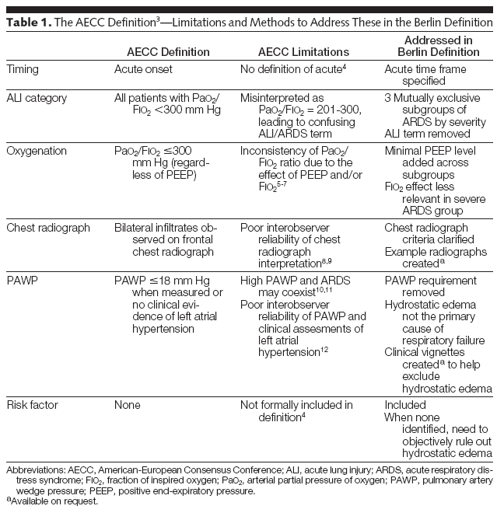
THE BERLIN DEFINITION

Slide 38
LIMITATION
Small statistical difference between the two definitions; clinically
unimportant tool as a clinical prediction tool
Results are not generalizable because of the data sets that studied
  Populations including clinical trials, academic centers, community patients
Some variables were missing in some patients in the data
  CRS, PEEP

Slide 39
LIMITATION
Ancillary variables
  the number of quadrants on the chest radiograph: not reliable
  PEEP was not used in a predictable fashion,
  CRS and VECORR were not accurately measure
Only the variables and cutoffs proposed by the consensus panel
were used in this study

Slide 40
CONCLUSION
Draft definition for ARDS with an international panel using framework focused on feasibility, reliability, and validity
Empirical evaluatioin of clinical outcome, radiographic findings and physiological measures
→ linking consensus definition activities with empirical research to better inform clinical care, research, and health sevices planning

Slide 41
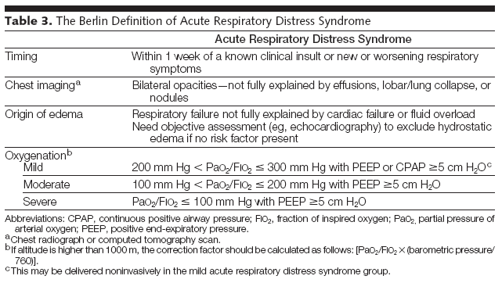
NEW DEFINITION OF ARDS

Slide 42
INDIVIDUALIZED MANAGEMENT of ARDS
Mild(200-300) |  | Moderate(100-200) |  | Severe(<100)
Low tidal volume
NIV
Low-moderate PEEP
 |  | Higher PEEP
 |  |  |  | Prone Positioning
 |  |  |  | Neuromuscular blocker
 |  |  |  | iNO
 |  |  |  | HFO
 |  |  | ECCO2-R
 |  |  |  |  | ECMO

Slide 43
INDIVIDUALIZED MANAGEMENT of ARDS
Values of physiological parameters that can be associated with different severity of ARDS
 | Mild | Moderate | Severe
P plat | 11-25 |  | 25-40 | >40
VE(CORR) | 5-7 | 7-9 | 10-19 | >19
Dynamic compliance |  | 60-40 | 40-20 | <20
EVLWI | <7 | 7-14 | 15-20 | >20

